Slide 1
2013 Evolution Team:
Ned Dochtermann
Erin Gillam
Tim Greives
Steve Travers
(North Dakota State Univ.)
Kris Holder
Jen Weghorst
(Univ. of Kansas)
Facilitators:
Catherine Kirkpatrick (Univ. of Minnesota)
Steven Ralph (Univ. of North Dakota)

Slide 2
Understanding the mechanisms of evolution: genetic drift
Context: sophomore-level evolution course for biological science majors
Previous unit: mutation and natural selection
Goal: understand the evolutionary mechanism of random genetic drift
Notes:
Context: this unit fits within a larger unit focused on evolutionary mechanisms; students will have already learned

Slide 3
Learning outcomes
Students will be able to:
recognize an example of random genetic drift
explain how drift differs from natural selection
use drift to explain why it is incorrect to state that evolution leads to perfection
explain how population size influences the relative ability of drift to affect allele frequencies
graph data and formulate hypotheses to explain their observations
understand that multiple biological scenarios can result in drift (e.g. bottleneck, founder effect)
use a simulation program to evaluate the mechanisms of natural selection, mutation, and drift

Slide 4
Learning outcomes for the tidbit
Students will be able to:
recognize an example of random genetic drift
explain how drift differs from natural selection
use drift to explain why it is incorrect to state that evolution leads to perfection
explain how population size influences the relative ability of drift to affect allele frequencies
graph data and formulate hypotheses to explain their observations
understand that multiple biological scenarios can result in drift (e.g. bottleneck, founder effect)
use a simulation program to evaluate the mechanisms of natural selection, mutation, and drift

Slide 5
Pre-tidbit assessment
Pre-tidbit assessment: clicker questions on natural selection (from previous unit)

Slide 6
Sample clicker questions
Which one of the following is an example of a situation where natural selection could be acting?
Which of the following is a situation that is NOT likely to be affected by genetic drift?
Omitted from original presentation

Slide 7
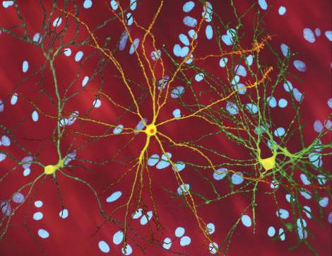
Huntington’s Disease
http://en.wikipedia.org/wiki/File:Neuron_with_mHtt_inclusion.jpg

Slide 8
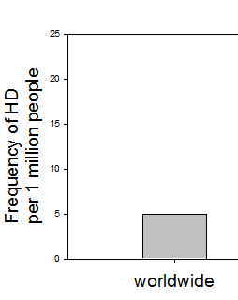
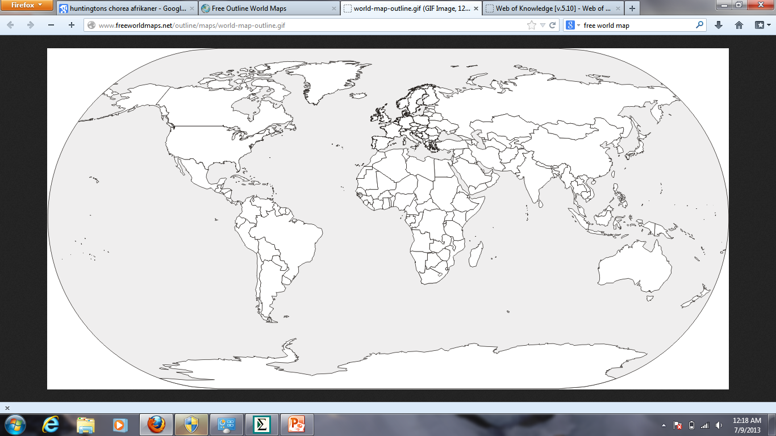
Frequency of Huntington’s Disease
Magazi et al. 2008. South African Medical Journal
Greeff, JM. 2007. Annals of Human Genetics
Hayden et al. 1980. South African Medical Journal
http://www.freeworldmaps.net/outline/maps/world-map-outline.gif

Slide 9
http://www.freeworldmaps.net/outline/maps/world-map-outline.gif

Slide 10
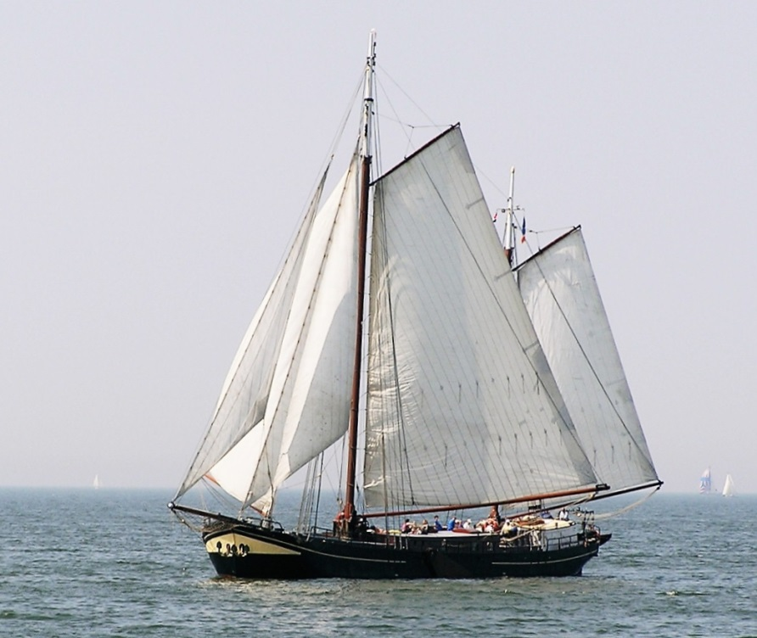
http://www.freeworldmaps.net/outline/maps/world-map-outline.gif
‪https://commons.wikimedia.org/wiki/File:IJsselmeerTraditionalBoat.JPG

Slide 11
Frequency of Huntington’s Disease
Magazi et al. 2008. South African Medical Journal
Greeff, JM. 2007. Annals of Human Genetics
Hayden et al. 1980. South African Medical Journal
http://www.freeworldmaps.net/outline/maps/world-map-outline.gif

Slide 12
Skip
Huntington’s disease discussion
Form hypotheses
Discuss hypotheses

Slide 13
Experimental study system
Simple model organisms
Controlled environments

Slide 14
The elusive POISONOUS M&M
Haploid
Two color phenotypes of M&M’s
Reproduces asexually by fission
http://www.mms.com/#character

Slide 15
M&M fission
http://www.mms.com/#character

Slide 16
M&M fission
http://www.mms.com/#character

Slide 17
Please read through the activity instruction sheet silently.
http://www.mms.com/#character

Slide 18
Questions?
http://www.mms.com/#character

Slide 19
Please proceed through steps 1-4
http://www.mms.com/#character

Slide 20
Please complete activity
http://www.mms.com/#character

Slide 21
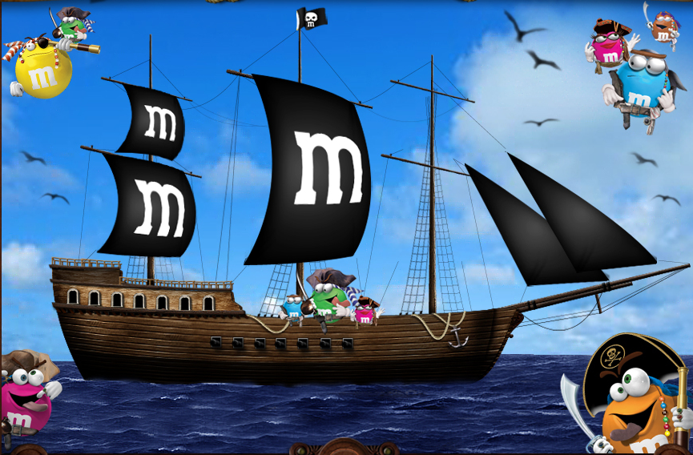
http://www.mms.com/#character

Slide 22
Frequency of Huntington’s Disease
Magazi et al. 2008. South African Medical Journal
Greeff, JM. 2007. Annals of Human Genetics
Hayden et al. 1980. South African Medical Journal
http://www.freeworldmaps.net/outline/maps/world-map-outline.gif

Slide 23
Frequency of Huntington’s Disease
Magazi et al. 2008. South African Medical Journal
Greeff, JM. 2007. Annals of Human Genetics
Hayden et al. 1980. South African Medical Journal
http://www.freeworldmaps.net/outline/maps/world-map-outline.gif

Slide 24
Learning outcomes
Students will be able to:
recognize an example of random genetic drift
explain how drift differs from natural selection
use drift to explain why it is incorrect to state that evolution leads to perfection
explain how population size influences the relative ability of drift to affect allele frequencies
graph data and formulate hypotheses to explain their observations
understand that multiple biological scenarios can result in drift (e.g. bottleneck, founder effect)
use a simulation program to evaluate the mechanisms of natural selection, mutation, and drift

Slide 25
Learning outcomes
Students will be able to:
recognize an example of random genetic drift
explain how drift differs from natural selection
use drift to explain why it is incorrect to state that evolution leads to perfection
explain how population size influences the relative ability of drift to affect allele frequencies
graph data and formulate hypotheses to explain their observations
understand that multiple biological scenarios can result in drift (e.g. bottleneck, founder effect)
use a simulation program to evaluate the mechanisms of natural selection, mutation, and drift

Slide 26
Post-tidbit

Slide 27
Learning outcomes
Students will be able to:
recognize an example of random genetic drift
explain how drift differs from natural selection
use drift to explain why it is incorrect to state that evolution leads to perfection
explain how population size influences the relative ability of drift to affect allele frequencies
graph data and formulate hypotheses to explain their observations
understand that multiple biological scenarios can result in drift (e.g. bottleneck, founder effect)
use a simulation program to evaluate the mechanisms of natural selection, mutation, and drift

Slide 28
Activities and assessments for these outcomes
Simulation homework
Introduced after tidbit
Discussed in next class
another formative assessment
Summative assessment
Conservation case study
Discussed in next class
Covers bottlenecks
Formative assessment

Slide 29
Simulation
PopG (alternative programs available)
Allows alteration of numerous parameters
Population size (drift)
Fitness
Migration, mutation

Slide 30
PopG v.3.3

Slide 31
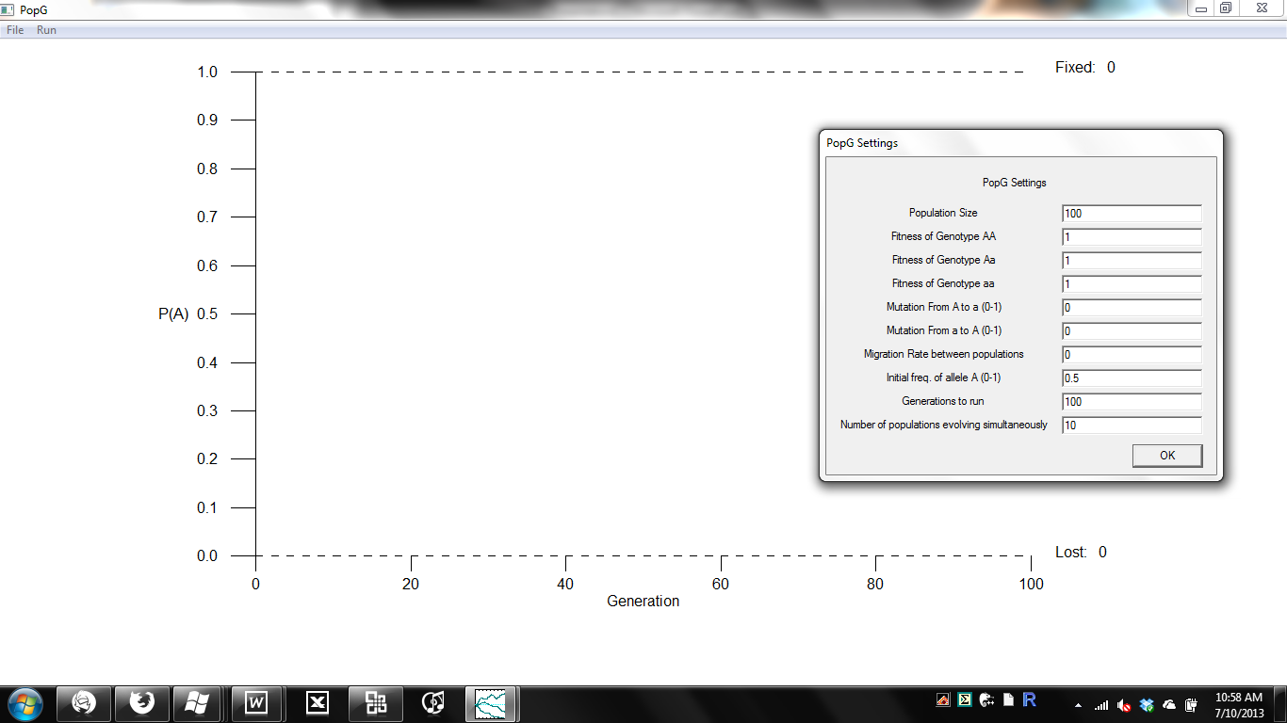
PopG v.3.3

Slide 32
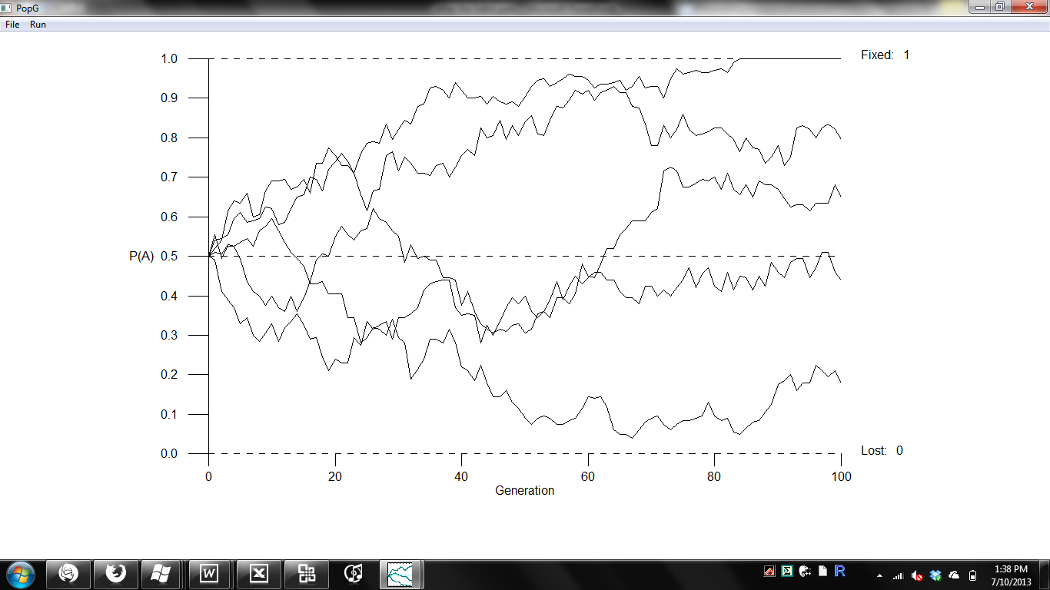
PopG v.3.3

Slide 33
Example homework questions
How would you predict allele frequencies might fluctuate as population sizes are decreased? And when increased?
Introduce selection into your simulations. What should happen if the AA genotype has a fitness of 0.9, and Aa and aa fitnesses of 1? Set these fitnesses and set population sizes to 25. Were your predictions supported?

Slide 34
Activities and assessments for these outcomes
Simulation homework
Introduced after tidbit
Discussed in next class
another formative assessment
Summative assessment
Conservation case study
Discussed in next class
Covers bottlenecks
Formative assessment

Slide 35
Assessments & Related Activities
Simulation homework
Introduced after tidbit
Discussed in next class
another formative assessment
Summative assessment
Conservation case study
Discussed in next class
Covers bottlenecks
Formative assessment

Slide 36
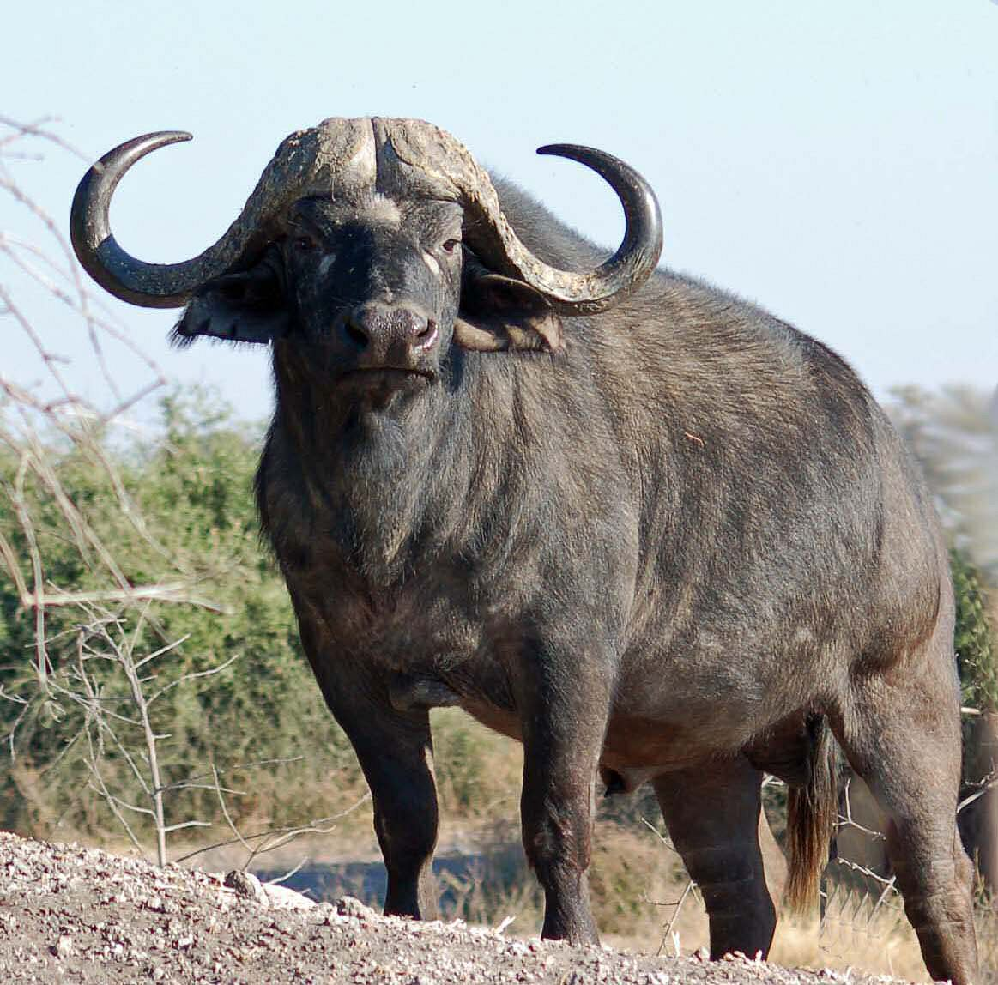
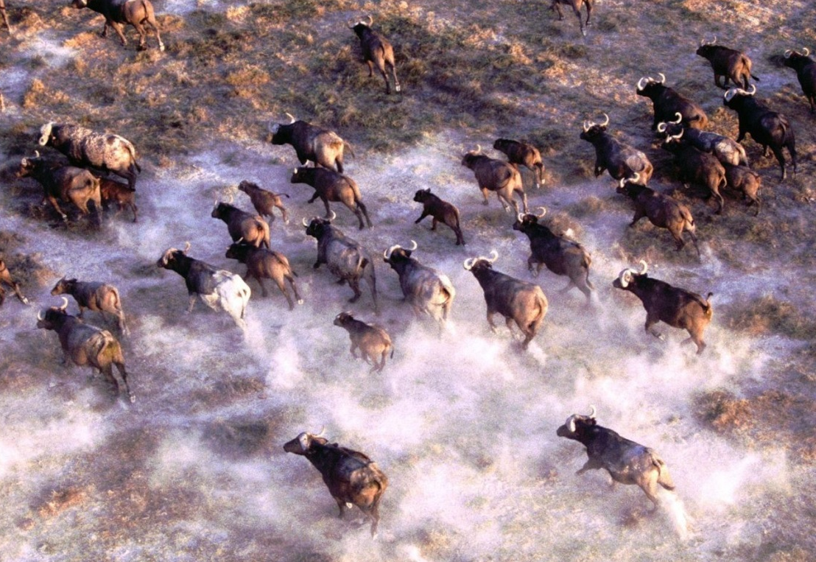
Conservation case study
http://www.hsd3.org/HighSchool/Teachers/MATTIXS/Mattix%20homepage/studentwork/Kyle%20Kohn%20web%20page/Cape%20buffalo.htm
http://www.sharewallpapers.org/d/3444-1/Stampede---African-Cape-Buffalo-Herd-1.jpeg

Slide 37
Conservation case study
Cape buffalo (Syncerus caffer caffer)
Historically widespread and panmictic
Currently confined to protected areas
Isolation of populations
How might this affect genetic diversity?

Slide 38
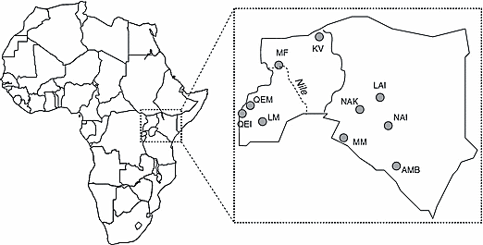
Heller et al. 2010. Molecular Ecology. 19:1324-1334

Slide 39
Discuss in groups
Propose hypotheses

Slide 40
Heller et al. 2010. Molecular Ecology

Slide 41
Instructor notes
Background information
Possible activities
Reserves are of different sizes (area)
Reserves support different size populations
Researchers quantified allelic diversity (amongst other things)
Go back to group discussions. Formulate hypotheses. Draw a figure with your expectations
Group discussions formulating hypotheses
Have groups draw hypothetical results
Have class discuss drawings of multiple groups
After data is presented, have students discuss what they would expect if selection were at play (e.g. bovine tuberculosis is a big problem for many wild ungulates)

