Slide 1
Biochemistry Teachable Unit
Junior/senior course in Biology or Biochemistry. Teachable Unit for 2 class periods.
Background knowledge: general biology and general chemistry.
Prior knowledge: fundamental protein structure from amino acids through quaternary structure.

Slide 2
Learning Goals
Understand:
1. The relationship between protein structure and function
How binding interactions can change protein structure, which may modify function
How environmental changes can change protein structure, which may modify function
How mutation can change protein structure, which may modify function

Slide 3
Desired Outcomes
Students should be able to:
Predict magnitude of effect of specific amino acid changes on protein function (BT = 6)
Predict how changes in cellular environment e.g. temperature, pH, binding interactions affect structure and function (BT = 6)
Collaborate with other students to solve problems
Analyze data about protein structure and function (BT = 5)
Modify protein sequence / structure for specific function/enhancement (BT = 6)

Slide 4
Protein Function Follows Form: Small Changes may Cause Big Effects
Team: Biochemistry
Moriah Beck (moriah.beck@wichita.edu)
Masih Shokrani (mshokrani@niu.edu)
Karen Koster (karen.koster@usd.edu)
William Soto(wsoto@umn.edu)
David McDonald(david.mcdonald@wichita.edu
David Swanson (david.swanson@usd.edu)
Facilitators:
Bernd Fritzsch (Bernd.Fritzsch@iowa.edu)
Michelle Withers (Michelle.Withers@mail.uwv.edu)

Slide 5
A Quick Review of Protein Structure
http://www.youtube.com/watch?v=iaHHgEoa2c8

Slide 6
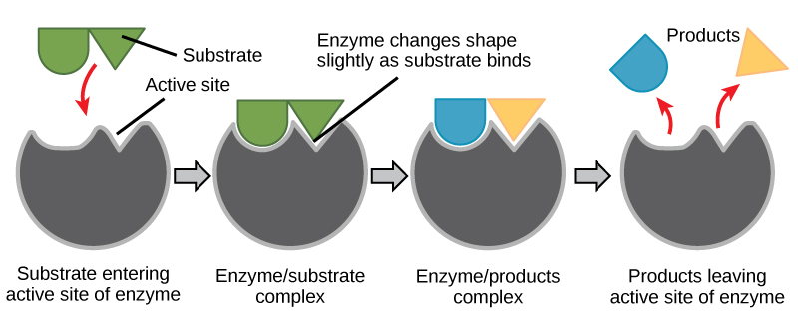
Some Proteins are Enzymes
http://cnx.org/content/m44429/latest/
Notes:
Enzyact 5

Slide 7
Enzyme Regulation
Allosteric regulation occurs when a regulatory molecule binds somewhere other than the active site.
Images courtesy of M. Withers

Slide 8
Which line represents the enzyme’s reaction rate when an allosteric regulator is added?
A.
B.
C. Not enough information is given.
Control rate (blue)
A (green)
B (red)
Graph adapted from one shown at: http://droualb.faculty.mjc.edu/Course%20Materials/Physiology%20101/Chapter%20Notes/Fall%202011/chapter_3%20Fall%202011.htm

Slide 9
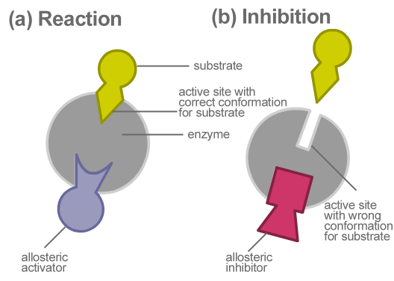
Allosteric regulation of enzymes
http://www.kmle.co.kr/search.php?Search=allosteric%20inhibition/

Slide 10
Primary Research Paper Assigned for Summative Assessment
Ikeda et al. (1997) Conversion of Non-allosteric Pyruvate Kinase Isozyme into an Allosteric Enzyme by a Single Amino Acid Substitution. J. Biol. Chem. 272: 20495-20501.
Students will work in groups outside class, read paper, do jigsaw activity to discuss paper, and write answers to questions as a group.

Slide 11
Questions from Research Paper for Summative Assessment:
Questions:
What technique do the investigators use to demonstrate that the new enzyme is allosterically regulated?
How does Arginine substitution affect the pyruvate kinase M1 activity? Predict what would happen if the substitution were Lysine instead of Arginine?

Slide 12
What’s protein got to do with it?

Slide 13
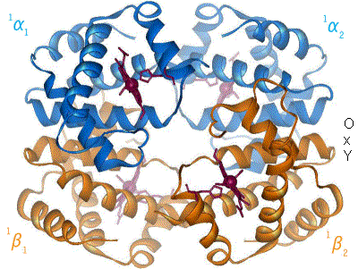
Case Study: Hemoglobin – an O₂ binding protein
http://en.wikipedia.org/wiki/Hemoglobin

Slide 14
Hemoglobin-O₂ binding curve
http://sunburst.usd.edu/~dlswanso/ecophys/index.html

Slide 15
Question 1: The data in the plot show the S-shaped (sigmoid) relationship between oxygen binding to hemoglobin and oxygen availability (pO₂). The sigmoid oxygen binding curves allow …
high oxygen binding at low pO₂
effective oxygen loading at the tissues and unloading at the lung
effective oxygen loading at the lungs and unloading at the tissues
insensitivity to oxygen availability

Slide 16
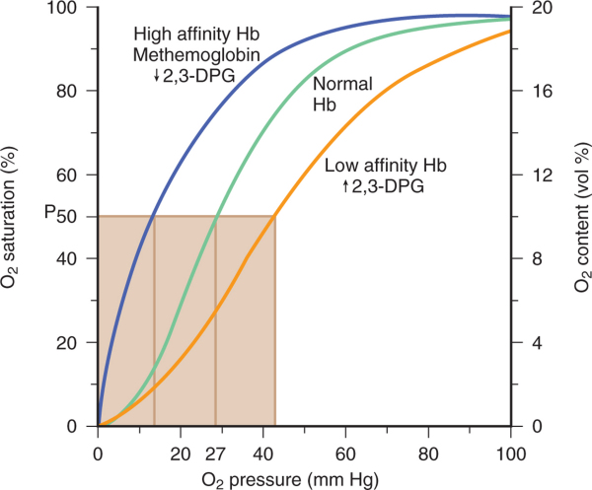
Effectors of Oxygen Binding Affinity
↑ pH
↓ Temperature
↓ 2,3 DPG
↓ pH
↑ Temperature
↑ 2,3 DPG
www.cixip.com

Slide 17
Questions 2&3: The plot shows the impact of allosteric modifiers, which bind to hemoglobin at site other than the oxygen binding site, on the affinity of hemoglobin for oxygen
True or False – Changes in hemoglobin structure can affect oxygen binding to heme.
Which of the following would favor oxygen binding at the lungs
↑DPG, b) ↓ pH, c) ↑ temperature,
d) ↓ temperature

Slide 18
Group Activity: Amino Acid Sorting
Students will work in groups with notecards that each have an amino acid structure, with its name and abbreviation(s).
Students will sort the amino acids according to the chemical properties (polarity, size, charge) of their side chains.
This formative assessment will assure that students understand these properties before the next activities.

Slide 19
Tidbit: Mutation Analysis and Function Prediction
Handouts listing a known human mutation are given. (Three different mutations will be used, each one to a different group.)
Students are asked to predict functional outcomes that may result from the mutations.
Second set of handouts then will be given showing the actual data for that mutation. If the students’ hypotheses were not supported, they should make a second hypothesis.
A final handout explains the details of the structural change and how it affects the hemoglobin function. Citations to primary sources are included.

Slide 20
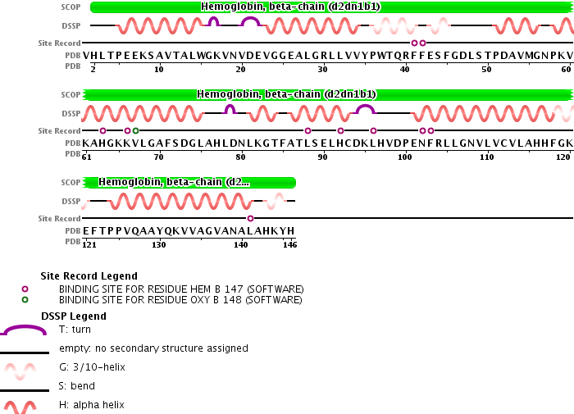
Hemoglobin beta chain structure
http://www.rcsb.org/pdb/explore/remediatedSequence.do?structureId=2DN3

Slide 21
Tidbit: Mutation Analysis and Function Prediction
Discussion of the mutations and their effects is a formative assessment for this tidbit.

Slide 22
Summative Assessment
Students will write a 150 word essay on the following pictorial question.

Slide 23
What’s protein got to do with it?

Slide 24
Summary
Intro: Reminder of Protein Structure
Tidbit 1: Enzyme Regulation by Allosteric Regulators
Formative: Clicker questions
Summative: Literature reading and essay
Tidbit 2: Hemoglobin Structure, Function and Regulation
Formative: Group discussion questions, group activities
Summative: Group activity, 150-word essay

