Slide 1
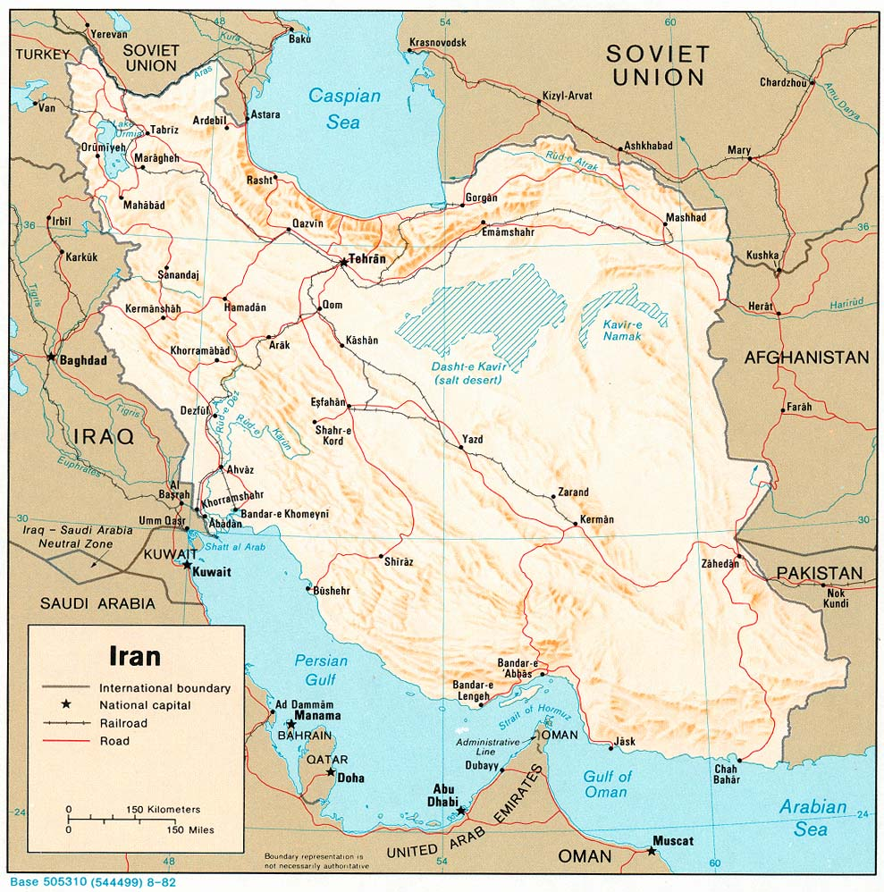
Oперация “защитный щит – OP PROTECTIVE SHIELD
IRANIAN SYMPATHIZERSHAVE CUT OFF ROAD/RAIL
MASHAD UNDER CONTROL OF SOVIET FORCES AND LOCAL COMMUNIST PARTY
AXIS OF ADVANCE TO ROADS TO OIL AREAS SEIZED
US WILL EXPECT AN AIR DROP; WE DO NOT HAVE ENOUGH TROOPERS

Slide 2
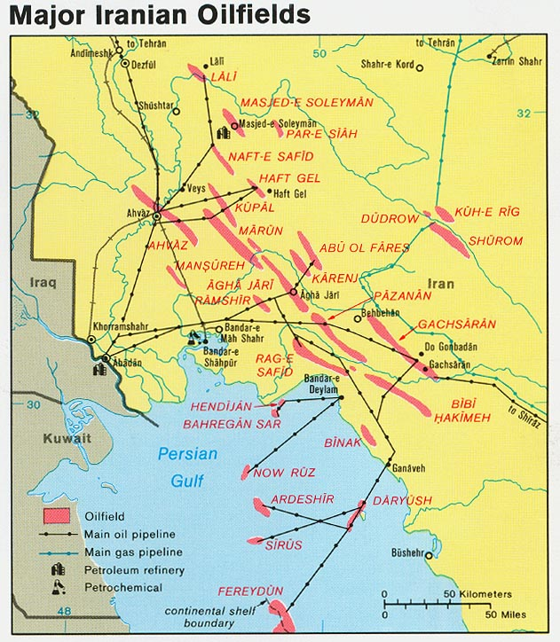
OUR OBJECTIVE: CONTROL OF THE GULF
MOD ESTIMATE:
FROM ZERO-DAY TO COMPLETE CONTROL OF IRANIAN FIELDS:
8 DAYS MAXIMUM

Slide 3
IF USA INTERVENES
WE DO DO NOT DISPUTE OUR KGB COLLEAGUES ASSESSMENT THAT US WILL NOT REACT WITH FORCE BUT WE CANNOT EXCLUDE THIS POSSIBILITY
WE CANNOT challenge airborne and USMC forces; we must therefore stop them from arriving
Our paratroopers will seize rail and road access toward the oil fields. This will deter US from using paratroops
Soviet Navy cruisers on scene should “interfere” with US Navy operations but NOT attack them
If US Navy or Air Force air assets are used, we must retaliate FORCEFULLY
TIME IS THE KEY

Slide 4
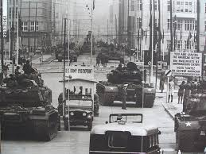
OPTION IN CASE OF US RESISTANCE: BERLIN
US WILL NOT GO TO WAR IF BERLIN IS THREATENED
NATO WILL CRUMBLE IN FACE OF CONFLICT
EUROPEANS WILL NOT DIE FOR OIL
KGB ASSURANCES OF PEACE MOVEMENT ARE HELPFUL BUT CANNOT BE COUNTED ON TO REPLACE SPEEDY ACTION

