Slide 1
Intro to PS Research Methods
Topic 9: Multiple Regression

Slide 2
Announcements
Final on May 13, 2 pm
Homework in on Friday (or before)
Final homework out Wednesday 21 (probably)

Slide 3
Overview
we often have theories involving more than one X
multiple regression and controlled comparison, partial coefficients
we can include nominal Xs
“dummy” variables, and easy to interpret
we want to compare “models” – which is best?
R² and adjusted-R²
sometimes effect of one X depends on the value of another X
interaction effects, multiplicative terms
be sure that whole model is jointly worth reporting
F-test

Slide 4
Multiple Regression
Remember, we are thinking of…
Y=α+βX
…and we want to estimate the value of
a, the intercept and
b, the coefficient.
bivariate (two variables) regression is a good choice when we have one independent variable (and one Y).
want to
explain this…
using this!
not multivariate regression

Slide 5
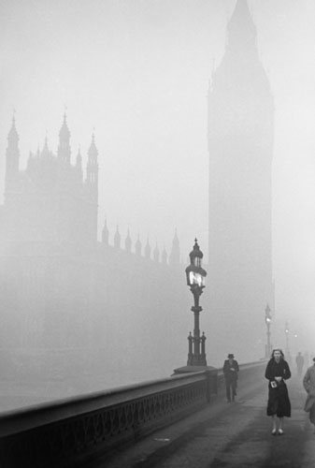
But the problem is…
…it’s very rare that our theory involves just one explanatory variable!
why am I 5’9’’?
genetics? diet? environment? sex?
what determines salary?
gender? type of work? education? location?
why did you vote for that candidate?
stance on guns? on abortion? your ethnic group?
kind eyes?

Slide 6
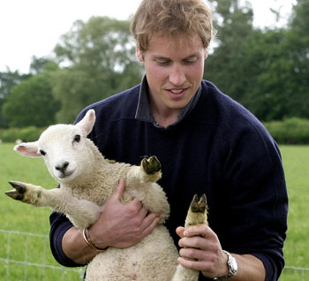
So what do we want?
Multiple predictors…
…multiple independent variables
…multiple Xs
to make controlled comparisons
…huh?

Slide 7
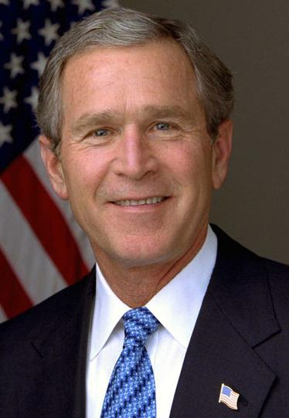
Controlled comparisons
Suppose we are trying to predict how people feel about President Bush (Y).
We think it depends on…
religiosity → X₁
“is Bible word of God or man?”
(level of measurement?)
age → X₂
in years (level of measurement?)
education → X₃
less than or more than high school? (level of measurement?)

Slide 8
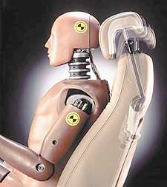
Dummy variables
Take another look at education. It takes one of two values
you have HS or less
you have more than HS
SPSS codes as 0 or 1 and we call it a “dummy variable”.
These are very useful, and very easy to interpret in a regression…
0
1

Slide 9
For example…
Suppose I want to know if sex is a good predictor of how much people like environmentalists:
alpha-hat
Remember:
a (Constant) tells us what people feel about Environmentalists when sex=0…
…what does that mean?
predicted Y= a+ bX
beta-hat

Slide 10
Well…
“base” category
SPSS codes woman as zero, and men as one.
When sex=0, we are talking about…
…women.
So, for women (on average),
Yhat= a+ bX
now, from the table…
Yhat=95.96-20.34(0)
=95.96
constant
regression
coefficient
predicted Y
a number times
zero is zero
ok, what about men?
environmentalist?

Slide 11
Men…
for men (on average),
predicted Y= a+ bX
=95.96-20.34(1)
=75.62
Life is a little more complicated when we have multiple categories (though the logic is the same)…
…we will stick to the simple case for this class

Slide 12
Back to Bush: could we…
estimate Y= a+ b₁X₁
…the “effect” of religion
then,
estimate Y= a+ b₂X₂
…the “effect” of age
then,
estimate Y= a+ b₃X₃
…the “effect” of education
?

Slide 13
Sure, but…
what if the independent variables themselves are related to one another?
are older people or younger people more likely to be religious?
are more educated people more or less religious?
So, when we look at the regression of Bush’s popularity on religiosity only, what might happen?
…we are implicitly comparing older to younger people
…and less educated to more educated
And that means we are assigning “too much” explanatory power to a variable (in this case religiosity)!

Slide 14
Controlled Comparisons
Controlled comparisons are what we want.
Remember, “controlling for X” means…
“taking X into account”
“holding X constant”
Multiple regression lets us do this very simply…
…we can get the partial effect of a variable

Slide 15
So…
Our regression equation becomes…
Y= a+ b₁X₁ + b₂X₂ + b₃X₃+e
error term
(what we
can’t explain)
“right hand side”
“left hand side”
coefficient of education,
controlling for religion and age
intercept term
coefficient of religion,
controlling for age and
education
coefficient of age,
controlling for religion and
education

Slide 16
Partial Regression Coefficient
The partial regression coefficient for a particular independent variable tells us…
the average change in Y for a unit change in that particular X, controlling for all the other independent variables in the model.
...partial regression coefficients help us “isolate’’ effects
impact of X,
taking the other
variables into
account
(partial derivative of Y
with respect to X)

Slide 17
Let’s take a look…
constant is the intercept – what is Bush thermometer when all X variables are zero?
bible2 is 1 (word of man) or 0 (word of God) – dummy variable
Respondent age is in years
Education is less than high school or more than high school

Slide 18
What is the effect of religiosity on feelings towards Bush?
…people who believe the Bible is the word of man (not God) like Bush 8.169 points less (-8.169).
Is the variable statistically significant?
…are we worried that they might be older and less educated?
NO! we are controlling for those variables!
times one by
the coefficient

Slide 19
What about Education?
What happens, on average, as education increases?
…reduce “Bush liking” by 1.755 points
Is the effect statistically significant?
…are we worried that more educated people are less religious?
NO! we are controlling for those variables!

Slide 20
Seeing stars
sometimes authors put stars by coefficients to signify significance level:
* * * implies p<0.01
** implies p<0.05
* implies p<0.10
Is bible2 “more significant” than age?
NO: just state whether or not a variable
is significant (and what level)
***
***
**

Slide 21
Have we proved causation?
Of course not!
But, the regression results might be supportive evidence for our theory (whatever that is).
Unfortunately, many people misunderstand social science research:
“I don’t believe the results, because correlation does not equal causation”
ok, what is the ‘lurking’ variable(s) that I’m missing?
…tell me and I will control for it in the model.

Slide 22
Predicting Y…
no error term
for a prediction
Exactly as before:
Y= a+ b₁X₁ + b₂X₂ + b₃X₃
Consider someone who
believes the Bible is God’s word (X₁=0)
is 56 (X₂=56)
went to college (X₃=1)
Then we have…
Y= 64.2+ -8.169 0 + .147 56 + -1.7551
=70.68
^
^

Slide 23
Model fit (“goodness of fit”)
We want to know how well our model “explains” the data.
We could use R², also called the coefficient of determination.
Our Bush regression explains .024 x 100= 2.4% of the variation in the data…

Slide 24
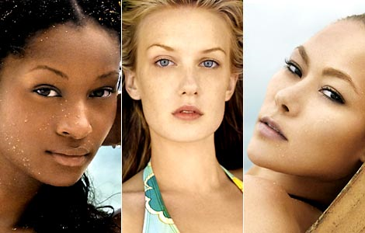
So…
is that good?
is that a lot?
…might be
The real question is how our model does versus other models…in terms of explaining the data.

Slide 25
Actually…
We don’t often use R² because it can be very unhelpful…
…it turns out that adding more and more variables will always increase it
So, if we just used R² which would we choose?
model 1: 900,345 variables, R² =0.2401
model II: 3 variables, R² =0.2400
→ model I.
…but is that the parsimonious choice?

Slide 26
Adjusted R²
If we care about parsimony, then the number of independent variables in the model should influence our choice…
…the fit of the model should be punished if it needs lots of variables
That is exactly what the “adjusted-R²” does
…and we will use that from now on.
“penalized”
SPSS reports this

Slide 27
Model fit
remember that we care about adjusted R square --- here we can explain 2.2% of the variation in Y with our Xs
…we also care about how it changes in response to adding or subtracting variables
we’ll come back
to this idea!

Slide 28
Why multiple regression?
Partly because we think there are multiple explanatory variables that we should consider (from our theory).
But we sometimes use multiple regression to rule out a variable(s)…
…especially when we suspect a spurious association

Slide 29
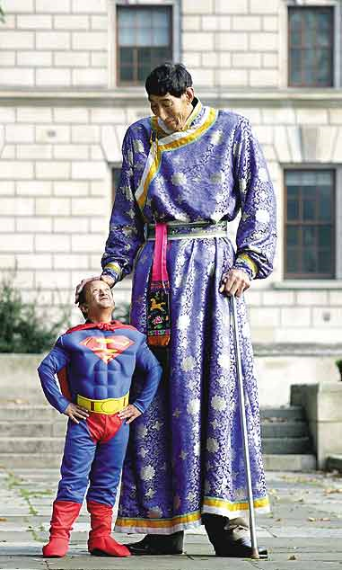
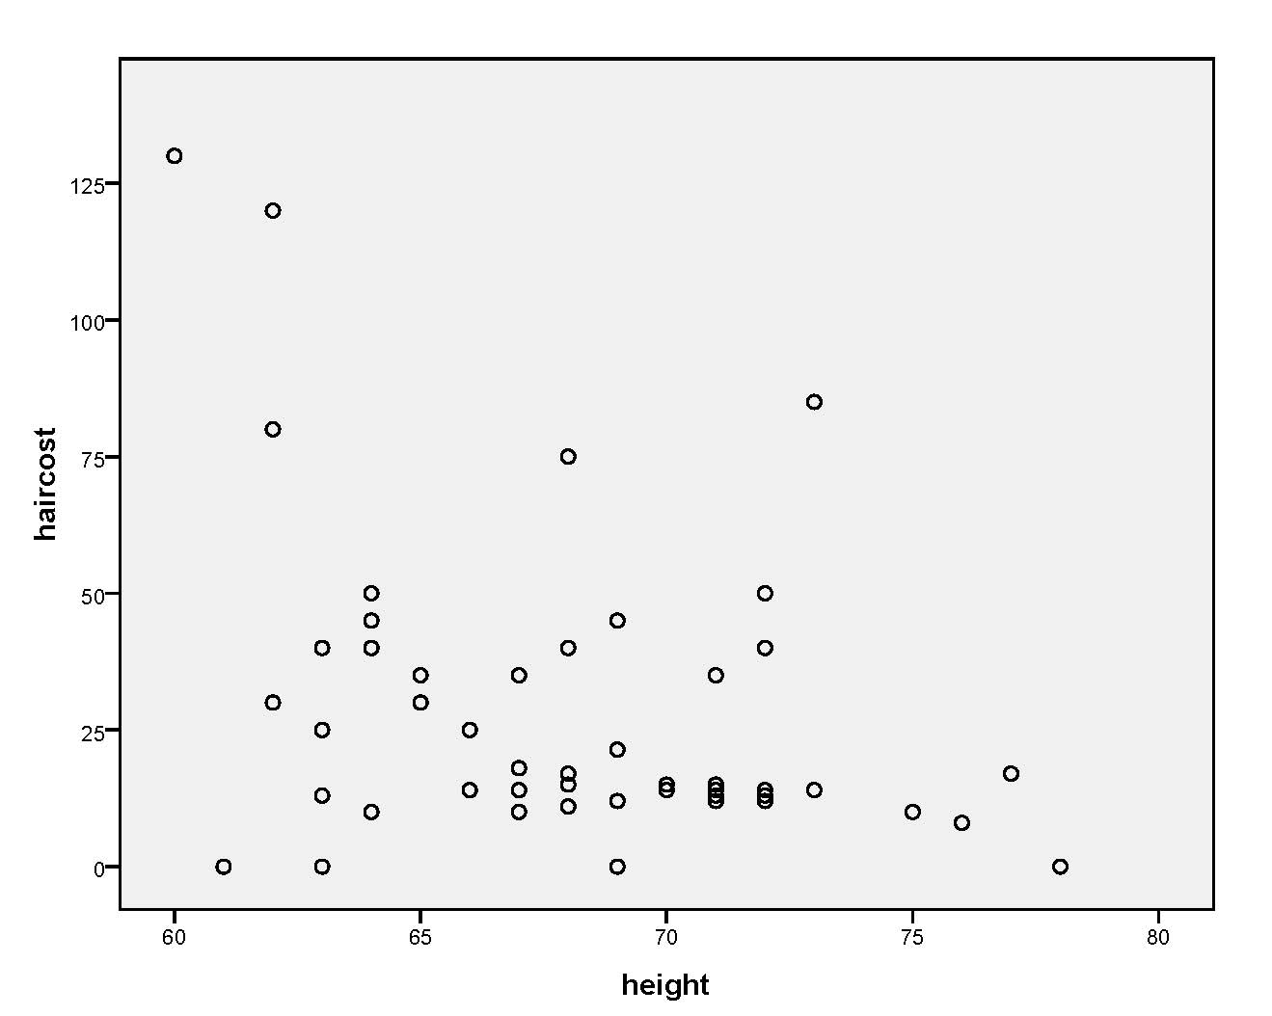
An example
We found that shorter people paid more for their haircut in our survey:
$$
$$$$$$
$$$$$$

Slide 30
And in a regression…
So for every 1 inch extra in height, you pay $2.20 less for your haircut!
[so put off haircuts until after puberty]
hmm…what’s really going on?

Slide 31
Controlling for sex…
So, once we control for sex, height is not a significant predictor…
…and we see men pay $21.22 less (on average)
[…this implies that taller men are not
paying significantly less than shorter men]
height
“drops out”

Slide 32
Comparing models
Suppose we started out with sex
(alone) predicting hair cut cost…
…is it “worth” adding height as a variable?
The “cost” is a less parsimonious model, but the benefit might be a better fit…
…maybe we can explain much more variation?
parsimony v.
“generality”

Slide 33
Next time!

Slide 34
Let’s see!
reduced
model
So:
Y= b sex + e → adj-R²=0.183
Y= b sex + b height + e → adj-R²=0.181
It went down when we added another (not very helpful) variable…
…so we prefer the simpler model in this case.
complete
model

Slide 35
Notice
Use adj-R² if we are comparing models which are versions of each other…
…just adding extra variables to the original equation
Y= b sex + e
Y= b sex + b height + e
Will also work for models that do not have this form:
Y= b race + b partyID + e
Y= b sex + b height + e
…here RHS is changed completely.
nested models
non-nested models
(but Y must be same)

Slide 36
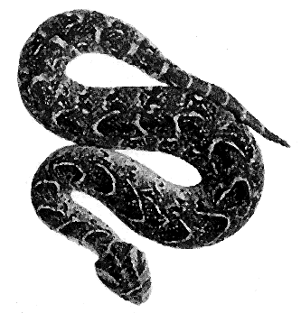
Interaction Effects
adder
Up to now…
Y= a+ b₁X₁ + b₂X₂ + b₃X₃+…+e
we say this regression is “additive”…
…because we just add the terms up.
The coefficient on Age, 1.47, tells us that…
no matter what your Education or Religiosity,
…one extra year older means (on average) you like Bush 1.47 points more.

Slide 37
But what if…
…the effect of the variable depends on the value of another variable in the model?
interactive relationship: the sign and the magnitude
of X’s effect on Y changes depending on the value
of Z.
In a regression, we talk about an “interaction effect”
Y= a+ b₁X₁ + b₂X₂ + b₃(X₁*X₂)+e
the interaction of X₁ and X₂

Slide 38
An example…
Suppose we were interested in what determines income:
Income= a+ b₁Race + b₂Sex + b₃(Race*Sex)+e
…what values can (Race*Sex) take?
interaction of
race and sex
male = 0, female =1
white = 0, black =1

Slide 39
The interaction term
(Race*Sex)
4 possibilities:
white man → 0 * 0 = 0
black man → 1 * 0 = 0
white woman →0 * 1 = 0
black woman → 1 * 1 = 1
The interaction term coefficient will tells us…
…whether being a woman has a different effect on income for different races.
…whether being black has a different effect on income for different sexes.
etc, etc

Slide 40
Here we go then…
(You have to create the interaction in SPSS, but it’s very easy)
...what are the directions of the variables?
…are the variables significant?

Slide 41
Predicted income
Income= a+ b₁Race + b₂Sex + b₃(Race*Sex)
= 23.5 -5.65 (0) -6.54 (0) + 2.45 (0) = $23,500
= 23.5 -5.65 (1) -6.54 (0) + 2.45 (0) = $17,500
= 23.5 -5.65 (1) -6.54 (1) + 2.45 (1) = $13,760
= 23.5 -5.65 (0) -6.54 (1) + 2.45 (0) = $16,960

Slide 42
So…
blacks earn less than whites…
…women earn less than men.
But also…
…there is an “extra” (negative overall) effect of being a black woman
or
…an “extra” (positive overall) effect of being a white man
The effect of sex is not constant across races…
…the effect of race is not constant across sex.

Slide 43
Be careful…
When you interpret an interaction, be sure to consider all the variables it involves:
= 23.5 -5.65 (1) -6.54 (1) + 2.45 (1) = $13,760
…we need to think about the net effect of being black and female:
…-5.65-6.54+2.45= -9.74 (relative to white men)
if we only looked
here, what would
it imply?
but these negative
terms are also key

Slide 44
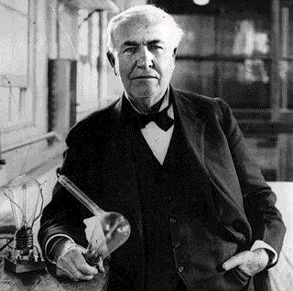
When do we use interactions?
when we think there is an “extra” bump up or down for some combination of the variables
we still think race and sex are important…
when we think there that only the combination of the variables in a certain way will lead to an effect
“success” = hard work + good ideas + (good ideas * hard work)
# parties = elec rules + cleavages + (rules*cleavages)
interaction significant
but nothing else!

Slide 45
One last check…
So far we’ve seen how to assess the evidence for the null that
H₀: b₁=0
H:₀ b₂=0
etc…
…all we have to do is check the p-values for the coefficients.
But, we might also like to test the joint hypothesis that Y is related to X₁ and X₂
H₀: b₁= b₂ =0
significance of
regression line
does Y have a linear
relationship with
X₁ and X₂?

Slide 46
Wait…
Why can’t we just use the hypothesis tests on the coefficients, one by one?
answer is subtle…
…implicitly we acted as if the
samples for testing b₁ and b₂ were
drawn independent of one another
but here, we are using the same sample
But the test is very easy…
…SPSS does it for you.

Slide 47
F-test
We do an F-test…
..so named because it uses an F distribution.
Look for “ANOVA” table in output
Stat sig → we know that at least one variable is linearly associated with Y

Slide 48
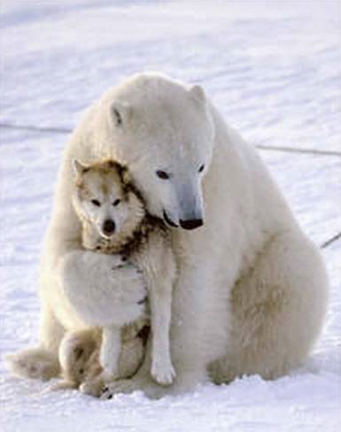
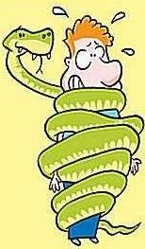
Multicollinearity
We know that X variables are often related to each other…
…that’s why we need multiple regression
But sometimes, they are a too tightly related…
…and this results in a statistical problem called
multicollinearity
old, religious
…we can “tease out” or “isolate”
effects even if two variables are
associated with one another

Slide 49
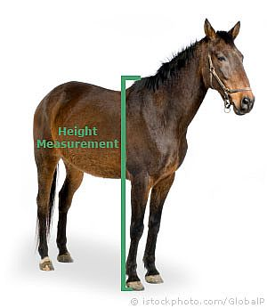
An example
Suppose…
trying to explain weight (in lbs) based on:
height in inches
height in centimeters
So,
weight = height.inches + height.centimeters + e
…what is the correlation between the two height measurements?

Slide 50
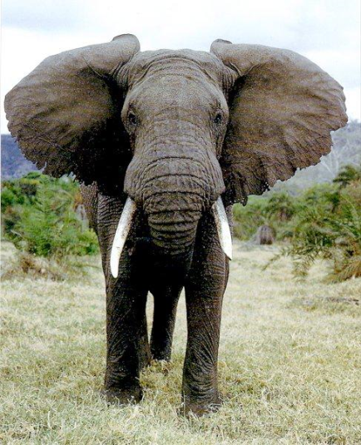
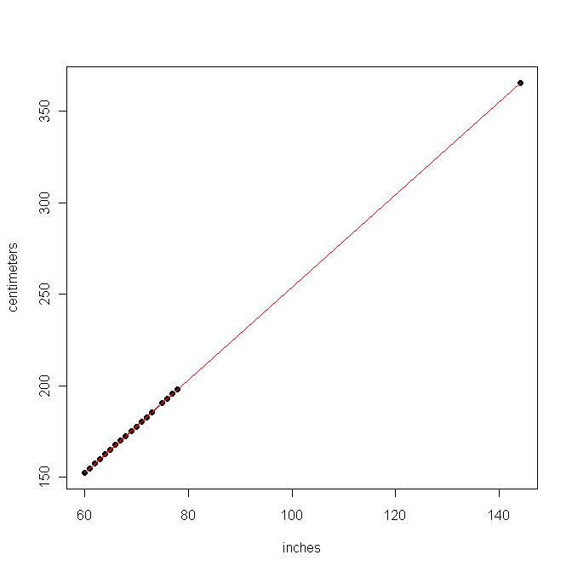
Well…
correlation is 1!

Slide 51
So…
what will the partial regression coefficient tell us?
…the effect of height in inches on weight,
holding height in centimeters constant.
And what’s the problem?
we cannot meaningfully hold it constant
…everyone who is 5’2’’ is 157.48 cm
…everyone who is 6’1’’ is 185.42 cm
etc…
So we cannot see “what happens” to Y as we vary the inches –
both must change at the same time

Slide 52
Before…
There were some people who were religious and young and well educated…
(…although the majority were older and less educated)
But now, how many people are 5’2” and not 157.48 centimeters tall?
…we cannot even estimate the regression coefficients in this case!
none!
(singularities mean
the model matrix
cannot be inverted)

Slide 53
Generally…
It is rare to have perfect correlation between variables…
…so long as the correlation is less than 0.9 (-0.9) the regression will run fine.
How can we tell if we have a multicollinearity problem?
use common sense
don’t have income in UK pounds + income in US dollars
don’t have “woman” and “not woman” as separate variables
F-test says predictors matter, but individual p-values are insignificant
massive changes in adj-R when an X is added/deleted

Slide 54
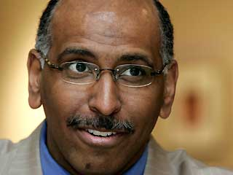
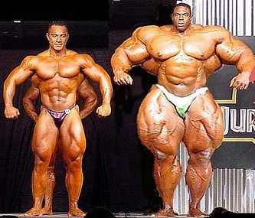
What to do?
Outside of the extreme cases (correlation =1), the fundamental problem is…
…not enough data
“not enough” blacks that vote Republican
“not enough” women that have autism
So, go bigger…
get more data.
Or, re-specify and rebuild your model carefully… delete a variable?

Slide 55
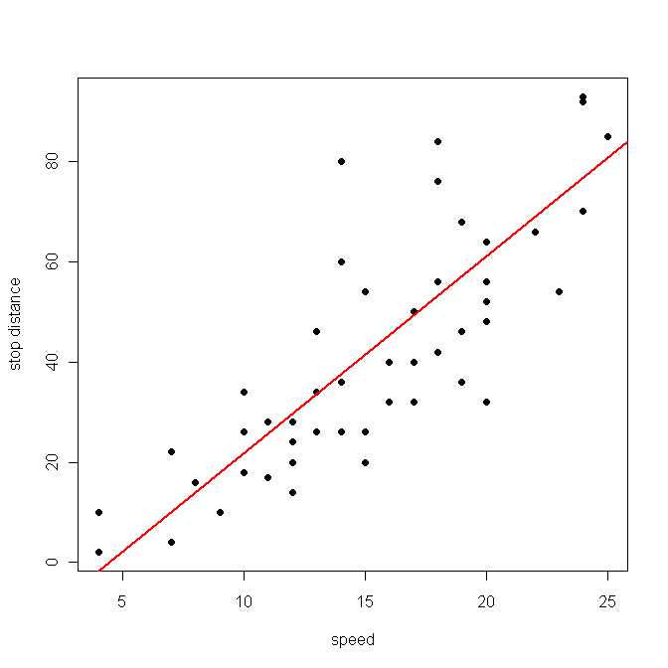
Outliers
The regression gives the best fit through the points, such that it maximizes the variation explained:
adj-R²=0.651
we like the
“point cloud”
to be tight
around the line
b=+3.93

Slide 56
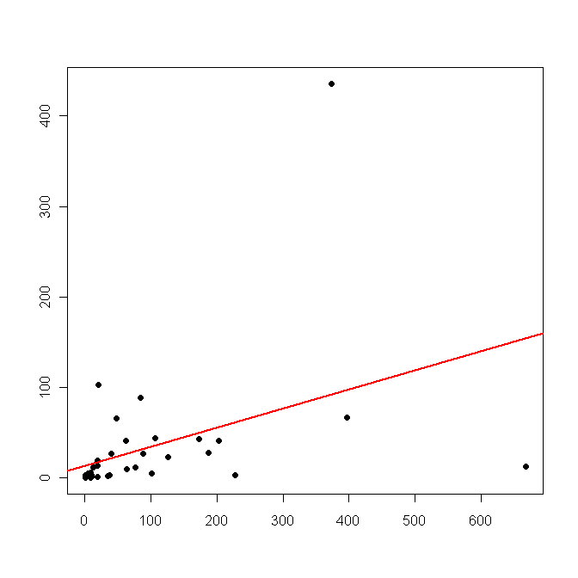
Sometimes…
…certain points are very far from the trend that the other data points follow:
executions
(since 1976)
who is this?
b=0.213
states where lots
of people get the death penalty
tend to execute more…
death row

Slide 57
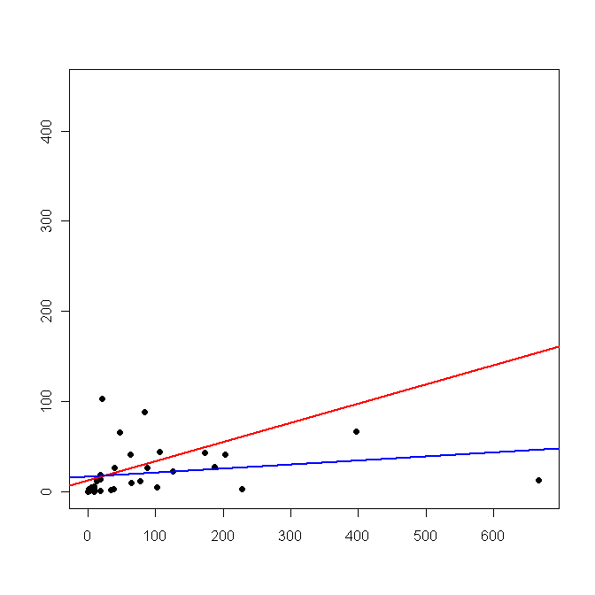
An outlier…
Texas is an outlier…
…it falls far from the trend
…and it pulls the line “up”
getting rid of TX
moves the regression
line down…
in fact, death row is no
longer significant…

Slide 58
We say…
we won’t be
very specific about this
an outlier is “influential” if removing it results in ‘large’ changes to the model results (in terms of significance or slope)
Where do they come from?
nature –
our model is just not very good for some units
…e.g. Texas is unusual in executing so many people
mistake –
sometimes we make coding mistakes, mistypes etc.
…what if someone was 1655 lbs, but 5’10’’?

Slide 59
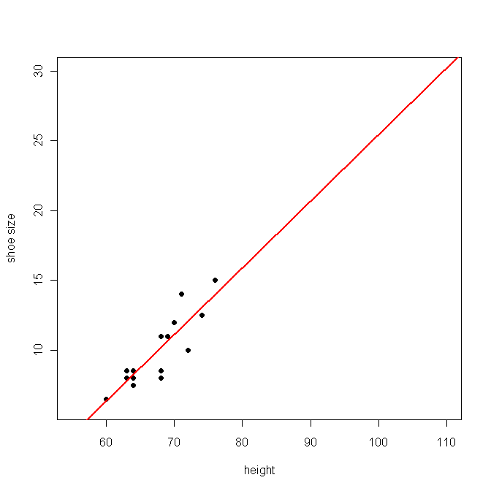
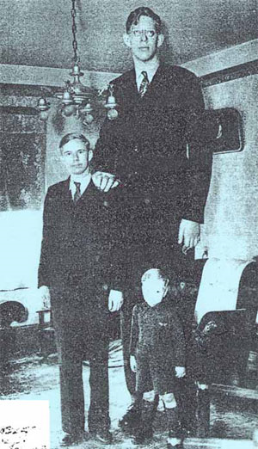
If you suspect…
an influential regression outlier…
…consider re-running your regression
without that observation
- does anything change?
coefficient estimates? p-values?
But don’t get confused …an observation can be far
from the others, but still be
part of the trend.
shoe size
height

Slide 60
Numbers of things
How large a sample do I need for a regression?
…as many as possible,
but 30 will be enough in
most cases for hypotheses tests
How many independent variables can I use?
…fewer than the number of observations!
…you cannot estimate a regression
with 200 observations and 350 variables.

