Slide 1
Section 4 - BCMP234
March 6, 2015
Harvard Medical School

Slide 2
Your Feedback to Me From Last Week
The only thing you said was “please add more sound effects.”
So please go to http://www.myinstants.com/

Slide 3

50:50
15
$1 Million
14
$500,000
Welcome to
Who Wants to be a Metabolipardyaire
13
$250,000
12
$125,000
11
$64,000
10
$32,000
9
$16,000
8
$8,000
7
$4,000
6
$2,000
5
$1,000
4
$500
3
$300
2
$200
1
$100

Slide 4
15
$1 Million
14
$500,000
13
$250,000
12
$125,000
11
$64,000
10
$32,000
9
$16,000
8
$8,000
7
$4,000
6
$2,000
5
$1,000
4
$500
3
$300
2
$200
1
$100

Slide 5
What can be used to measure gout risk?
  Steady state serum urate levels correlate with gout risk

Slide 6
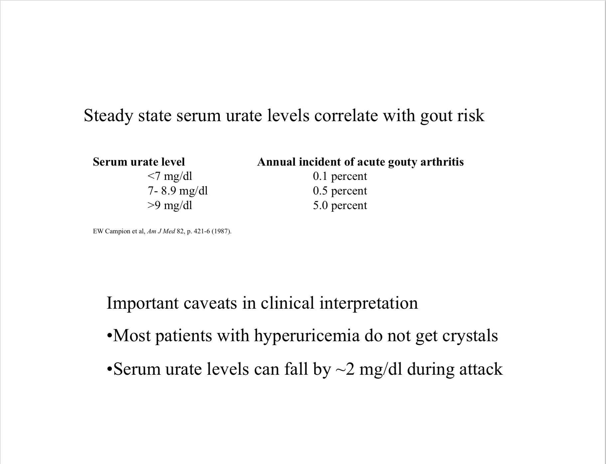

Slide 7
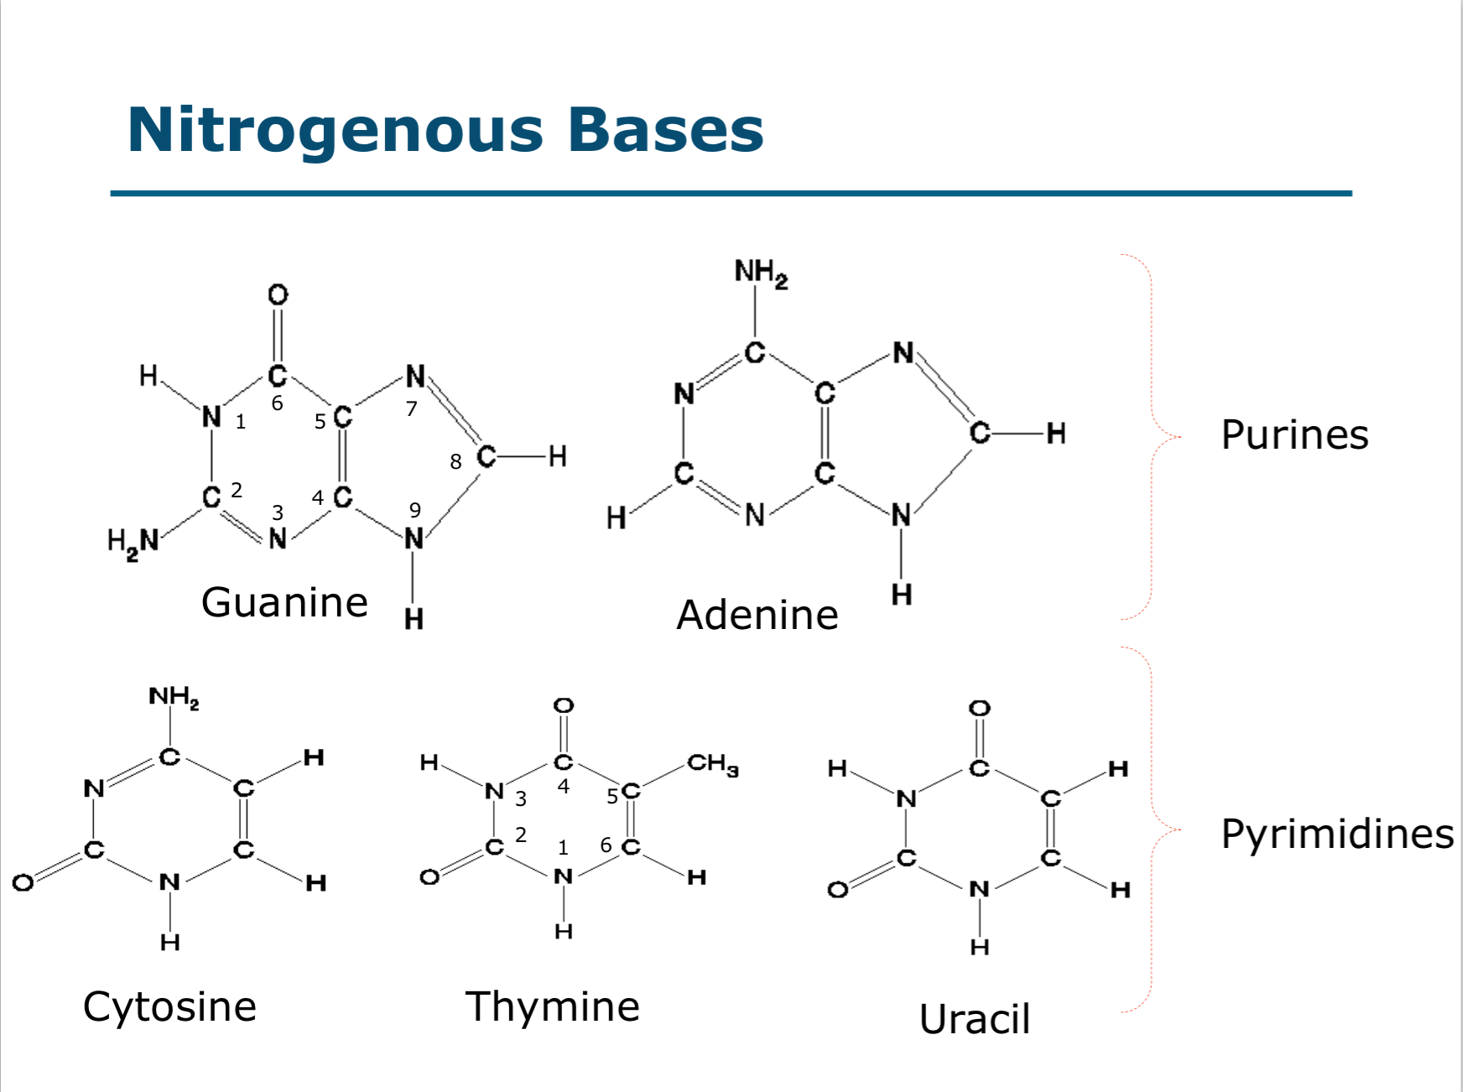
Which of these are purines? Which are pyrimidines?

Slide 8
15
$1 Million
14
$500,000
13
$250,000
12
$125,000
11
$64,000
10
$32,000
9
$16,000
8
$8,000
7
$4,000
6
$2,000
5
$1,000
4
$500
3
$300
2
$200
1
$100

Slide 9
Case presentation
55 y/o male
12 hours “pain in my big toe & ankle”
went to bed last night feeling fine
felt as if had broken toe this morning
PMH of similar problems in right ankle & left wrist

Slide 10
Case presentation
can barely walk (due to pain)
right elbow swollen
exam shows left first MTP joint & left ankle to be red, swollen & tender to touch
right elbow also swollen

Slide 11
Case presentation
lab studies
  serum uric acid = 11.5 mg/dl
  24-hour uric acid excretion = 300 mg
left foot X-rays show bony erosion with overhanging edge, medial side of first metatarsal head

Slide 12
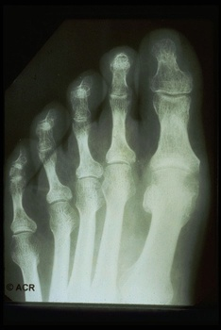
Gout - X-ray changes
bony erosions

Slide 13
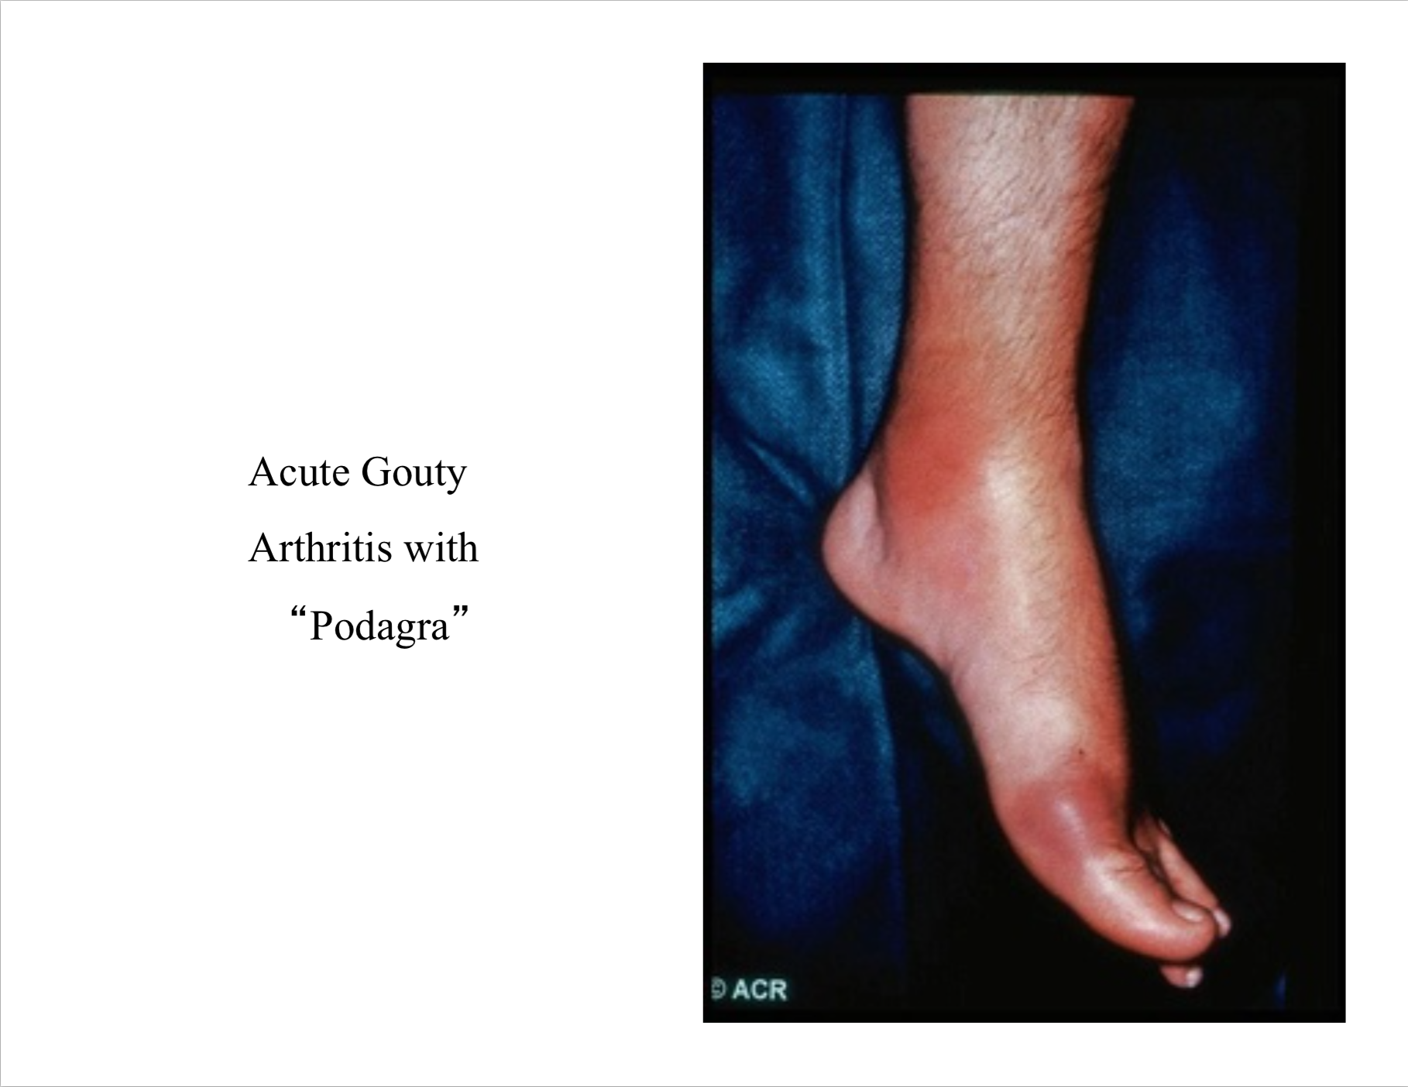
Upon physical examination, you look at
the patient’s foot, which he has
complained about, and you see the
following:
What is the diagnosis?

Slide 14
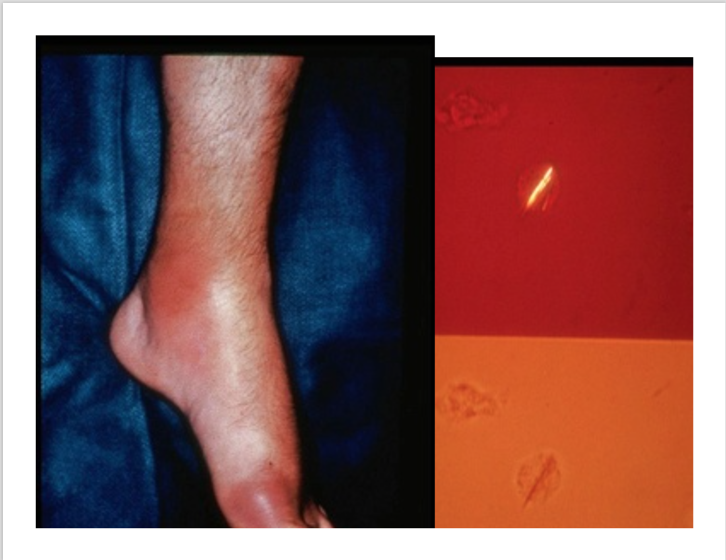

Slide 15
15
$1 Million
14
$500,000
13
$250,000
12
$125,000
11
$64,000
10
$32,000
9
$16,000
8
$8,000
7
$4,000
6
$2,000
5
$1,000
4
$500
3
$300
2
$200
1
$100

Slide 16
Why does more than 90% of gout occur in men?
  Males have higher levels of urate in the blood.
Why do premenopausal women almost never get gout?
  It is largely because estrogenic hormones have a mild uricosuric effect (increase excretion of uric acid); therefore, gout is unusual in premenopausal women. There is higher renal clearance of urate in women possibly due to their higher plasma estrogen levels and significantly lower tubular urate postsecretory reabsorption

Slide 17
15
$1 Million
14
$500,000
13
$250,000
12
$125,000
11
$64,000
10
$32,000
9
$16,000
8
$8,000
7
$4,000
6
$2,000
5
$1,000
4
$500
3
$300
2
$200
1
$100

Slide 18
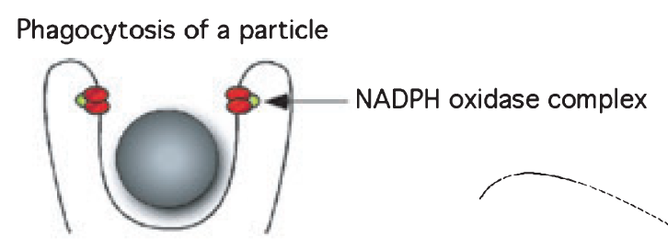
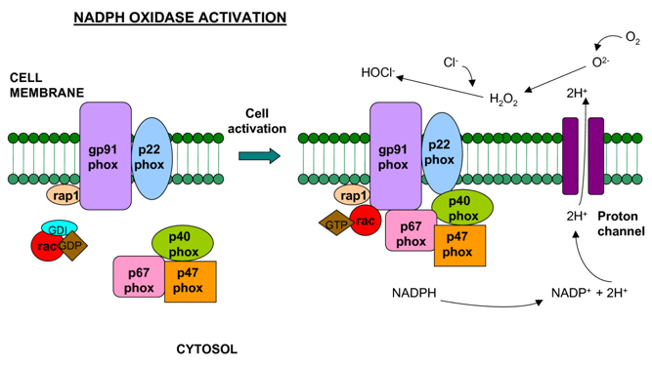
What complex is critical for Phagosome maturation?
?
?
?
?

Slide 19
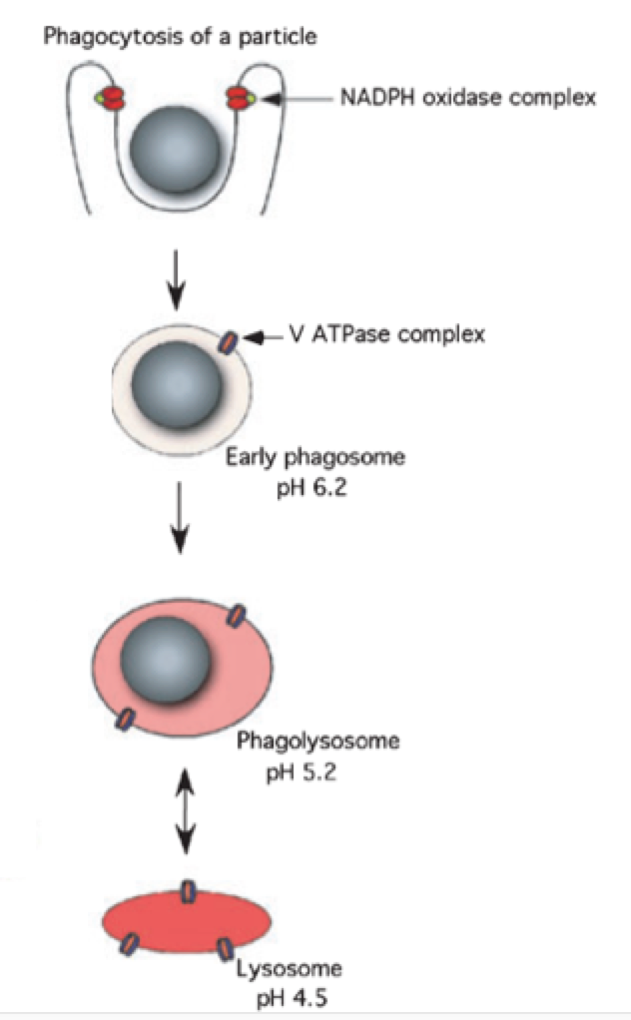
What’s the complex that’s important for pH decrease over here?
What’s happening here? It appears as if some sort of sack is fusing with
some other sack…what’s going on?
Why is the result a decrease in pH? Why is a decrease in pH important to
include in this cartoon?

Slide 20
15
$1 Million
14
$500,000
13
$250,000
12
$125,000
11
$64,000
10
$32,000
9
$16,000
8
$8,000
7
$4,000
6
$2,000
5
$1,000
4
$500
3
$300
2
$200
1
$100

Slide 21
Congratulations!
Congratulations!
Congratulations!
You’ve Reached
the $1,000
Milestone!

Slide 22
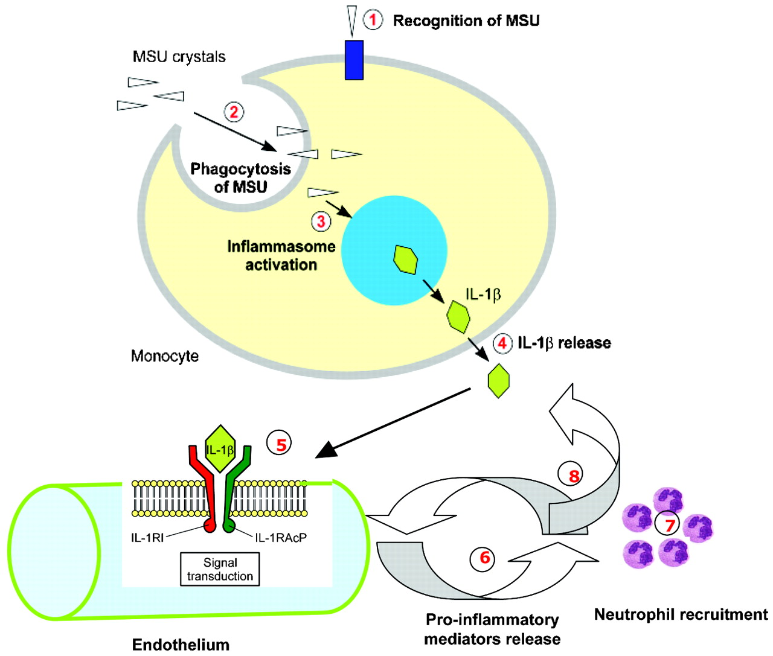
The inflammatory cascade initiated by monosodium urate (MSU) crystals
?
?
?
?
?
?
?
?
?
?
Release of other pro-inflammatory cytokines and recruitment of neutrophils
?
So A , Busso N Ann Rheum Dis 2009;68:1517-1519
©2009 by BMJ Publishing Group Ltd and European League Against Rheumatism
Notes:
**Run through this slide**

Slide 23
15
$1 Million
14
$500,000
13
$250,000
12
$125,000
11
$64,000
10
$32,000
9
$16,000
8
$8,000
7
$4,000
6
$2,000
5
$1,000
4
$500
3
$300
2
$200
1
$100

Slide 24
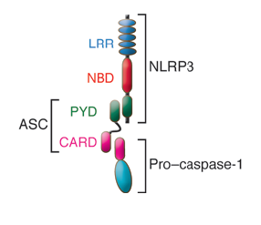
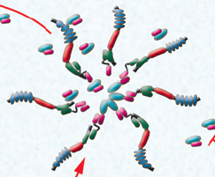

Enter: NLRP3 (NALP3) inflammasome
NLR proteins have a nucleotide binding domain and a leucine rich domain
NLRP proteins have an additional N-terminal pyrin domains (PYD)
ASC is an adaptor protein that recruits pro-caspase-1 through its CARD domain
Oligomerization is promoted by low K+ and requires binding of ATP by NLRP3
?
?
?
?
?
?
?
?
?
Inflammasome activation produces mature, active caspase-1
?
?
Notes:
Click 1: This is a three protein complex.
Click 2: The NLRs have nucleotide binding domains and a leucine rich domain. (Nucleotide-binding domain leucine-rich repeat–containing receptors)
Click 3: They also have a pyrin domain (PYD) which differentiates inflammasome from other complexes, one example being heptamers such as the apoptosome.
Click 4: The ASC is an adapter protein that has a CARD domain (caspase recruitment domain) and CARD recruits pro-caspase
Click 5: and you get oligomerization in concentrations of low K+ and high ATP and you form
Click 6: this massive heptomer (this massive wheel shape) If you’ve taken cell biology you recognize this is similar to the apoptosome. There’s only a single inflammasome per cell that’s 2 microns in diameter – it’s enormous.
Click 7: The inflammasome needs to be activated and once it’s been activated, active caspase 1 is produced from pro-caspase 1.
Click 8: Then, caspase becomes active protease and that’s the event we need to actually get the inflammatory response.
- But, how do we know this?

Slide 25
15
$1 Million
14
$500,000
13
$250,000
12
$125,000
11
$64,000
10
$32,000
9
$16,000
8
$8,000
7
$4,000
6
$2,000
5
$1,000
4
$500
3
$300
2
$200
1
$100

Slide 26
What is indocin (indomethacin) used to treat?
  Treats pain caused by arthritis, gout, bursitis, and tendonitis. This is a nonsteroidal anti-inflammatory drug (NSAID).
What’s allopurinol?
  inhibits uric acid formation in the body and is used to treat gout and related conditions. It’s a xanthine oxidase inhibitor.
Notes:
http://www.rxlist.com/colchicine-drug/clinical-pharmacology.htm

Slide 27
15
$1 Million
14
$500,000
13
$250,000
12
$125,000
11
$64,000
10
$32,000
9
$16,000
8
$8,000
7
$4,000
6
$2,000
5
$1,000
4
$500
3
$300
2
$200
1
$100

Slide 28
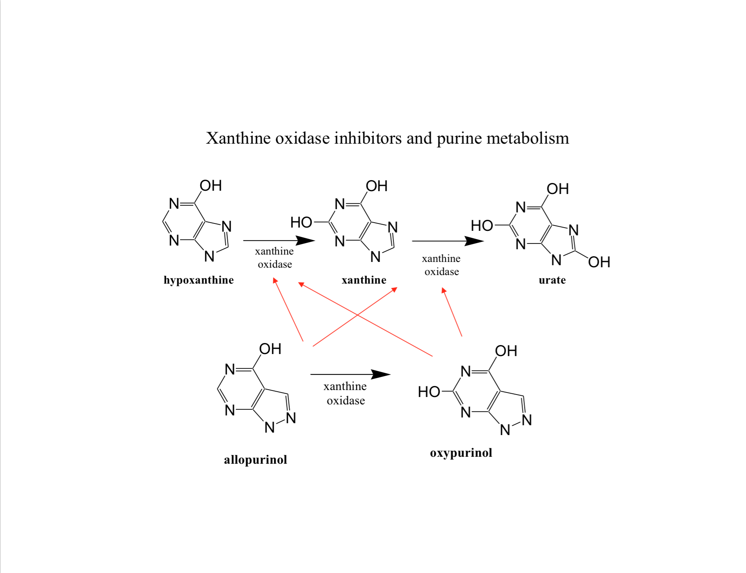
What enzyme converts hypoxanthine to xanthine?
What enzyme converts xanthine to urate?
What does xanthine oxidase inhibits the metabolism of this category
of heterocyclic aromatic organic compounds.
What enzyme converts allopurinol to oxypurinol?

Slide 29
Why is a Xanthine oxidase inhibitor important for treating gout?
  Because that inhibits purine metabolism, and the end product of purine metabolism is uric acid, which leads to MSU, which is a chief component of the pathogenesis of gout.
What is a potential extreme but rare side effect of Allopurinol that will get you in the ICU?
  toxic epidermal necrolysis - 1 in 40,000 allpurinol
Notes:
http://www.rxlist.com/colchicine-drug/clinical-pharmacology.htm

Slide 30
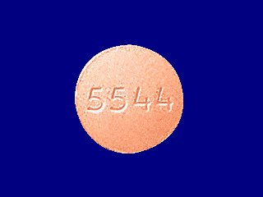
Allopurinol (Zyloprim™)
inhibitor of xanthine oxidase
effectively blocks formation of uric acid
how supplied - 100 mg & 300 mg tablets
allopurinol
Notes:
Drug Therapy of Gout
LSU Clinical Pharmacology
Reginald D Sanders, MD

Slide 31
Allopurinol effects
Effect of Allopurinol on Total Serum Levels of Xanthine + Hypoxanthine
Normal
0.15 mg/dl
Allopurinol
0.35 mg/dl
saturation level of xanthine & hypoxanthine > 7 mg/dl

Slide 32
15
$1 Million
14
$500,000
13
$250,000
12
$125,000
11
$64,000
10
$32,000
9
$16,000
8
$8,000
7
$4,000
6
$2,000
5
$1,000
4
$500
3
$300
2
$200
1
$100

Slide 33
What’s the mechanism of action of Colchicine? What is it used to treat?
  The exact mechanism of action of colchicine in gout is not completely known,
  but
  it involves (1) a reduction in lactic acid production by leukocytes, which results in a decrease in uric acid deposition, and (2) a reduction in phagocytosis, with abatement of the inflammatory response.
Notes:
http://www.rxlist.com/colchicine-drug/clinical-pharmacology.htm

Slide 34
Why is uric acid a natural a product of cell death?
  Uric acid is a breakdown product of purine catabolism and when cells die the DNA and RNA containing purine bases are broken down into uric acid producing a local increase in uric acid concentration.
How is uric acid both a naturally occurring harmless substance in the blood and an activator of the immune system?
  Uric acid in its soluble form is a non-inflammatory naturally occurring metabolite. When it reaches above a certain concentration (~70 mg/L) in biological fluids, it can form crystals, which appears to be the active form in this context.
What cellular process is uric acid “alerting” the immune system to?
  Cell death.
Is this effect acute or long term?
  It would continue as long as large numbers of cells are dying but would generally be acute.
Notes:
http://www.rxlist.com/colchicine-drug/clinical-pharmacology.htm

Slide 35
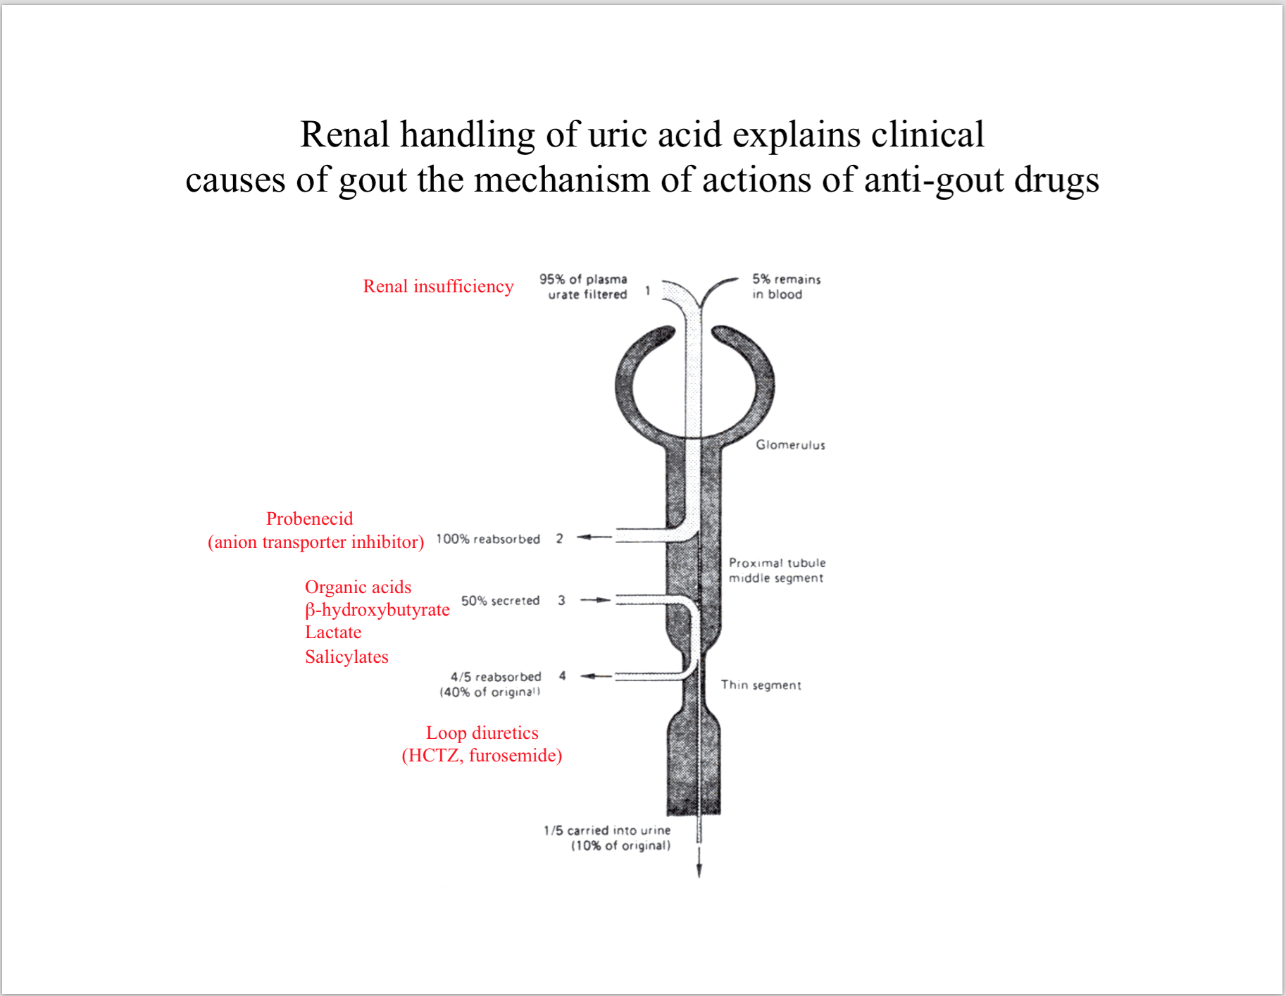

Slide 36
15
$1 Million
14
$500,000
13
$250,000
12
$125,000
11
$64,000
10
$32,000
9
$16,000
8
$8,000
7
$4,000
6
$2,000
5
$1,000
4
$500
3
$300
2
$200
1
$100

Slide 37
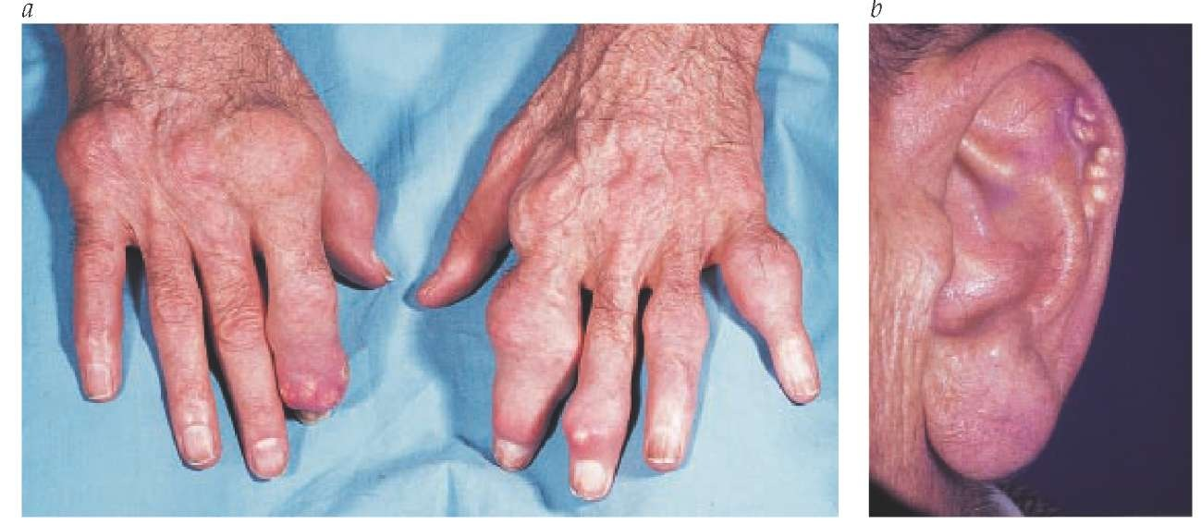
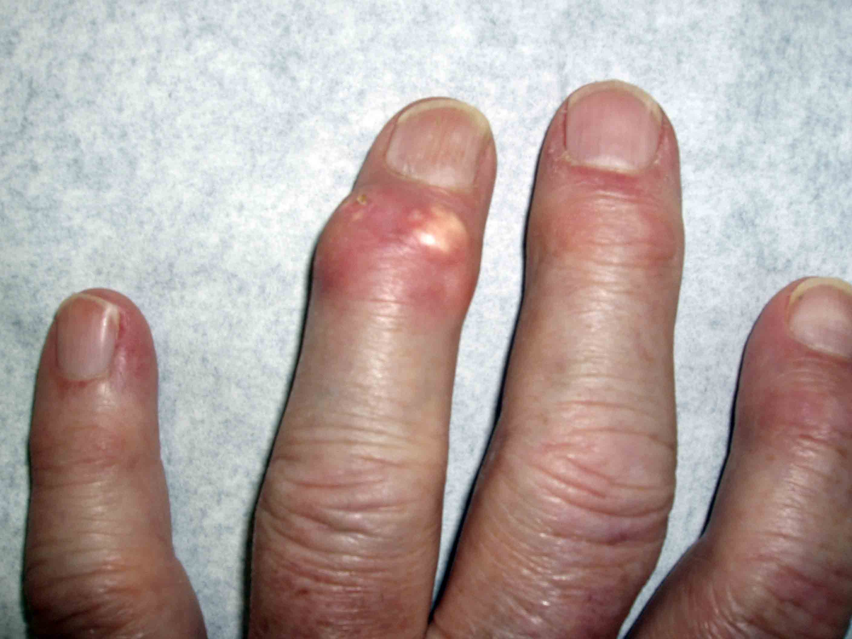
What is this?
Tophaceous gout

Slide 38
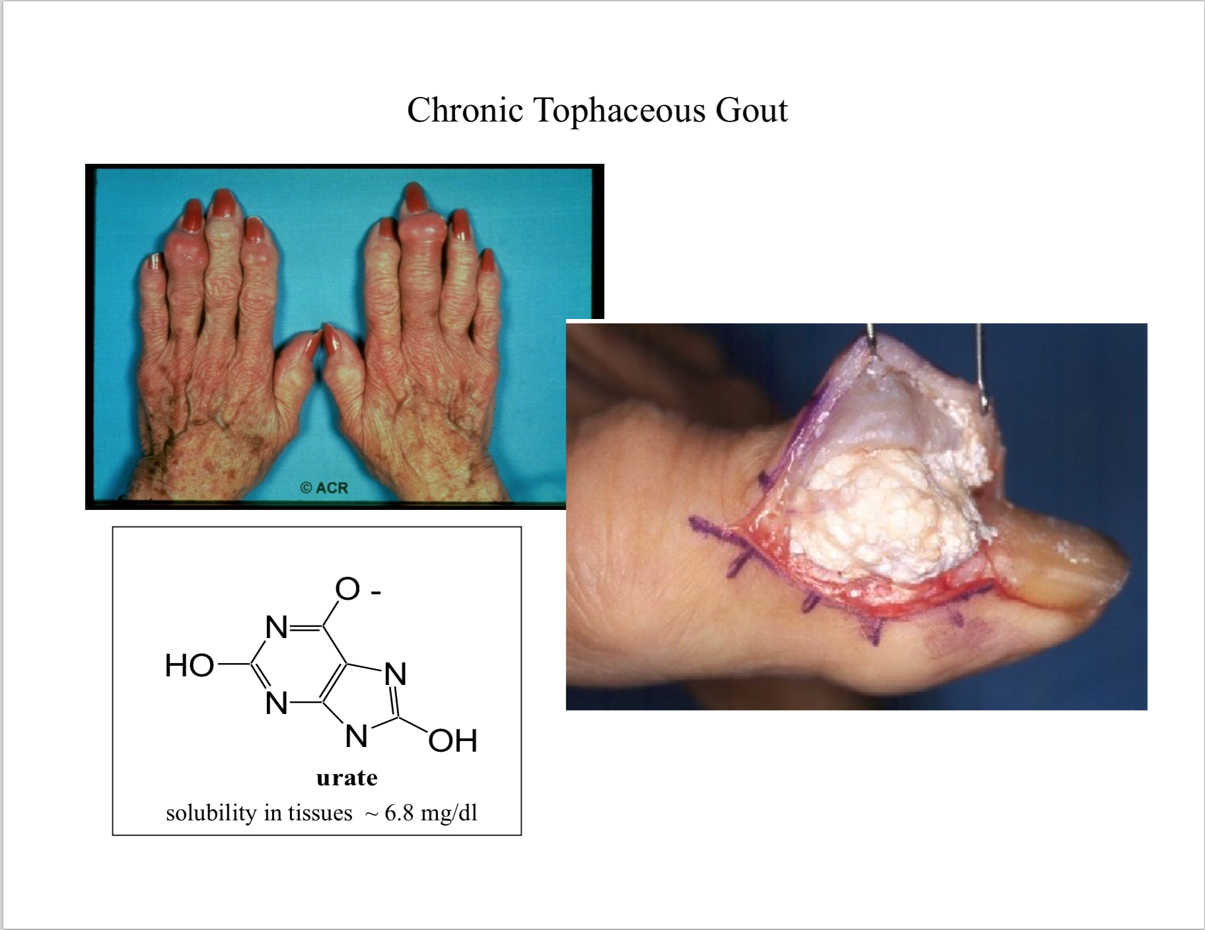

Slide 39
15
$1 Million
14
$500,000
13
$250,000
12
$125,000
11
$64,000
10
$32,000
9
$16,000
8
$8,000
7
$4,000
6
$2,000
5
$1,000
4
$500
3
$300
2
$200
1
$100

Slide 40

Draw as much of the Purine excretion pathway as you can

Slide 41
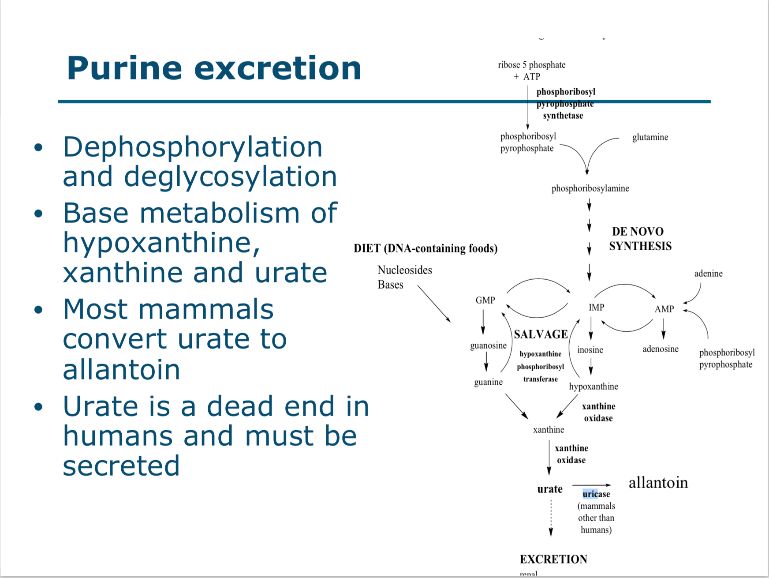

Slide 42
15
$1 Million
14
$500,000
13
$250,000
12
$125,000
11
$64,000
10
$32,000
9
$16,000
8
$8,000
7
$4,000
6
$2,000
5
$1,000
4
$500
3
$300
2
$200
1
$100

Slide 43
Thought question:
Why do you think blocking glycolysis would block the inflammatory immune response?
  Answer: many immune cells depend on quick ATP generation by glycolysis to function. The more “fast acting” the immune cell, the more it typically depends on glycolysis.

Slide 44
15
$1 Million
14
$500,000
13
$250,000
12
$125,000
11
$64,000
10
$32,000
9
$16,000
8
$8,000
7
$4,000
6
$2,000
5
$1,000
4
$500
3
$300
2
$200
1
$100

Slide 45
Review ketone body production:
  In what physiologic states are ketone bodies typically produced?
    starvation, diabetes, intense exercise
  What organ typically produces ketone bodies and what organs utilize them for energy?
    Liver makes; brain, heart, and muscle use.

Slide 46
  Why are ketone bodies produced during CR or low-carb diets? (week 1/3)
    Fatty acid metab; alt energy source to produce ATP when glucose unavailable …
    If no glucose, then oxaloacetate (formed by combining 2 pyruvates at the conclusion of glycolysis) is insufficient, and the acetyl CoA generated from lipolysis and beta oxidation of fatty acids is unable to enter the TCA cycle; the excess acetyl CoA molecules are condensed in pairs to form acetoacetylCoA, which is converted to ketone bodies by 2 additional enzymatic steps (see Week 3 clinical correlation).

Slide 47
15
$1 Million
14
$500,000
13
$250,000
12
$125,000
11
$64,000
10
$32,000
9
$16,000
8
$8,000
7
$4,000
6
$2,000
5
$1,000
4
$500
3
$300
2
$200
1
$100

Slide 48
Fasting/Caloric Restriction (CR)
  Reported to reduce inflammation
  Status of field: Unknown what effect ketones/other alternative metabolites produced during fasting have on innate immune response
  Q: What is currently known about the health benefits of CR? What are the major players?
    Extends lifespan
    CR reduces IGF signaling (increased IGF signaling associated w/ many pathologies)
    Activation of NAD+-dependent Sirtuins (histone deacetylases)
    Roles in metabolism, DNA repair, response to stress, aging
    Reduces inflammation (prob contributes to lifespan)
    SIRT2 (sirtuin activated by CR) also known to inhibit inflammation (via inflammasome NLRP3)
    SIRT6 (another sirtuin) known to modulate inflammatory response via repression of NF-KB signaling
    Before this paper, unknown whether metabolites could directly affect inflammation.

Slide 49
15
$1 Million
14
$500,000
13
$250,000
12
$125,000
11
$64,000
10
$32,000
9
$16,000
8
$8,000
7
$4,000
6
$2,000
5
$1,000
4
$500
3
$300
2
$200
1
$100

Slide 50
Write down on your boards:
What’s the most important figure from this week’s paper?

Slide 51
YOU WIN $1 MILLION DOLLARS!

Slide 52
What is RNR activity?

Slide 53
