Slide 1
Red Light, Green Light!
Contributors
Melanie Badtke Regis University
Amanda Charlesworth University of Colorado, Denver
Melissa Krebs Colorado School of Mines
Vida Melvin Regis University
Paul D. Ogg Colorado School of Mines
http://2.bp.blogspot.com/-Ni0GZUo4_WY/UI_wlyATFXI/AAA
AAAAADMw/z-P-qGQqskQ/s640/RedLightGreenLight1.jpg
1

Slide 2
Unit – Cellular Division and Cell Cycle.
Course – Introductory Biology.
Number of Lecture Hours – 3 hours.
How did the idea for the unit arise? - Students are known to struggle with this topic.
Why was this topic chosen? - All participants can utilize this topic in their courses.
What misconceptions or difficult topics are addressed? - Differences of tumor suppressor and oncogene function.
Previous knowledge required for activity – mutation, cell cycle, cell division, general knowledge of cancer (overproduction of cells).
2

Slide 3
Learning Goals –
Students will understand how a cell regulates division.
Unit Intended Learning Outcomes –
Evaluate the benefits and risks of cellular division in multicellular organisms.
Construct a diagram of the cell cycle and describe important events.
Describe checkpoints that protect an organism against the risks of cell division.
Tidbit Intended Learning Outcomes
Distinguish between an oncogene and a tumor suppressor.
Analyze flow cytometry data to make conclusions about cellular growth and activity of oncogenes or tumor suppressors.
Predict the effect of tumor suppressors and oncogenes on cell cycle progression.
3

Slide 4
Pre-assessment –
Objective – Students can define a proto-oncogene, oncogene and tumor suppressor and relate these definitions to the previously discussed topic of cell cycle.
Proto-oncogene = a naturally occurring gene found in healthy cells that promotes cell division under normal conditions. (used for growth and repair of tissues, growth and development of organisms).
Oncogenes = mutated forms of proto-oncogenes that lead to overproduction or hyper-activation resulting in abnormal growth of cells and tissues.
Tumor suppressors = genes that encode for naturally occurring proteins that normally inhibit cell division at cell cycle checkpoints.
4

Slide 5
Pre-assessment Quiz
The analogy of a car is often used to describe the function of proto-oncogenes, oncogenes and tumor suppressors in the cell cycle and cell division. The gas pedal pushes the car/cell into the cell cycle and promotes cellular division and the brake pedal stops the cell cycle and inhibits cellular division.
(1) Using this analogy, which of the following are the brakes and which are the gas?
Proto-oncogenes.
Tumor suppressor.
(2) Two kinds of problems can occur in this car – one in which the pedals are always engaged and the other where the pedals fail to carry out their function. Which of the following scenarios would lead to uncontrolled cellular division?
Gas pedal is broken in such a way to prevent acceleration.
Brakes are broken and do not stop the car.
Brakes never disengage and car is always stopped.
Gas pedal is always engaged and car accelerates unchecked.
(3) Please indicate from the list in #2, which represents the action of an oncogene?
5

Slide 6
“ … I carry a ‘faulty’ gene, BRCA1, which sharply increases my risk of developing breast cancer and ovarian cancer.”
Angelina Jolie on her decision to have a prophylactic double mastectomy in “My Medical Choice”, NY Times, May 2013
http://www.nytimes.com/2013/05/14/opinion/my-medical-choice.html?_r=0
6

Slide 7
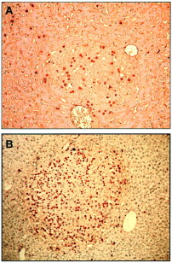
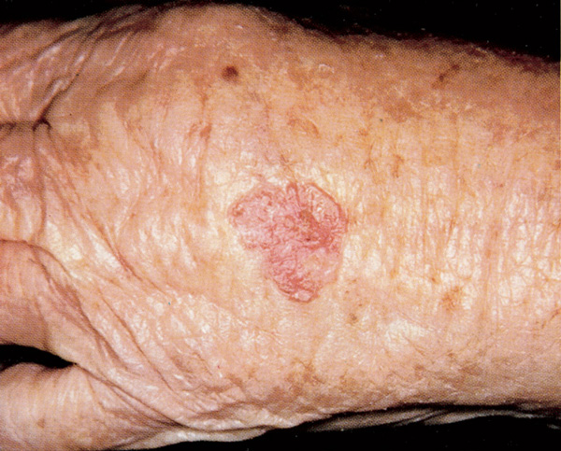
Importance of Cell Cycle Control
Today we will learn how the function of tumor suppressors and oncogenes can affect the cell cycle.
Dividing Cells = Dark
Basal Cell Carcinoma
Healthy Tissue
Tumor
(Pierce, et al., 2002)
100X
http://5minuteconsult.com/loadMedia.ashx?bookname=idams&filename=F1793-061-027.jpg
7

Slide 8
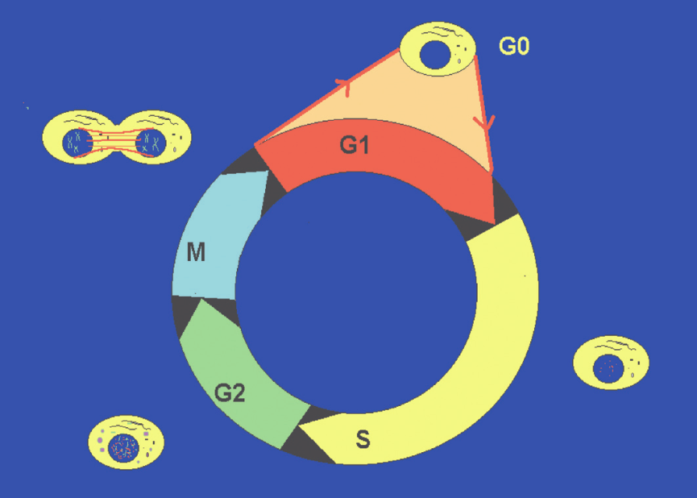
Review
Make a prediction –
In which phase of the cell cycle will a cell have the most DNA?
G1
S
G2/M
(Adapted from Brotherick, I., 2005)
http://www.dako.com/08065_15dec05_guide_to_flow_cytometry_basic_dna_measurement_by_flow_cytometry_chapter16.pdf
2n
2n
2 x 2n
2 x 2n
more than 2n
8

Slide 9
Review
Thus, we can determine where a cell is in the cell cycle by figuring out how much DNA the cell has.
Let’s see how we can do this for each cell in a large population of 1,000,000 cells.
(Adapted from Brotherick, I., 2005)
2n
2n
http://www.dako.com/08065_15dec05_guide_to_flow_cytometry_basic_dna_measurement_by_flow_cytometry_chapter16.pdf
2 x 2n
2 x 2n
more than 2n
9
Notes:
Clicker question – get across the idea that cells in G1 are 2n (diploid), cells in G2 have 4n (tetraploid – has been copied), and cells in S are in between because not all DNA has been completely copied)

Slide 10
Draw Our Own Histogram
Imagine, each of you is a cell in a population of cells.
Place your finger on the cell cycle figure you created in our last class session.
When I say ‘green light’ begin to trace your finger around the circle on your paper.
When I say ‘red light’ stop moving your finger.
Use your clicker to indicate where your finger stopped;
G1
Early S-phase
Middle S-phase
Late S-phase
G2/M
10

Slide 11
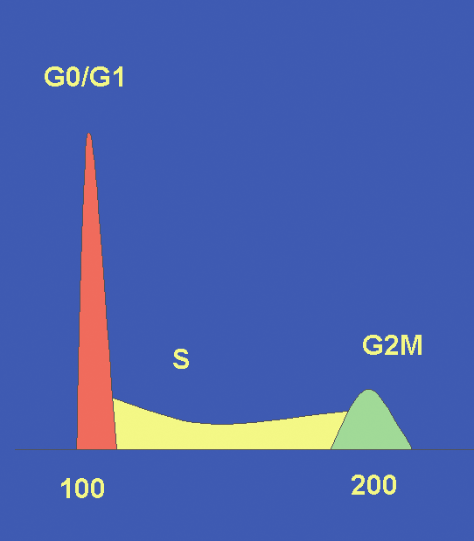
We can measure the DNA content of each cell in a large population of cells, using an instrument called a flow cytometer.
2n
2n
http://www.dako.com/08065_15dec05_guide_to_flow_cytometry_basic_dna_measurement_by_flow_cytometry_chapter16.pdf
2x 2n
# cells
2x 2n
More than 2n
2n
2x 2n
Amount of DNA
(Adapted from Brotherick, I., 2005)
11
Notes:
We literally put cells into piles based on how much DNA they have.
Histogram first, then cell cycle pops up.
<<<Need a formative assessment here to make sure they understand how this histogram and cell cycle image are linked together>>>

Slide 12
How does an oncogene change the profile of a population of cells?
How does an oncogene accomplish this change?
Cells with a
Proto-oncogene
(normal)
Cells with an Oncogene (‘gas pedal’)
(hyperactivated proto-oncogene)
# cells
# cells
2n 2 x 2n
2n 2 x 2n
Amount of DNA
Amount of DNA
12
Notes:
So, here is an example of actual data collected from populations of cells and the researchers have given us actual percentages of cells that are in each peak.
In the first panel a cancer cell has been treated an oncogene has been inactivated through the use of an inhibitor.
<<<Pair share for 2 minutes then share amongst your group>>>

Slide 13
In this experiment, the cells were shifted to the right because the cells progressed more readily into the cell cycle.
Cells with a
Proto-oncogene
(normal)
Cells with an Oncogene (‘gas pedal’)
(hyperactivated proto-oncogene)
# cells
# cells
2n 2 x 2n
2n 2 x 2n
Amount of DNA
Amount of DNA
13
Notes:
So, here is an example of actual data collected from populations of cells and the researchers have given us actual percentages of cells that are in each peak.
In the first panel a cancer cell has been treated an oncogene has been inactivated through the use of an inhibitor.
<<<Pair share for 2 minutes then share amongst your group>>>

Slide 14
Which of the below options would change the cancer cell histogram to the treated histogram?
Inactive a proto-oncogene
Inactive a tumor suppressor
Activate an oncogene
Activate a proto-oncogene
Activate a tumor suppressor
Cancer Cells
Treated
# cells
# cells
2n 2 x 2n
2n 2 x 2n
Amount of DNA
Amount of DNA
14
Notes:
So, here is an example of actual data collected from populations of cells and the researchers have actually given us actual percentages of cells that are in each peak.
In the first panel a cancer cell has been treated an oncogene has been inactivated through the use of an inhibitor.
<<<oncogene is gas pedal. Tumor suppressor is the brakes. Here is the same histogram. Besides a hyperactivated oncogene what could you do to a population of cells to get the same result?>>>

Slide 15
Concept check
What is the difference between how a proto-oncogene and a tumor suppressor are mutated to promote cell cycle progression?
Mutations need to activate the proto-oncogene (oncogene) or the tumor suppressor.
Mutations need to inhibit the proto-oncogene or the tumor suppressor.
Mutations need to activate the proto-oncogene (oncogene) or inhibit the tumor suppressor.
Mutations need to inhibit the proto-oncogene (oncogene) or activate the tumor suppressor.
15
Notes:
Lets just check that you get the principle you deduced from the previous slide. Think about this question and use your clicker to answer.

Slide 16
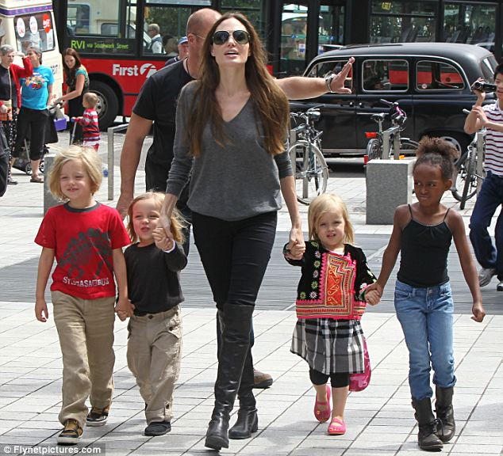
“ … I carry a “faulty” gene, BRCA1, which sharply increases my risk of developing breast cancer and ovarian cancer.”
Angelina Jolie
Basal Cell Carcinoma
http://popledgeplus.files.wordpress.com/2011/09/article-2032713-0d27ea7100000578-957_634x576.jpg
http://5minuteconsult.com/loadMedia.ashx?bookname=idams&filename=F1793-061-027.jpg
If Angelina Jolie has a faulty BRCA1, why is she concerned about an increased risk for cancer?
Based on Angelina’s quote, can we determine if BRCA1 is an oncogene or a tumor suppressor?
Why doesn’t she already have cancer?
16

Slide 17
Learning Goals –
Students will understand how a cell regulates division.
Unit Intended Learning Outcomes –
Evaluate the benefits and risks of cellular division in multicellular organisms.
Construct a diagram of the cell cycle and describe important events.
Propose (new word – does this make sense?) checkpoints that protect an organism against the risks of cell division.
Tidbit Intended Learning Outcomes
Distinguish between an oncogene and a tumor suppressor.
Analyze flow cytometry data to make conclusions about cellular growth and activity of oncogenes or tumor suppressors.
Predict the effect of tumor suppressors and oncogenes on cell cycle progression.
3 & 17

Slide 18
Summative assessment - (Short answer exam question)
Below are two histograms that show the DNA content of two different population of cells, normal and infected with HPV (human papilloma virus). How does HPV change the profile of the infected cell population?
Could HPV cause cancer or be used to treat cancer? Using the data above, defend your answer.
(Adapted from Bihani, 2004)
Normal
Infected
# Cells
# Cells
Amount of DNA
Amount of DNA
18

Slide 19
References
Brotherick, I. (2005) Guide to Flow Cytometry: Chapter 16 Basic DNA Measurement by Flow Cytometry. Dako.com p. 99-106.
Pierce, HR. (2002) Bcl-2 Expression Inhibits Liver Carcinogenesis and Delays the Development of Proliferating Foci. Am. J. of Pathology. Vol. 160; 5. p.1555-1560.
Bihani, T. (2004) Differential Oncogenic Ras Signaling and Senescence in Tumor Cells. Cell Cycle 3:9, 1201-1207.
Acknowledgments
Molly Bolger and Lianna Etchberger
Groups 1 and 6
19

Slide 21
“ … I carry a “faulty” gene, BRCA1, which sharply increases my risk of developing breast cancer and ovarian cancer.”
Angelina Jolie
“Mutations affecting the BRCT domains of the breast cancer–associated tumor suppressor BRCA1 disrupt the recruitment of this protein to DNA double-strand breaks (DSBs).”
Bijan Sobhian, Genze Shao, Dana R. Lilli, Aedín C. Culhane, Lisa A. Moreau, Bing Xia, David M. Livingston, Roger A. Greenberg.
Science 25 May 2007: Vol. 316 no. 5828 pp. 1198-1202.
http://www.sciencemag.org/content/316/5828/1198

Slide 22
“ … I carry a “faulty” gene, BRCA1, which sharply increases my risk of developing breast cancer and ovarian cancer.”
Non-Functional
BRCA1 Gene
(Angelina Jolie)
Functional
BRCA1 Gene
http://www.ncbi.nlm.nih.gov/pubmed/8589721
# cells
2n 2 x 2n
2n 2 x 2n
Amount of DNA
Is BRCA1 acting like an oncogene or tumor suppressor?
** Think-pair-share and clicker?

