Slide 1
Teachable Tidbit Learning Outcomes
Define acids, bases in biosystems
Predict charge of molecule @ particular pH based on its pKa
Interpret graph of the above relationship
Calculate ratio of protonated/unprotonated forms of ionizable groups depending on chemical characteristics and environmental pH (use the HH equation)
Apply in medical context
Notes:
This slide describes where in a teaching unit our tidbit falls. Initially our group had intended to introduce the Henderson-Hasselbalch equation. For this reason, we had named the unit “Taking the Hassle out of Henderson-Hasselbalch”. As we do not actually reach that point in the unit with this tidbit, we have renamed it “Shakespeare ‘on’ Acid
To ionize or not to ionize?…that is the question.”

Slide 2
Tidbit Goals
Understand relationship of between pH, pKa and ionization of weak acids in aqueous systems
  Define acids, bases in biosystems
  Predict charge of molecule @ particular pH based on its pKa
  Apply in medical context
Notes:
To prepare for this Tidbit the Instructor needs only to have grouped students into small groups for discussion during TPS (Think Pair Share exercises). Additionally, each group should be given a pH 5, 7 or 9 solution depiction handout (follows) and 6 small pink and 6 small blue sticky notes

Slide 3

Removing the Hassle from
Henderson-Hasselbalch, part I
OR
Shakespeare on Acid
To ionize or not to ionize…that is the question?
  GROUP 2 :
  Erika Abel, Vanessa Castleberry, Rizalia Klausmeyer, Aaron Snead, Martina Rosenberg, William Sherman Garver, Marcy Osgood

Slide 4
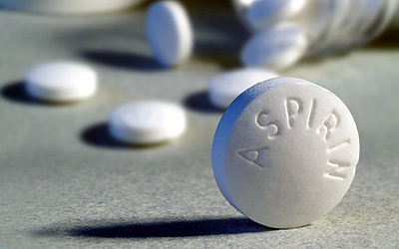
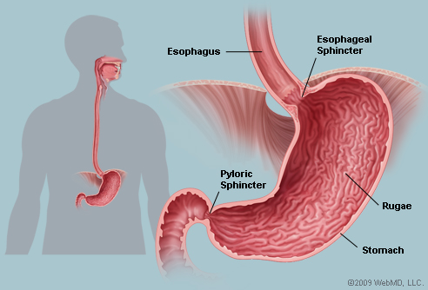
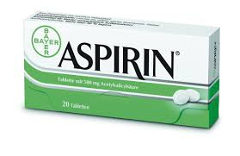
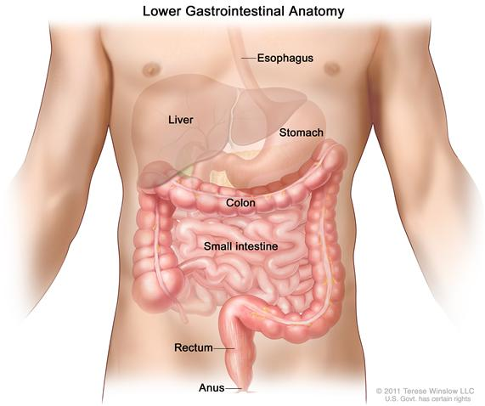
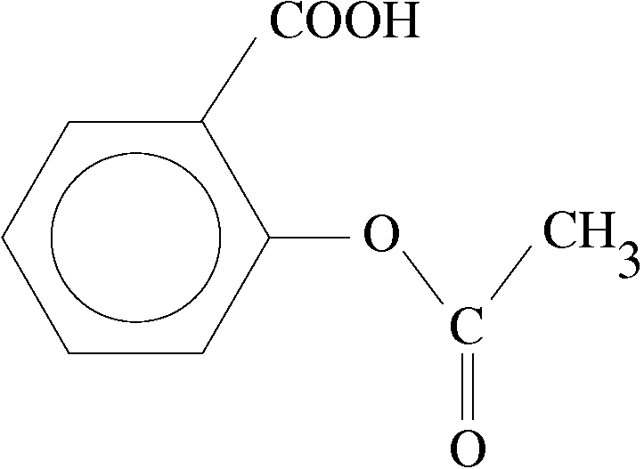
After aspirin tablets are swallowed, how do they reach the bloodstream?
Notes:
Have the students TPS. Surprisingly, students do not necessarily have a clear picture of what happens to a tablet once ingested
-Students may answer that the pill begins to dissolve in saliva
-Students may wonder about the stomach acid and whether this helps pill to dissolve
-Students will usually answer ‘it is absorbed in the stomach’
-Ask a follow-up question about which specific barriers must be crossed before the individual aspirin molecules arrive in the bloodstream

Slide 5
In which gastrointestinal compartment (stomach or intestine) is the majority of aspirin absorbed?
Notes:
Give students a moment to think but explain that you will come back to this question at the end of the class period

Slide 6
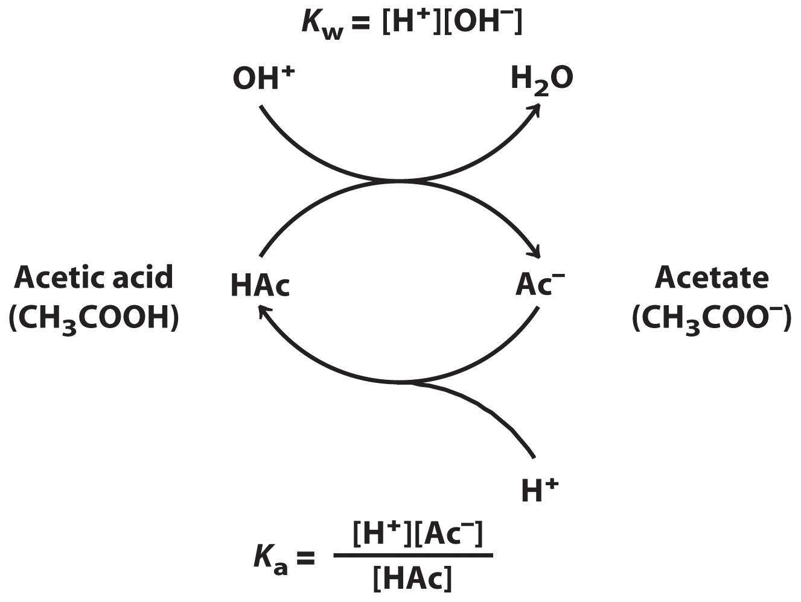
Ionization of Weak Acids….is far from complete
H+
⬅=========➔
(proton donor HA) (proton acceptor A-)
H+
Notes:
Explain that:
What is meant by ionization and that for weak acids the process is reversible. The rate of association is not equal to dissociation (the ratio for weak acids is not 1:1…far from it)

Slide 7
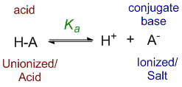
Ionization of Weak Acids….
How Do We Describe It?
  The acid dissociation constant K_{a} describes the extent of dissociation of a weak acid (HA→ H⁺ and A⁻)
  The higher an acid’s K_{a}, the lower its pK_{a}, and the greater its strength as an acid.
  -lower pK_{a}➔ more likely to donate a proton
  -higher pK_{a}➔ less likely to donate a proton
[A⁻]*[H⁺]
K_{a} =
[HA]
pKa = -log[K_{a}]
Notes:
Briefly review the definition of pKa and relationship to ionization. (Mention it is not dissimilar to [H+], and pH—both pH and pKa are –log of a value)
Relate pKa to tendency to donate a proton; “good” proton donors are relatively stronger acids

Slide 8
Clicker
When added to water, which of the following compounds raises the [H+]
(= lowers pH) the most?
  Compound A, pKa = 3.8
  Compound B, pKa = 5.5
  Compound C, pKa = 7.4
  Compound D, pKa = 9.2
Notes:
answer

Slide 9
Clicker
When added to water, which of the following compounds raises the [H+]
(= lowers pH) the most?
  Compound A, pKa = 3.8
  Compound B, pKa = 5.5
  Compound C, pKa = 7.4
  Compound D, pKa = 9.2
Notes:
Answer A

Slide 10
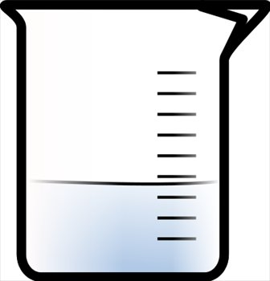
Ionization of Strong Acids
  A strong acid is likely to donate a proton…EVEN IF the surrounding [H⁺] is high!
When HCl is added
….what happens?
H⁺
H⁺
H⁺
H⁺
H⁺
H⁺
H⁺
H⁺
H⁺
H⁺
H⁺
Low pH solution
Notes:
The next goal is to lead students through the comparison of weak versus strong acids. Give students time to think. If answers are not immediately forthcoming, suggest TPS to get conversation going and to allow peers to help weaker students review.

Slide 11
Ionization of Strong Acids
  A strong acid is likely to donate a proton…EVEN IF the surrounding [H⁺] is high!
HCl → H⁺ + Cl⁻
The majority of molecules ionize
H⁺
H⁺
H⁺
H⁺
H⁺
H⁺
H⁺
H⁺
H⁺
H⁺
H⁺
Low pH solution

Slide 12
Surrounding pH Influences Weak Acid Ionization
  A weak acid is less likely to donate a proton…ESPECIALLY IF the surrounding [H⁺] is high!
When a weak acid HA is added,
…what happens?
H⁺
H⁺
H⁺
H⁺
H⁺
H⁺
H⁺
H⁺
H⁺
H⁺
H⁺
Low pH solution

Slide 13
Surrounding pH Influences Weak Acid Ionization
  A weak acid is less likely to donate a proton…ESPECIALLY IF the surrounding [H⁺] is high!
HA ← H⁺ + A⁻
The majority of molecules
do NOT ionize
H⁺
H⁺
H⁺
H⁺
H⁺
H⁺
H⁺
H⁺
H⁺
H⁺
H⁺
Low pH solution
Notes:
Students should be reminded that whether or not a weak acid ionizes is dependent upon the pH of the aqueous solution to which it is added. To gauge their knowledge and/or understanding between the relationship: pKa, pH, and ionization the following exercise should be conducted.

Slide 14
Think Pair Share Exercise
pH 5
pH 7
pH 9
H⁺
H⁺
H⁺
H⁺
H⁺
H⁺
H⁺
H⁺
H⁺
H⁺
H⁺
H⁺
H⁺
H⁺
H⁺
H⁺
H⁺
H⁺
H⁺
Each group will be given 6 red/pink post-it notes and 6 blue post-it notes and a handout representing one of the above beakers. The blue and red/pink stickers stand for a population weak of acid molecules (HA) with a pKa = 7.
The red/pink stickers represent unionized weak acid HA. The blue stickers represent ionized weak acid A⁻
Depending on the pH of the solution to which you are adding your weak acid molecule, determine which color of stickies to add to your beaker.
HA
A⁻
Notes:
One misconception this gets at...many students think of acids or bases as being one single molecule, instead of a POPULATION of hundreds of thousands or millions of molecules.

Slide 15
Draw on White Board or Elmo
pH = 5
pH = 7
pH = 9
H+
H+
H+
H+
H+
H+
H+
H+
H+
H+
H+
H+
H+
H+
H+
H+
H+
H+
H+
H+
H+
H+
H+
H+
H+
H+
H+
H+
H+
H+
H+
H+
H+
H+
H+
H+
H+
H+
H+
H+
H+
H+
H+
H+
H+
H+
H+
H+
H+
H+
H+
H+
H+
H+
H+
H+
H+
H+
H+
H+
H+
H+
H+
H+
H+
Notes:
The instructor will call upon 6 groups/individuals (2 from pH 5, 2 from pH 7 and 2 from pH 9) to come to the white board and place their stickies. Discuss the outcome. Those with pH 7 will be critical as this point is where pH=pKa. Introduce the idea that the pKa is the pH at which half the molecules have dissociated. HH equation will come in the next lecture.
IMPORTANT: mention that the number of H+s is NOT shown correctly for the given pH values. ASK...what actually are the concentrations of H+ in each of these solutions? (remind/review of definition of pH) (answer: pH 5 has a [H+] of 1 x 10-5 M, etc...)

Slide 16
Desired outcome
pH = 5
pH = 7
pH = 9
HA
H+
HA
H+
H+
H+
H+
A-
A-
A-
H+
HA
H+
HA
A-
H+
HA
H+
HA
H+
H+
HA
A-
A-
H+
A-
H+
H+
H+
H+
H+
H+
H+
H+
HA
HA
HA
H+
HA
A-
H+
H+
H+
H+
HA
A-
H+
H+
H+
H+
HA
A
A-
H+
H+
HA
H+
H+
HA
H+
A-
H+
H+
H+
H+
H+
H+
A-
H+
HA
HA
A-
A-
H+
H+
HA
H+
H+
A-
H+
H+
H+
H+
A-
H+
H+
A-
H+
H+
H+
H+
HA
H+
H+
H+
H+
HA
H+
H+
H+
H+
H+
H+
H+
A-
HA
H+
H+
A-
H+
H+
H+
H+
H+
H+
HA
H+
H+
H+
Notes:
Instructor follow up:
OK...good! If we were to count the HAs and A-. We would see that the number of HA and A- would be equal in the pH 7 solution...
This is based on a principle called the Henderson Hasslebalch equation, which you have read about, and we will have you working with during your homework. But for now, lets just make sure everyone gets this qualitatively
Next...Call and response
What if the pKa of the given weak acid, HA, was 9, rather than 7? (students should say that A- and HA, should be equal in pH 9 solution, and almost NO A- in the lower pH beakers)

Slide 17
Clicker
How easily do the following compounds lose their proton in an environment of pH 5 (from “easiest” to “hardest”)?
  a. Compound A, pKa = 3.8
  b. Compound B, pKa = 5.0
  c. Compound C, pKa = 7.4
  d. Compound D, pKa = 9.2
a-b-c-d
d-c-b-a
Notes:
Formative assessment of learning from previous activity, of what pKa indicates

Slide 18
Clicker
How easily do the following compounds lose their proton in an environment of pH 5 (from “easiest” to “hardest”)?
  a. Compound A, pKa = 3.8
  b. Compound B, pKa = 5.0
  c. Compound C, pKa = 7.4
  d. Compound D, pKa = 9.2
a-b-c-d
d-c-b-a
Notes:
Answer A
This could be extended...the next question could reinforce the idea from the last activity, if that is still a problem...ask which compound will have equal amounts of ionized and unionized molecules in the pH 5 solution. (Answer, compound B)

Slide 19
In which compartment is the majority of aspirin absorbed?
Notes:
Back to this question

Slide 20
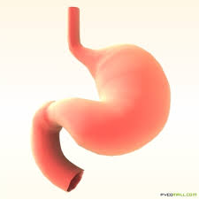
Think Pair Share 2 min
Which is the predominant form of Aspirin in the stomach (protonated or deprotonated)?
Stomach
pH = 1.5
Aspirin
pKa = 3.5
Small Intestine
pH = 6.5
Notes:
Answer: protonated, which means it is UNCHARGED, -COOH group is uncharged

Slide 21
Think Pair Share 2min
Which is the predominant form of Aspirin in the small intestine (protonated or deprotonated)?
Stomach
pH = 1.5
Aspirin
pKa = 3.5
Small Intestine
pH = 6.5
Notes:
Answer: deprotonated, which means it is NEGATIVELY CHARGED (ask students to draw structure..-COO- is the form of the acid group at a pH above its pKa)

Slide 22
Given that uncharged molecules are better able to cross membranes…
In which compartment is the majority of aspirin absorbed?
A. Stomach
pH = 1.5
Aspirin
pKa = 3.5
B. Small Intestine
pH = 6.5
Notes:
Answer. In the stomach, where it is protonated, which means it is UNCHARGED. This may need a titration curve on the board...

Slide 23
Questions?

