Slide 1
The Problem of Scale in Evolution
Jillian Banks, Jeremy Brown, Cindy Gordon, Chris Gregg, Travis Marsico, Chris Osovitz, Rebecca Symula
Evolution II – We Rule!!

Slide 2
Context
Designed for 100+ student, introductory-level course
Designed for the final day of a week long module on evolution
Prior knowledge
  Students will understand divergence from a common ancestor; i.e., they will have a tree-like rather than a ladder-like view of evolution
  Students will understand natural selection, population, variation, inheritance, genotype, and phenotype

Slide 3
Organizational scale
Natural selection
Organism phenotype
Protein phenotype
Genotype

Slide 4
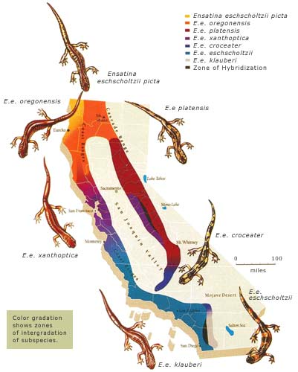
Spatial scale
rosarubicondior.blogspot.com

Slide 5
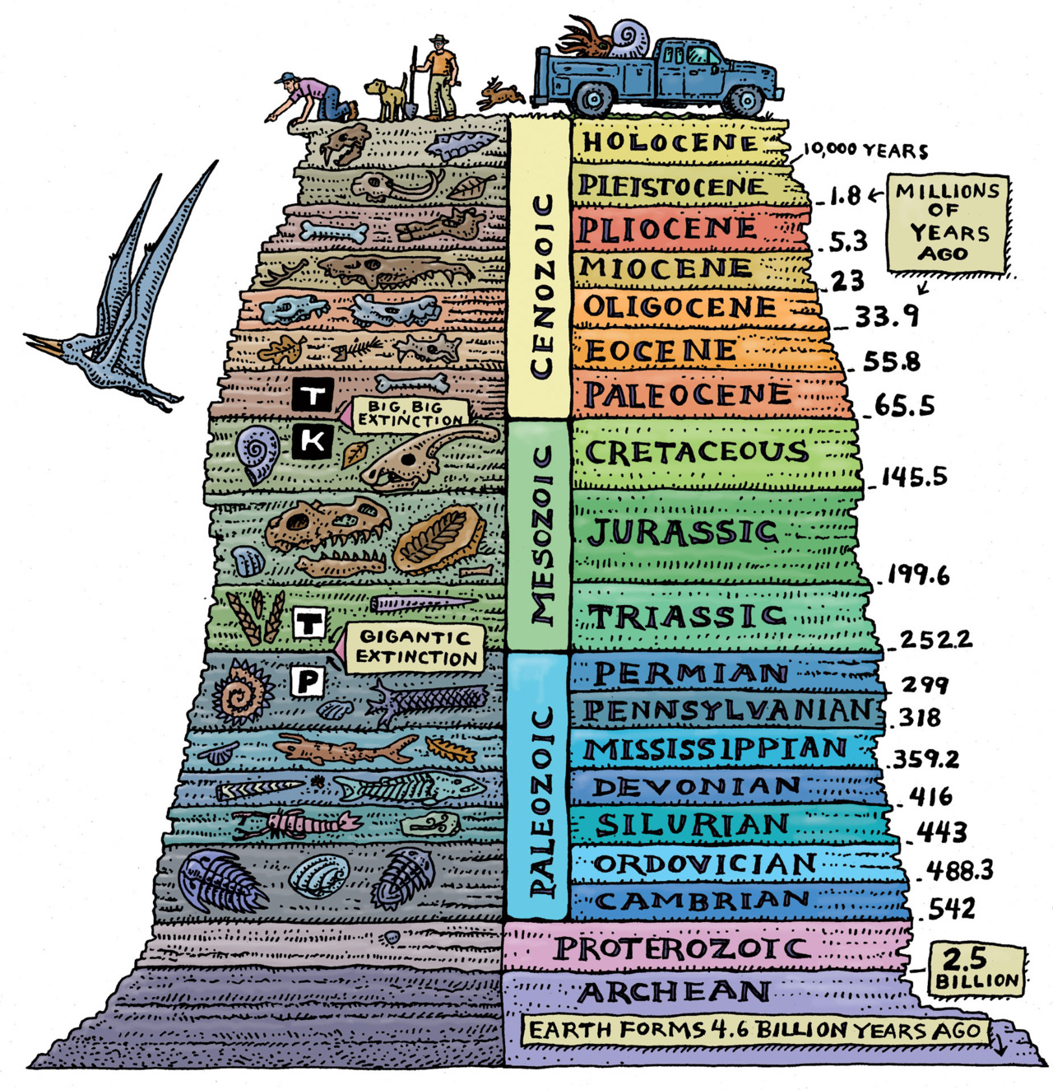
Time scale
earth-time.org

Slide 6
Approximately how long would you expect it to take for diverging populations to display morphological variation?
100 years
100,000 years
1,000,000 years
1,000,000,000 years
It varies
Response Counter

Slide 7
Activity
Pair up with another person
Rank your cards according to instructions provided (5 min)
‘A’ group pair with a ‘B’ group and compare:
  What you based your rankings on (morphology or time)
  The rankings themselves (2 min)
Flip your cards over, preserving the order of rankings. There is one correct sequence of colors which applies to both groups.
  Do your two groups match? Why or why not? Discuss! (3 min)

Slide 8
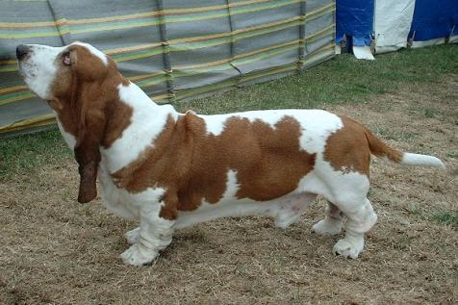
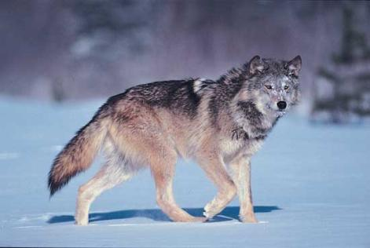
0.01 million years ago
commons.wikimedia.org
brittanica.com

Slide 9
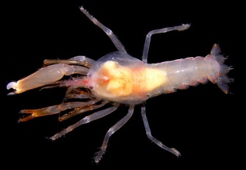
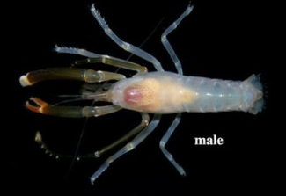
≥3 million years ago
flickriver.com
flickriver.com

Slide 10
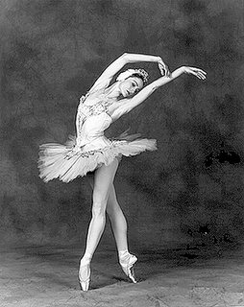
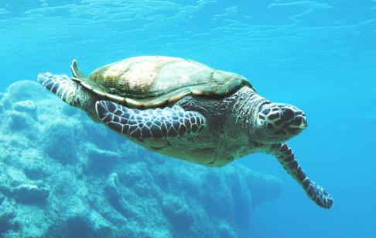
~300 million years ago
0000050603428.deviantart.com
cs.trinity.edu

Slide 11
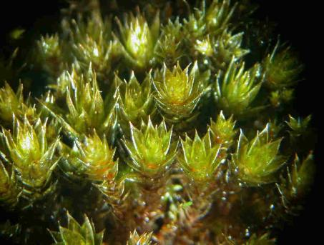
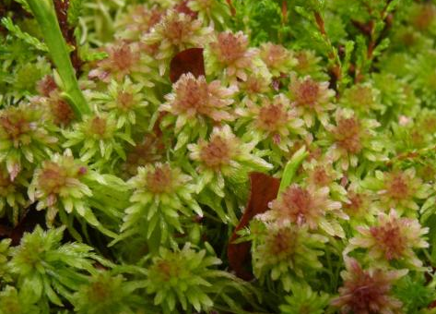
~375 million years ago
www.cisfbr.org.uk
commons.wikimedia.org

Slide 12
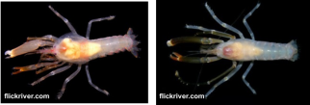
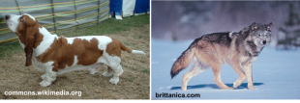



Sequence
Morphology
Time

Slide 13
Approximately how long would you expect it to take for diverging populations to display morphological variation?
100 years
100,000 years
1,000,000 years
1,000,000,000 years
It varies
Response Counter

Slide 14
Learning Outcome
Students will resolve the misconception that evolution occurs at a single time scale

