Slide 1
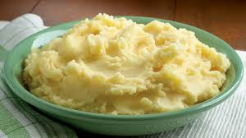
Mashed Potatoes
Dr. Vicky Gilpin

Slide 2
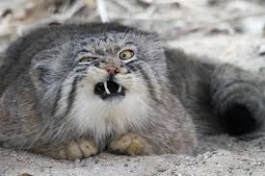
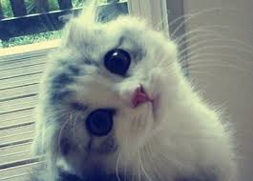
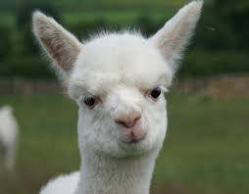
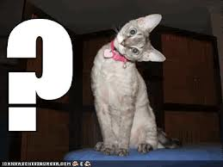
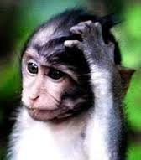
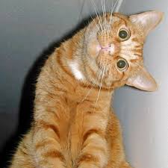
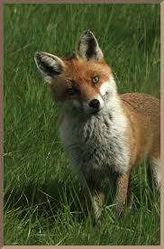
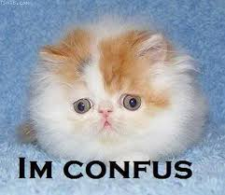
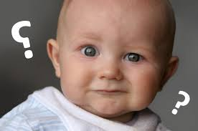
What were some people’s reactions?

Slide 3
Academic Objective of “mashed potatoes”
Differentiated instruction
Active learning
Engaged learning
To build the memories from which to create a lifetime metaphor
CCSS: “Use precise words and phrases, telling details, and sensory language to convey a vivid picture of the experiences…” and “determine the meaning of words and phrases, including figurative language…”
Also, to practice speaking/listening skills and use technology effectively

Slide 4
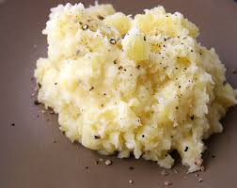
What is the experience of mashed potatoes?

Slide 5
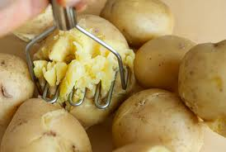
Keep mashed potatoes’ qualities in your brain

Slide 6
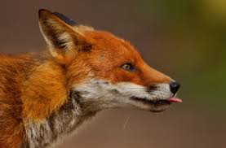
…and now, for a slight digression…

Slide 7

Young adulthood is a powerful time
Many groups, both with positive and negative aims, want to make use of young people:
  Cults
  Legitimate religious organizations
  Social activist groups
  Hate groups
  Nonprofit organizations
  Businesses
  Etc.

Slide 8
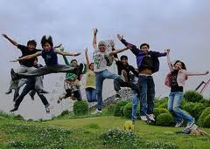
Lots of reasons exist for this
Young adults have
  Time
  Money (often)
  Energy
  Less restrictive schedules
  Tradition of listening to authority
  Etc.

Slide 9
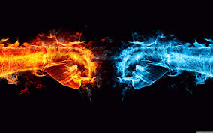
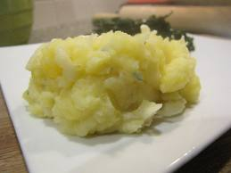
Which is easier to bend to another’s will?

Slide 10
The Metaphor:
A person without a goal, a passion, an ambition, an interest…
A person without direction, without aim, without passion…
Such a person is apathetic, malleable, programmable
Such a person IS mashed potatoes

Slide 11

You don’t have to take my word for it…

Slide 12
“Without ambition, one starts nothing. Without work, one finishes nothing. The prize will not be sent to you. You have to win it.” –Ralph Waldo Emerson
“Each of us is put here in this place and this time to personally decide the future of humankind. Did you think you were put here for something less?” –Chief Arvol Looking Horse

Slide 13
We are taught you must blame your father, your sisters, your brothers, the school the teachers---you can blame anyone, but never blame yourself. It’s never your fault. But it’s ALWAYS your fault, because if you wanted to change, you’re the one who has got to change. It’s as simple as that, isn’t it? --Katherine Hepburn

Slide 14
“Our deepest fear is not that we are inadequate. Our deepest fear is that we are powerful beyond measure. It is our light, not our darkness, that most frightens us. Your playing small does not serve the world….As we are liberated from our own fear, our presence automatically liberates others” from Marianne Williamson and quoted in Coach Carter

Slide 15
“The future is now. It’s time to grow up and be strong. Tomorrow may well be too late.” LaBute

Slide 16
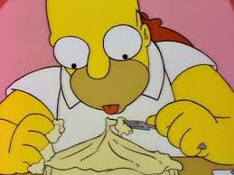
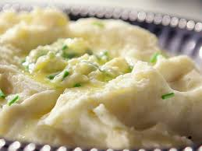

The point
DON’T BE MASHED POTATOES!!!

