Slide 1

Habitable solar systems?

Slide 2

Habitable worlds?

Slide 3

Habitable world?

Slide 4

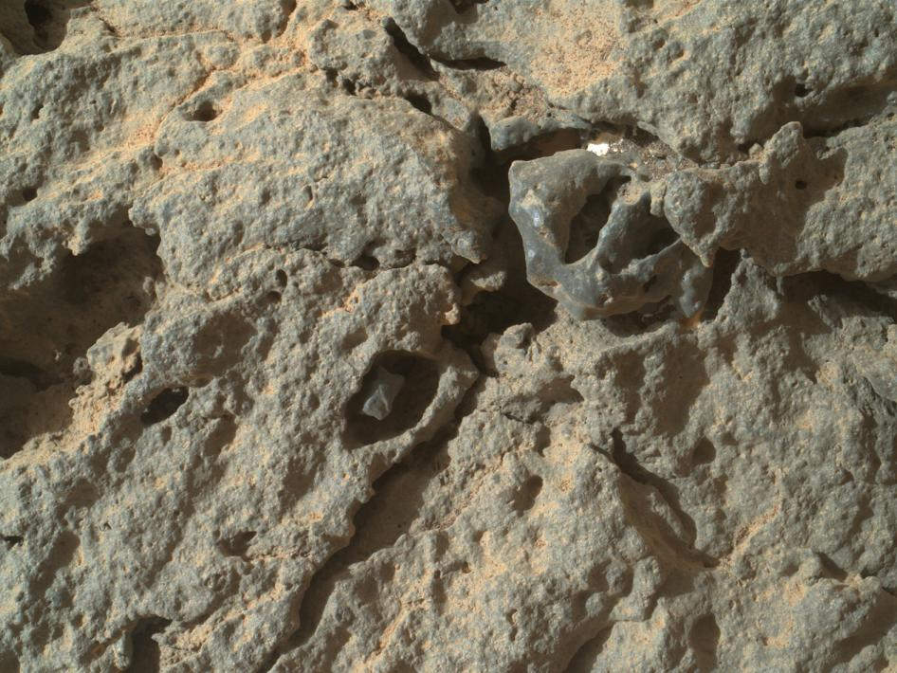
Habitable world?
Notes:
http://www.nasa.gov/mission_pages/msl/news/msl20130708.html#.UdxOUm3t6iQ
PASADENA, Calif. – With drives on July 4 and July 7, NASA's Mars rover Curiosity has departed its last science target in the "Glenelg" area and commenced a many-month overland journey to the base of the mission's main destination, Mount Sharp.
The rover finished close-up investigation of a target sedimentary outcrop called "Shaler" last week. On July 4, it drove 59 feet (18 meters) away from Shaler. On July 7, a second drive added another 131 feet (40 meters) on the trip toward a destination about 5 miles (8 kilometers) away, the entry to the lower layers of Mount Sharp.
Mount Sharp, in the middle of Gale Crater, exposes many layers where scientists anticipate finding evidence about how the ancient Martian environment changed and evolved. In the Glenelg area, where Curiosity worked for the first half of 2013, the rover found evidence for an ancient wet environment that had conditions favorable for microbial life. This means the mission already accomplished its main science objective.
NASA's Jet Propulsion Laboratory, a division of the California Institute of Technology, Pasadena, manages the Mars Science Laboratory Project for NASA's Science Mission Directorate, Washington. JPL designed and built the project's Curiosity rover.
More information about Curiosity is online at http://www.nasa.gov/msl and http://mars.jpl.nasa.gov/msl/ . You can follow the mission on Facebook at http://www.facebook.com/marscuriosity and on Twitter at http://www.twitter.com/marscuriosity
Lower right:
http://www.nasa.gov/mission_pages/msl/multimedia/pia17267.html#.UdxO723t6iQ
Close-Up Detail in 'Point Lake' Outcrop
The Mars Hand Lens Imager (MAHLI) on the arm of NASA's Mars rover Curiosity was positioned about 4 inches (10 centimeters) from the surface of the "Point Lake" outcrop when it took this image of a portion of the outcrop's steep face. This close-up view and others from MAHLI on the same Martian day - Sol 303 of the mission (June 13, 2013) - show that many holes in the rock are occupied by what appears to be material different from that of the main rock itself. Specifically, the material in the holes seems to be finer-grained, slightly darker, and slightly more resistant to weathering. In many instances, there is a moat of sorts between the more resistant interior material and the main Point Lake rock.
In this image, the larger hole containing a darker inclusion with a fleck of bright material in the moat is roughly 1 inch (2.5 centimeters) in diameter.
Curiosity's science team chose to approach Point Lake with the rover in June 2013 to get a closer look after earlier imaging of Point Lake (such as at http://photojournal.jpl.nasa.gov/catalog/PIA17071 ) left uncertainty about whether this outcrop is igneous or sedimentary.
A closer look still leaves room for interpretation. The material in the holes observed with MAHLI could be pebbles that blew into pre-existing holes, but it seems unlikely that the same type of pebble would blow into every hole. They might be pebbles that were part of the rock all along, as would be expected if Point Lake is sandstone with a few coarser pebbles (and therefore supporting the sedimentary interpretation). If Point Lake is igneous, the material in the holes might be individual, larger crystals within an otherwise finer-crystalline rock. Such crystals are called phenocrysts, and indicate that they got a head start on cooling before the rest of the rock was erupted onto the surface. Finally, the material in the holes could be secondary - having been deposited at a later time in pre-existing holes of the rock from percolating fluids or gases. This last scenario could fit either the sedimentary or igneous interpretation, without favoring one over the oth

Slide 5
(Our) Habitable World
The Supercool Group 6: Biology/Chemistry Interface
By: Khoa Nguyen, Michal Brylinski, Benjamin Maas, Kristy Stensaas, Suniti Karunatillake, Achim Herrmann, Wolfgang Kramer
Our Awesome Facilitators: Bill Wischusen and Anne Grove

Slide 6
Course Description:
-upper level class (juniors and seniors)
  -interdisciplinary, including the fields of biology,
  chemistry and geosciences
Prerequisites: Students have taken introductory biology, chemistry and geology
Length/time of unit: 2 week unit; early in the course

Slide 7
Learning goals:
-students will be able to analyze data and construct a
graph
-students will be able to understand the importance of evolutionary events on atmospheric oxygen content
Learning outcomes:
-given an event, students will be able to use the graph to predict the outcome
-students will be able to develop a response to
changes in an environmental condition
-students will understand the co-evolution of chemical
and biological systems on a geological timescale

Slide 8

Activity:
1. Divide into groups of six
2a. Describe each event to a partner
b. Assess potential effects on atmospheric O2 levels
c. Estimate O2 levels at each event
d. Plot estimates on the graph
Each group of 6 constructs a consensus graph and brings it to the front

Slide 9
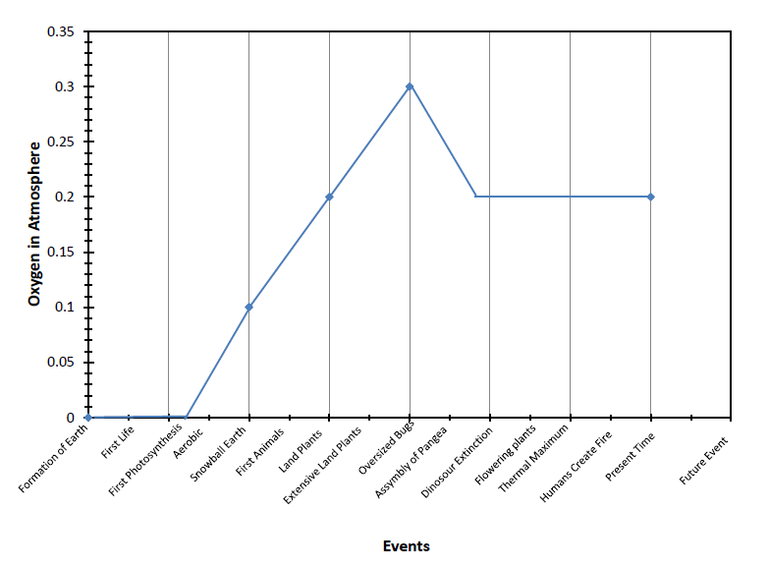

Slide 10

http://en.wikipedia.org/wiki/Geological_history_of_oxygen

Slide 11
If all the fossil fuels are burned, predict what would happen to the level of oxygen.
Increase
Decrease
Stay the same

Slide 12
If the ocean becomes supersaturated with CO2, predict what would happen to the level of oxygen.
Increase
Decrease
Stay the same

Slide 13
If all rainforests are destroyed, predict what would happen to the level of oxygen.
Increase
Decrease
Stay the same

Slide 14
Assuming a biosphere of only plants, predict what would happen to the level of oxygen.
Increase
Decrease
Stay the same

