Slide 1
DISCUSSION GROUPS
OEB 119: Deep Sea Biology
How to read and analyze a scientific paper
Kiana Frank

Slide 2
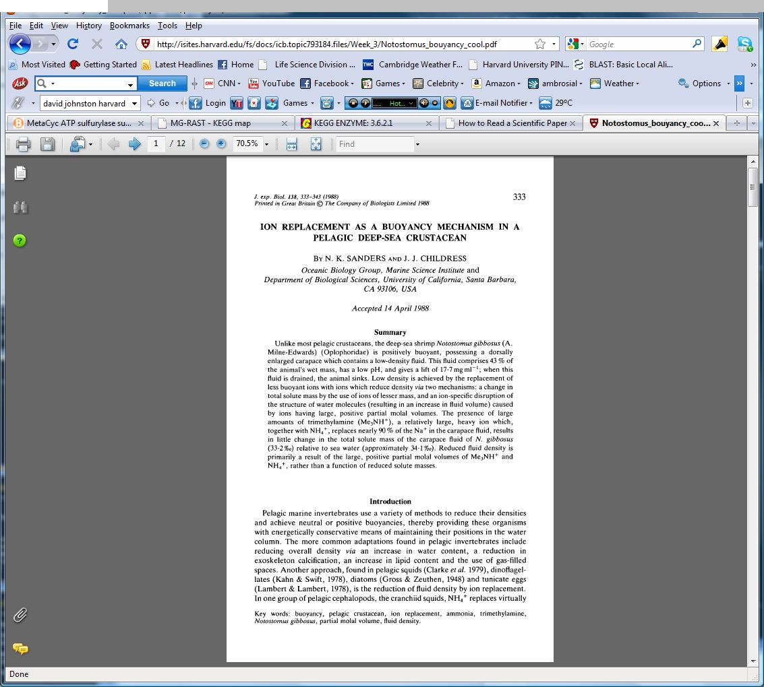
Organization of a Paper
Abstract
  Describes concisely the major findings of the paper
Introductions
  Background Knowledge necessary for understanding findings
  Hypothesis and Questions
  Purpose
Materials and Methods
Notes:
A paper begins with a short Summary or Abstract. Generally, it gives a brief background to the topic; describes concisely the major findings of the paper; and relates these findings to the field of study. As will be seen, this logical order is also that of the paper as a whole.
The next section of the paper is the Introduction. In many journals this section is not given a title. As its name implies, this section presents the background knowledge necessary for the reader to understand why the findings of the paper are an advance on the knowledge in the field. Typically, the Introduction describes first the accepted state of knowledge in a specialized field; then it focuses more specifically on a particular aspect, usually describing a finding or set of findings that led directly to the work described in the paper. If the authors are testing a hypothesis, the source of that hypothesis is spelled out, findings are given with which it is consistent, and one or more predictions are given. In many papers, one or several major conclusions of the paper are presented at the end of this section, so that the reader knows the major answers to the questions just posed. Papers more descriptive or comparative in nature may begin with an introduction to an area which interests the authors, or the need for a broader database.
The next section of most papers is the Materials and Methods. In some journals this section is the last one. Its purpose is to describe the materials used in the experiments and the methods by which the experiments were carried out. In principle, this description should be detailed enough to allow other researchers to replicate the work. In practice, these descriptions are often highly compressed, and they often refer back to previous papers by the authors.
The third section is usually Results. This section describes the experiments and the reasons they were done. Generally, the logic of the Results section follows directly from that of the Introduction. That is, the Introduction poses the questions addressed in the early part of Results. Beyond this point, the organization of Results differs from one paper to another. In some papers, the results are presented without extensive discussion, which is reserved for the following section. This is appropriate when the data in the early parts do not need to be interpreted extensively to understand why the later experiments were done. In other papers, results are given, and then they are interpreted, perhaps taken together with other findings not in the paper, so as to give the logical basis for later experiments.
The fourth section is the Discussion. This section serves several purposes. First, the data in the paper are interpreted; that is, they are analyzed to show what the authors believe the data show. Any limitations to the interpretations should be acknowledged, and fact should clearly be separated from speculation. Second, the findings of the paper are related to other findings in the field. This serves to show how the findings contribute to knowledge, or correct the errors of previous work. As stated, some of these logical arguments are often found in the Results when it is necessary to clarify why later experiments were carried out. Although you might argue that in this case the discussion material should be presented in the Introduction, more often you cannot grasp its significance until the first part of Results is given.

Slide 3
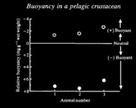
Organization cont..
Results
  Describes the experiments and why they were done
Discussion
  Data is interpreted
  Any limitations to the interpretation are acknowledged
  Findings of the paper are related to other findings in the field

Slide 4
Reading a Scientific Paper
Read the Abstract first
Note the Authors and the DATE
Look up words/concept/theory described in the introduction that you don’t understand
Read the Materials/Methods (its often easy to skip this section… but very important!!)
Reference the supplemental material if any

Slide 5
Evaluating a Paper
What questions does the paper address?
What are the main conclusions of the paper?
What evidence supports those conclusions?
Do the data actually support the conclusions?
What is the quality of the evidence?
Why are the conclusions important

Slide 6
What questions does the paper address?
Type of Research | Question Asked
DESCRIPTIVE | What is there? What do we see?
COMPARATIVE | How does it compare to other organisms? Are our findings general?
ANALYTICAL | How does it work? What is the mechanism?
Notes:
Descriptive research often takes place in the early stages of our understanding of a system. We can't formulate hypotheses about how a system works, or what its interconnections are, until we know what is there. Typical descriptive approaches in molecular biology are DNA sequencing and DNA microarray approaches. In biochemistry, one could regard x-ray crystallography as a descriptive endeavor.
Comparative research often takes place when we are asking how general a finding is. Is it specific to my particular organism, or is it broadly applicable? A typical comparative approach would be comparing the sequence of a gene from one organism with that from the other organisms in which that gene is found. One example of this is the observation that the actin genes from humans and budding yeast are 89% identical and 96% similar.
Analytical research generally takes place when we know enough to begin formulating hypotheses about how a system works, about how the parts are interconnected, and what the causal connections are. A typical analytical approach would be to devise two (or more) alternative hypotheses about how a system operates. These hypotheses would all be consistent with current knowledge about the system. Ideally, the approach would devise a set of experiments todistinguish among these hypotheses. A classic example is the Meselson-Stahl experiment.
Of course, many papers are a combination of these approaches. For instance, researchers might sequence a gene from their model organism; compare its sequence to homologous genes from other organisms; use this comparison to devise a hypothesis for the function of the gene product; and test this hypothesis by making a site-directed change in the gene and asking how that affects the phenotype of the organism and/or the biochemical function of the gene product.
Being aware that not all papers have the same approach can orient you towards recognizing the major questions that a paper addresses.

Slide 7
What are the main conclusions of the Paper?
Highlighted in the abstract
Expanded upon in the discussion

Slide 8
What evidence supports those conclusions?
Results
How many lines of evidence?
Notes:
Generally, you can get a pretty good idea about this from the Results section. The description of the findings points to the relevant tables and figures. This is easiest when there is one primary experiment to support a point. However, it is often the case that several different experiments or approaches combine to support a particular conclusion. For example, the first experiment might have several possible interpretations, and the later ones are designed to distinguish among these.
In the ideal case, the Discussion begins with a section of the form "Three lines of evidence provide support for the conclusion that... First, ...Second,... etc." However, difficulties can arise when the paper is poorly written (see above). The authors often do not present a concise summary of this type, leaving you to make it yourself. A skeptic might argue that in such cases the logical structure of the argument is weak and is omitted on purpose! In any case, you need to be sure that you understand the relationship between the data and the conclusions.

Slide 9
Do the data actually support the conclusions?
This helps evaluate whether the conclusion is sound
  Do the authors take multiple approaches to answering a question?
    Do they have multiple lines of evidence, from different directions, supporting their conclusions?
Are there implicit or hidden assumptions used by the authors in interpreting their data?

Slide 10
What is the quality of the evidence?
What are the limitations of the Methods
Distinguish between what the data show and what the authors say they show
Are the proper controls present?
Notes:
This is the hardest question to answer, for novices and experts alike. At the same time, it is one of the most important skills to learn as a young scientist. It involves a major reorientation from being a relatively passive consumer of information and ideas to an active producer and critical evaluator of them. This is not easy and takes years to master. Beginning scientists often wonder, "Who am I to question these authorities? After all the paper was published in a top journal, so the authors must have a high standing, and the work must have received a critical review by experts." Unfortunately, that's not always the case. In any case, developing your ability to evaluate evidence is one of the hardest and most important aspects of learning to be a critical scientist and reader.
How can you evaluate the evidence?
First, you need to understand thoroughly the methods used in the experiments. Often these are described poorly or not at all (see above). The details are often missing, but more importantly the authors usually assume that the reader has a general knowledge of common methods in the field (such as immunoblotting, cloning, genetic methods, or DNase I footprinting). If you lack this knowledge, as discussed above you have to make the extra effort to inform yourself about the basic methodology before you can evaluate the data.
Sometimes you have to trace back the details of the methods if they are important. The increasing availability of journals on the Web has made this easier by obviating the need to find a hard-copy issue, e.g. in the library. A comprehensive listing of journals relevant to this course, developed by the Science Library, allows access to most of the listed volumes from any computer at the University; a second list at the Arizona Health Sciences Library includes some other journals, again from University computers.
Second, you need to know the limitations of the methodology. Every method has limitations, and if the experiments are not done correctly they can't be interpreted.
For instance, an immunoblot is not a very quantitative method. Moreover, in a certain range of protein the signal increases (that is, the signal is at least roughly "linear"), but above a certain amount of protein the signal no longer increases. Therefore, to use this method correctly one needs a standard curve that shows that the experimental lanes are in a linear range. Often, the authors will not show this standard curve, but they should state that such curves were done. If you don't see such an assertion, it could of course result from bad writing, but it might also not have been done. If it wasn't done, a dark band might mean "there is this much protein or an indefinite amount more". Third, importantly, you need to distinguish between what the data show and what the authors say they show. The latter is really an interpretation on the authors' part, though it is generally not stated to be an interpretation. Papers usually state something like "the data in Fig. x show that ...". This is the authors' interpretation of the data. Do you interpret it the same way? You need to look carefully at the data to ensure that they really do show what the authors say they do. You can only do this effectively if you understand the methods and their limitations.
Fourth, it is often helpful to look at the original journal, or its electronic counterpart, instead of a photocopy. Particularly for half-tone figures such as photos of gels or autoradiograms, the contrast is distorted, usually increased, by photocopying, so that the data are misrepresented.
Fifth, you should ask if the proper controls are present. Controls tell us that nature is behaving the way we expect it to under the conditions of the experiment (see here for more details). If the controls are missing, it is harder to be confident that the results really show what is happening in the experiment. You should try to develop the habit of asking "where are the controls?" and looking for them.

Slide 11
Why are the conclusions important?
Do the conclusions make a significant advance in our knowledge?
Do they lead to new insights, or even new research directions?

Slide 12
Weekly assignment:
Each week you will need to submit the following to the course to the Discussion Forum by 10pm the night before the discussion.
In one sentence summarize the main finding of the paper. What is the take-away message?
What is one question you had from the paper? This can be something you did not understand, or something you would like to know more about.

Slide 13
Discussion leader –
  You facilitate the discussion
  Summarize the paper
  Discuss relevance to “Real World”
  Explain Connection to Lecture
  HW: Summarize and evaluate the discussion as a whole.

Slide 14
Background Presenter
Summarize relevant background information
What information was available before?
What assumptions do the authors make?
What are the scientific questions addressed by the authors?
What are their hypotheses?
HW – 1 page response (see options)

Slide 15
Methods Presenter
Summarize the methods used in the study
What did they do?
Should be able to clarify or explain any techniques or terminology that might not be familiar to everyone.
HW – 1 page response (see options)

Slide 16
Results/Conclusions Presenter
Summarize the findings of the study
What did they discover?
Should be able to explain all graphs or figures.
HW – 1 page response (see options)

Slide 17
Response Topics: (for the presenting team only)
Choose one of the following options to write on. Responses must be no more than 1 page, 12 point font. Papers are due the class following the discussion to the TF’s.
How is this study relevant to the real world? (Why does it matter?)
What are the shortcomings of this study?
How is this study connected to material covered in class?
Design a follow up experiment.
You are going to your younger sibling’s middle or high school class to talk about the work carried out in this paper. Explain the major findings and why it matters in a captivating and clear way that they would understand and enjoy.
Write a short story, poem, or song lyrics that reference, explain, or include the relevant issues, topics, or methods of this study.

Slide 18
Evaluation:
Attendance
Active participation in paper discussions
Timely submission of pre-discussion questions and post-discussion reponses
Quality of written questions and responses
Team discussion leading

Slide 19
Divide into Groups: Mothra/ Endevor

Slide 20
Each Group: make 4 teams
Mothra: teams #1-4; Endeavour: teams #5-8
Designate A, B, C, D person
  If 3 people – 1 person does 2 roles
  If 5 people – 2 people share 1 role
If you are not taking the class for credit see TFs - you must join a group, but not necessarily a team
Write your name on the appropriate index card and return to TF’s

Slide 21
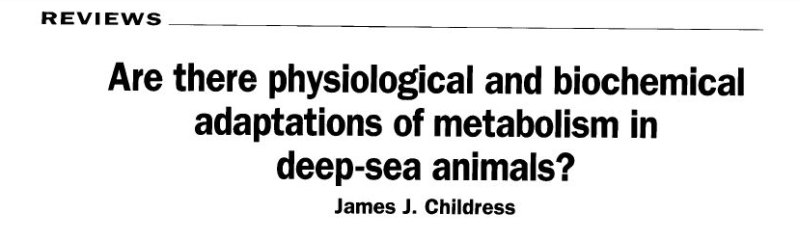
Next Monday Disscusion
Childress 1995; Sanders and Childress 1998

