Slide 1
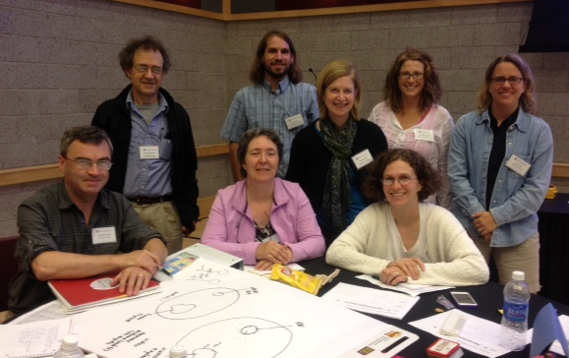
Group 1: Cell and Development A
Participants:
Kostia Bergman, Erin Cram, Wendy Smith (Northeastern)
Scott Dobrin, Rachael Hannah, Judith Roe (University of Maine, Presque Isle)
Facilitators:
Tamara Brenner
(Harvard University)
Maurice Kernan
(Stony Brook University)
Notes:
For this tidbit, we have white and black slides. White slides are information for the instructor, and black slides are intended for the students, but feel free to mix and match for your class.

Slide 2
Context
Unit for an intermediate Cell Biology course
Placed near the start of the course as a springboard for further learning
Students will be expected to know or review:
  Basic parts of the cell including plasma membrane, cytoskeletal proteins, major organelles including transport vesicles
  Tools for studying cells
  Requirement of energy for cellular processes
Students will have had previous experience reading primary literature
Notes:
To set the stage, we have designed this teachable tidbit for use in an intermediate level Cell Bio course. We envision it being used in the first few weeks of the course. Students will already have reviewed the basic components of the cell and should have a working knowledge of the various requirements of energy in cellular processes. Students will also have been introduced to common methods to study cells, at the level of material often provided at the start in Cell Biology texts. The tidbit activity will introduce concepts which will be explored in greater depth later in the course.

Slide 3
Learning Goals for the Unit
Students will understand:
Tissues are composed of specialized cells
Structures and functions of cells within tissues are interrelated
Cellular specialization depends upon adjacent cells and matrix
Maintenance of cellular structure involves dynamic processes
Notes:
Emphasize that dynamic change, including turnover of multiple cellular components, keeps cells healthy - even apparently “static” (non-dividing, non-motile) cells
Here are the 4 Learning Goals of this unit. The 4th goal is where this tidbit will be used. It is to understand that the maintenance of cellular structure involves dynamic processes.
The most important thing is not that your unit has all of these goals – this tidbit could work in a variety of different contexts including intro bio, A+P, etc.

Slide 4
Learning Objectives
Students will be able to:
4a. Compare cells and buildings with regard to processes required for maintenance and repair
4b. Identify at least 2 dynamic processes required to maintain and repair non-motile, non-dividing cells
4c. Design an experiment to visualize dynamic maintenance processes in cells
Notes:
To help reach this goal, the tidbit will help students achieve the listed objectives.

Slide 5
Assessment
Formative assessments, of increasingly higher-order:
  Pair brainstorming
  Jigsaw pair-shares
  1-minute paper
  Homework
Summative assessment
  Homework could be graded
  Creation of exam question similar to homework that interprets a dynamic cell process shown in a primary literature paper
  Creation of take home exam question that students must design a series of experiments to test hypotheses related to unit

Slide 6
Inclusive Teaching
Students bring diverse perspectives to the concept of building maintenance and repair
Activities accommodate multiple learning styles
Activities promote participation by different personality types
Minimal cost

Slide 7
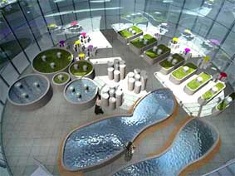
Static is Dynamic
Notes:
Note on the photo:
Sloan Kulper designed this building in the shape of a cell for the Institute for Nanobiomedical Technology and Membrane Biology in Chengdu China.
http://archinect.com/news/article/42013/two-from-mit-conceive-cell-shaped-building
Don’t dwell on the photo, unless you want to bring it back later. Could sub in your own relevant photo.

Slide 8
Cells vs. Buildings maintenance and repair
Partner Brainstorm
Pair up by color
Yellow: cells
OR
  Blue: this building
List or sketch dynamic processes needed to maintain non-motile cells or buildings
  Make sure each person has a list or sketch to take with them for the next step!
Notes:
You can split this up however you want, but we put yellow or blue post-its at each place before class.
Script: The goal of class today is to compare what needs to occur in a building maintain it with the processes that occur in a cellular to keep it alive and functional.
1) Students please find the post-it note at your place. Pair up with a student with the SAME COLOR of post it note.
Yellow post-it pairs are the “Cells”
Blue post-it pairs are the “Buildings”
YELLOW (Cell pairs) list or draw all the things that need to happen to keep a non-motile (could say non-moving), non-dividing cells functioning and well-maintained.
BLUE (Building pairs) list or draw all the things that need to happen to keep THIS BUILDING functioning and well-maintained.
You have 4 minutes. Be sure each person makes his or her OWN LIST because you will take it with you in the next activity.

Slide 9
Cells vs. Buildings maintenance and repair
Jigsaw Pair-Share
Find a partner of the opposite color (Cell x Building)
Share your drawing or list with your new partner
Compile one shared cellular maintenance and repair list, inspired by discussion
Report to the class one dynamic process needed for cellular maintenance or repair
Notes:
Script: Now if you are a cell person, find a building person, and if you are a building person find a cell person. Your goal is identify dynamic processes needed to maintain a cell. Be INSPIRED by the dynamic processes in a building to complement your “dynamic processes in the cell” list. Be ready to report your favorite dynamic process to the class.
You have 3 minutes for this activity. (could expand to longer if desired)

Slide 10
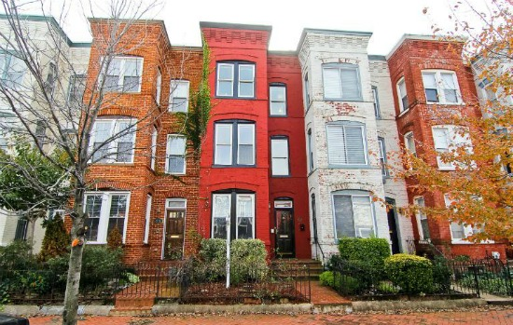
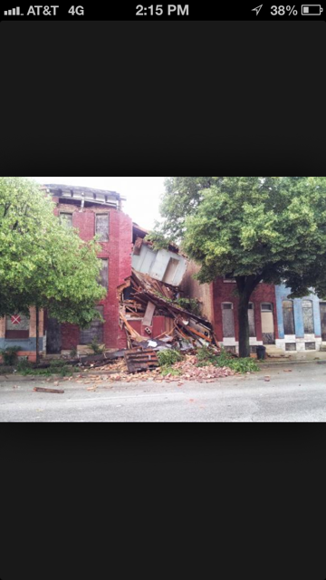
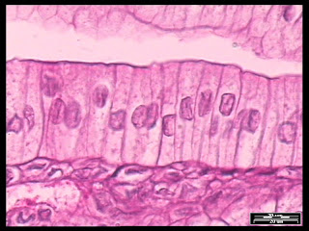
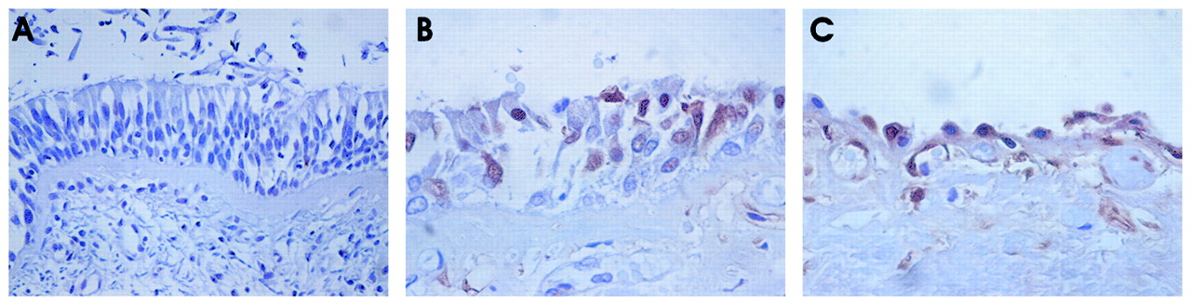
Notes:
Say as you point to the pictures something like: The goal of this exercise was to IDENTIFY DYNAMIC CELL PROCESSES THAT KEEP WELL-MAINTAINED buildings and cells here from looking like these over here. (Optional: point out how these pictures show cells/ buildings are not isolated from each other and what happens can affect neighbors).
What kind of dynamic processes occur in cells? (After each response, ask them what the parallel is in a building that can help them remember the cell function). Call on each group and write up ideas from the groups on the board/white board.
(If you use our example on slide 10, make sure to probe the students to come up with membrane or vesicle transport).
Some analogies our groups came up with
Waste removal (toilets or trash removal) : autophagy, lysosomal degradation
Energy/physical plant: mitochondria
Scaffolding: cytoskeleton
Windows and doors: Gas exchange
Communications/WiFi systems: Signal transduction
Maintenace of Roof, walls: rebuilding plasma membranes
Central control: nuclear processes like transcription
Deliveries of packages: endocytosis and exocytosis
Electrical systems: maintenance of membrane polarity

Slide 11
1-Minute Paper: Cells
Write a 1 minute paper articulating the strongest analogy between dynamic processes in cells and buildings, and your reasons for choosing it.
Hand in paper at the end of class.
Notes:
Now individually, take 1 minute to write the single strongest aspect of this analogy. You will turn these in at the end of class. (1 min)
Optional: collect the papers and then have the class report on their chosen analogy.
TRANSITION: Circle the membrane renewal / vesicle transport on your white paper.

Slide 12
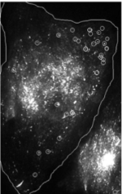

Vesicle trafficking: a dynamic cell process
This cell is expressing a GFP-tagged membrane protein
This allows us to watch vesicles moving to the cell membrane and delivering their cargo of lipids and proteins.
vesicles
Modified from: Kreitzer et al., 2003. Three-dimensional analysis of post-Golgi carrier exocytosis in epithelial cells. Nature Cell Biology 5: 126-136.
membrane
Notes:
One of the dynamic processes you just identified (point to it) is vesicle trafficking/replacement of membrane. This image is one frame of a movie showing GFP-tagged vesicles moving to the plasma membrane in an epithelial cell. The GFP tag is on a membrane protein, the LDL receptor. As the vesicles fuse with the membrane, lipids and proteins are replaced. This image is part of figure 1. You will analyze all of figure one for tomorrow’s class. NEXT SLIDE
Optional: you could have the students tell you what they see in the picture. The idea here is to set up the homework, where the students will be analyzing THIS FIGURE.
Depending upon the level of the class, the homework itself is optional
Kreitzer et al., 2003. Three-dimensional analysis of post-Golgi carrier exocytosis in epithelial cells. Nature Cell Biology 5: 126-136. DOI: 10.1038/ncb917
The photo is of Geri Kreitzer, who is now an Associate Professor at Cornell. We show the scientist to help students make a personal connection.

Slide 13
Investigate Dynamic Cell Processes
Homework – On Your Own (OYO)
Read the assigned paper investigating a dynamic cellular process, focusing on Figure 1.
Write a 1-page synopsis of Figure 1 which includes the following: hypothesis, methods, controls, variables, results, conclusion.
Outline an experiment using a GFP-labeled protein to study a different process identified by the class.
Bring typed 1 page synopsis and outline to next class.
Notes:
Ask: What protein will you label? What process will it be used to study? As homework, we will read a paper that I put on blackboard. I want you to read the whole paper, but focus on figure 1. Write a 1 page synopsis of the figure. Be sure to include the hypothesis, methods, controls, variables, results, and any conclusions. Then I want you to outline an experiment using a GFP-labeled protein to study a different process identified by the class today.
Homework could be optional (or you could drop part 3), and can be adapted according to level of students and your learning goals.

