Slide 1

Financial Accounting
Mission Four
February 18, 2016
Agenda
Mission Three recap
Mission Four slides
Problems
In the news

Slide 2
Chart of Accounts
Assets | Liabilities | Stockholders' Equity
Current assets | Current liabilities | Capital by owners
Cash and Cash Equivalents | Accounts Payable | Common Stock
Accounts Receivables | Salaries and Wages Payable | Additional Paid-In Capital
Inventory | Utility Expense Payable
Prepaid Expenses | Unearned Revenue
 | Dividends Payable
 |  | Retained earnings
Non-current assets | Non-current liabilities | Net Income Dividends
Land | Notes Payable
Property, Plant and Equipment (net of accumulated depreciation) | Long-Term Bonds
Goodwill | Deferred Tax Liabilities
Revenues | Expenses
Sales Revenue | Cost of Goods Sold
Turnover | Wages and Salary Expense
 | Rent Expense

Slide 3
Trial Balance
Trial Balance
Assets:
Cash and Cash Equivalents
Property, Plant and Equipment – gross
(Accumulated Depreciation)
Property, Plant and Equipment – net of accumulated depreciation
Goodwill
Liabilities:
Unearned Revenue
Notes Payable
Stockholder's Equity:
Common Stock
Retained Earnings
Revenues:
Sales Revenue
Expenses:
Wages & Salary Expense
Cost of Goods Sold
Depreciation Expense
Goodwill Impairment Expense

Slide 4

Walt Disney Company

Slide 5
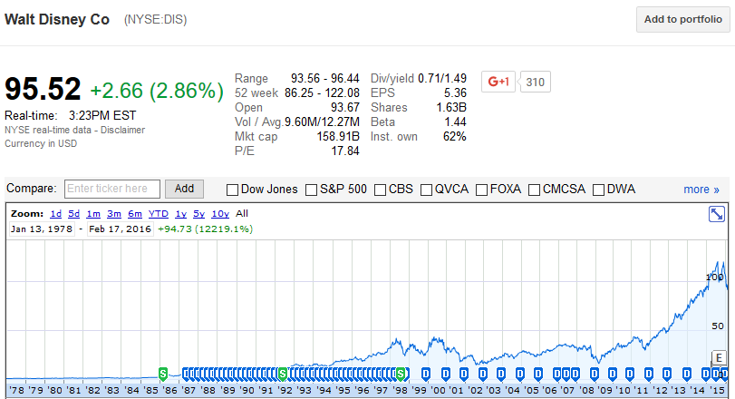
Walt Disney Company – Stock Chart

Slide 6
Disney’s Balance Sheet
Assets = Liabilities + Stockholders’ Equity
$88B = $40B + $48B .

Slide 7
Recording Goodwill
Date | Journal Entry | Debits | Credits
01/31/2016 | Property, plant and Equipment (+A) | $40 million
 | Goodwill (+A) | $60 million
 | Cash (-A) |  | $100 million
Goodwill Impairment
Date | Journal Entry | Debits | Credits
12/31/2016 | Goodwill impairment expense (+E, -SE) | $10 million
 | Goodwill (-A) |  | $10 million

Slide 8
Recording Depreciation
Date | Journal Entry | Debits | Credits
12/31/2016 | Depreciation Expense (+E, -SE) | $ 100,000
 | Accumulated Depreciation (+XA, -A) |  | $ 100,000

Slide 9
Working Capital
Walt Disney Company ($ in millions) | Oct. 03, 2015 | Sep. 27, 2014
Total current assets | $16,758 | $15,169
Total current liabilities | $16,334 | $13,292
Working capital | $424 | $1,877

Slide 10
Proper Format
At a point in time
Units
Accounting equation

Slide 11
Leverage Ratios
Debt to Equity
Debt to Assets
Long-Term Debt to Assets
Equity to Assets
Current Ratio
Quick Ratio
Liquidity Ratios

Slide 12
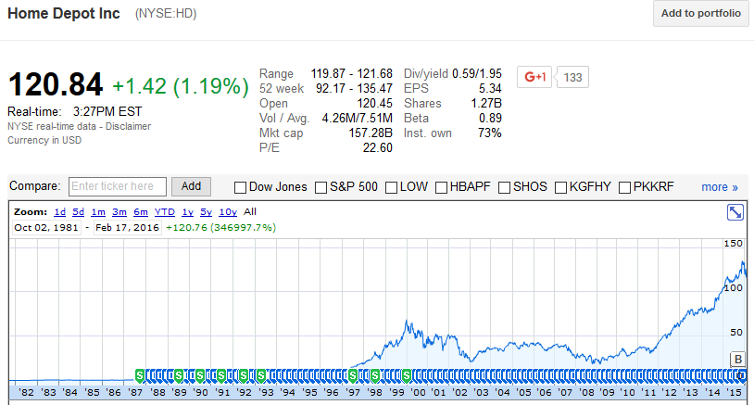
Home Depot – Stock Chart

Slide 13
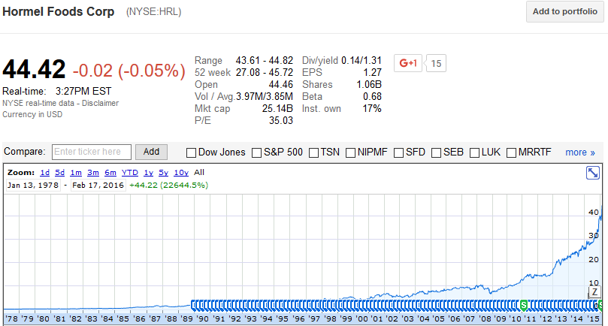
Hormel Foods – Stock Chart

Slide 14
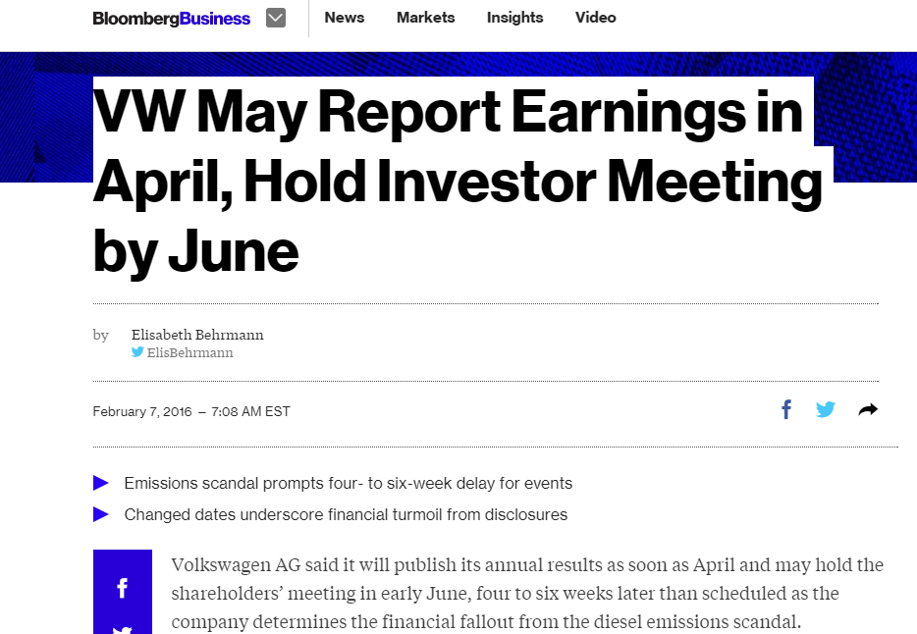
http://www.bloomberg.com/news/articles/2016-02-07/volkswagen-may-report-earnings-in-april-hold-agm-in-early-june

Slide 15
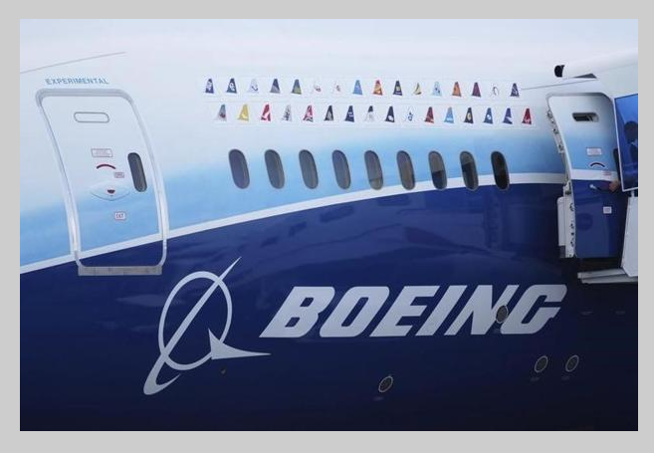
Boeing to Face SEC Probe for its Dreamliner and 747 Accounting
http://www.bloomberg.com/news/articles/2016-02-11/boeing-said-to-face-sec-probe-into-dreamliner-and-747-accounting

