Slide 1

Financial Accounting
Mission Five
February 25, 2016
Agenda
Mission Four recap
Quiz One recap
Mission Five slides
Problems
In the news

Slide 2

Nestlé

Slide 3
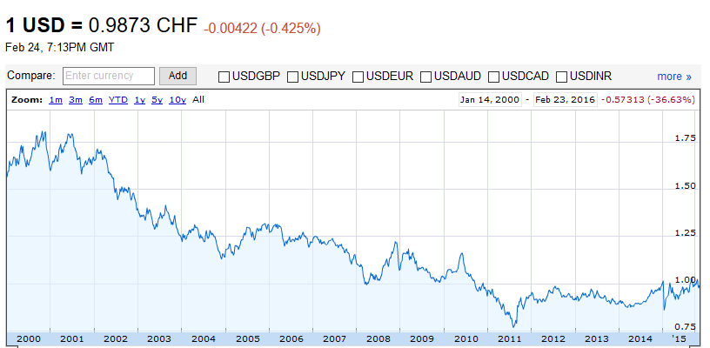
U.S. Dollar vs. Swiss Franc

Slide 4
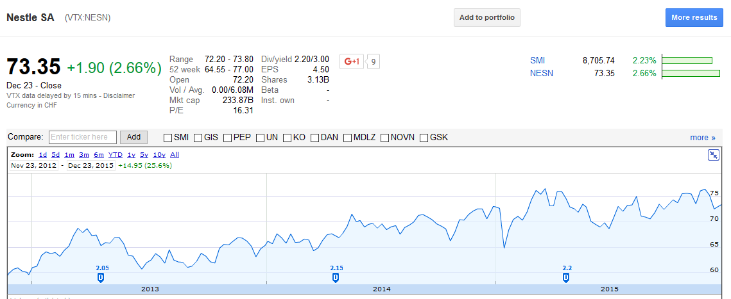
Nestlé Stock Chart

Slide 5
Nestlé’s Net Sales Breakdown by Region

Slide 6
Nestlé’s Income Statement
Metric | 2014 (in millions CHF)
Total revenues | 91,865 | 100.0%
Cost of goods sold | -47,553 | -51.8%
Gross profit | 44,312 | 48.2%
Total operating expenses | -33,407 | -36.4%
Operating income | 10,905 | 11.9%
Financial income (expense) | -637 | -0.7%
Profit before taxes, associates and joint ventures | 10,268 | 11.2%
Taxes | -3,367 | -3.7%
Income from associates and joint ventures | 8,003 | 8.7%
Profit for the year | 14,904 | 16.2%
of which attributable to non-controlling interests | -448 | -0.5%
of which attributable to shareholders of the parent (Net profit) | 14,456 | 15.7%

Slide 7
Nestlé’s Earnings Per Share
EPS ratio | 2014 | 2013
Basic earnings per share | CHF 4.54 | CHF 3.14
Diluted earnings per share | CHF 4.52 | CHF 3.13

Slide 8
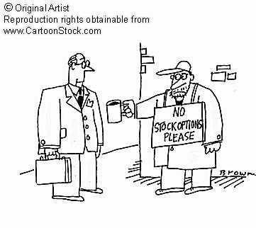
Stock Options

Slide 9
Profitability Ratios
Gross Profit Margin
Operating Profit Margin
Net Profit Margin
Earnings Per Share (EPS)
Price-To-Earnings (P/E)
Market Ratios

Slide 10
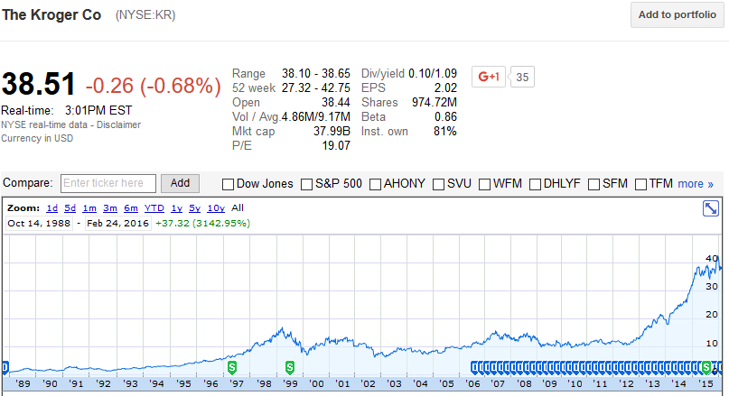
Kroger Company– Stock Chart

Slide 11
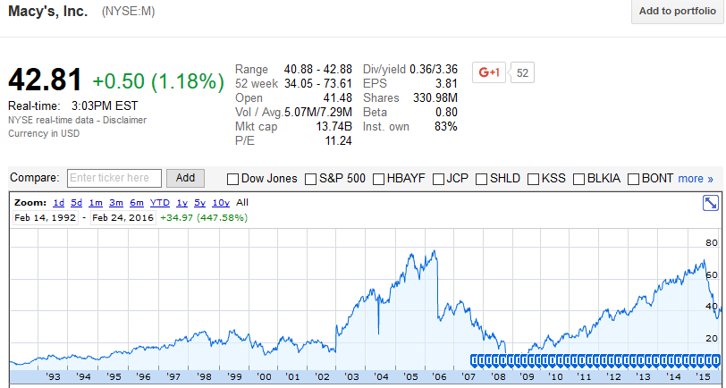
Macy’s Inc. – Stock Chart

Slide 12



Monsanto to Pay $80 Million to Settle Charge of Improper Accounting

Slide 13



buys
from
Deal Details:
Purchase Price: $2.6B
Estimated Book Value: $1.25B
Date | Journal Entry | Debits | Credits
07/31/2016 | Property, plant and Equipment (+A) | $1.25 billion
 | Goodwill (+A) | $1.35 billion
 | Cash (-A) |  | $2.6 billion

Slide 14
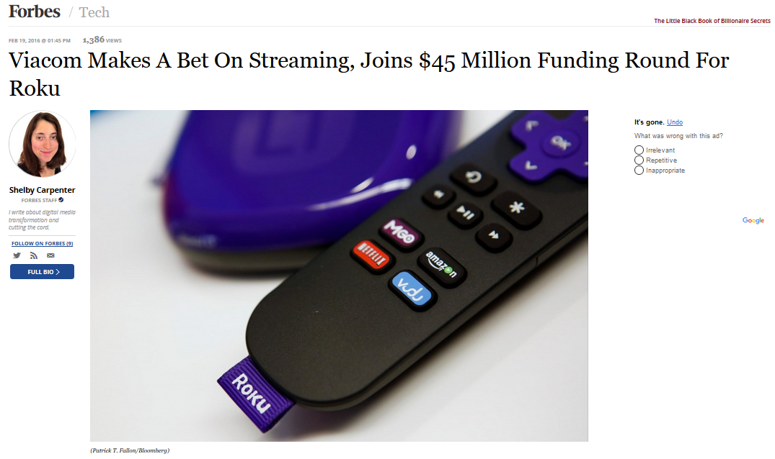
http://www.forbes.com/sites/shelbycarpenter/2016/02/19/viacom-makes-a-bet-on-streaming-invests-45-5-million-in-roku/#2f4ff5e45ceb

