Slide 1
In-Class Activity
Calculating Diffusion Coefficients of Dyes in Hydrogels

Slide 2
Important Considerations
Understanding diffusion is key to designing controlled release systems and fabricating engineered tissue constructs
Diffusion rates depend not only on the size of a molecule, but also many other factors, including:
  Molecular weight of diffusing species
  Matrix mesh size
  Temperature
  Chemical/Structural properties of the diffusing species
  Interactions between diffusing species and the matrix

Slide 3
Measure Dye Diffusion Coefficients
Split into teams, and receive the following from the TFs:
  4 hydrogel samples with dye
  Two hydrogel samples were prepared at a concentration, X and two at a concentration, Y
Do the following:
Determine whether Fick’s First or Second Law applies to this case.
Next, estimate the diffusion coefficients of the dye molecules within each of these hydrogels.
Based on your results, which hydrogel concentration X or Y is higher?
If you wanted to achieve the same diffusivities at a fixed hydrogel concentration, what else could you change?
*Hashmark spacing on the tubes is 3.17 mm
t
Notes:
2 Hydrogel Types: 0.5 w/v% and 1.5 w/v% agarose
2 Dye Concentrations: 10 mM and 0.1 mM
2 Diffusion Times:
First started at 10:00 PM last night
Second started this morning (TBD)

Slide 4
Fick’s Second Law
Concentrated dye,
C(x=0) = C_{s}
x = 0
Concentration in hydrogel, C(x, t)
Assume C_{s} remains constant for whole experiment
1D diffusion problem, assumes C_{s} and C₀ are constant and the gel is infinitely long
No dye in hydrogel,
C(x>0) = C₀ = 0
x = x₁
x = x₂
t = t_{o} = 0
t = t₁
t = t₂

Slide 5
Estimate Dye Diffusion Coefficients
Make this plot & determine the slope
for both cases!
What did you find?
Slope = D
x²
t
*Hashmark spacing on the tubes is 3.17 mm
A simple approach to estimate dye diffusivity in hydrogel matrices is to use:
D = L²/t (units of cm²/sec)
Notes:
2 Hydrogel Types: 0.5 w/v% and 1.5 w/v% agarose
2 Concentrations: 10 mM and 0.1 mM
2 Diffusion Times:
First started at 10:00 PM last night
Second started this morning (TBD)

Slide 6
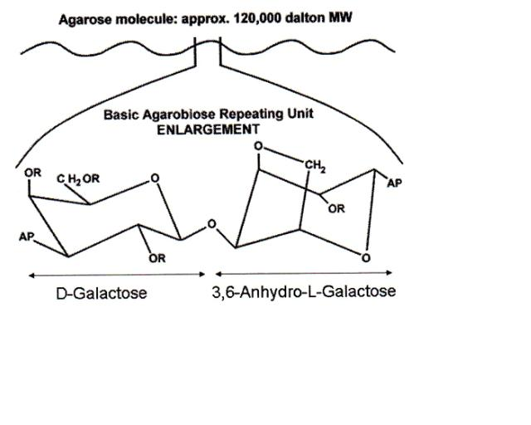
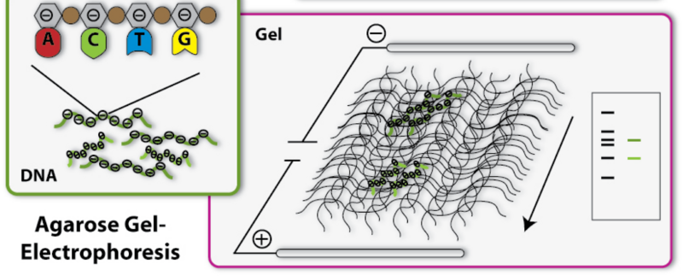
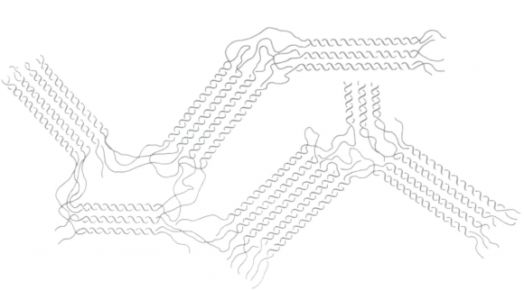
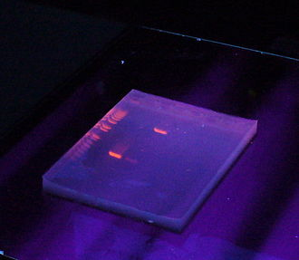
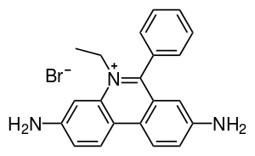
Most agarose gels are between 0.7 - 2% dissolved in a suitable electrophoresis buffer
Separating DNA by # of base pairs
Due to its negatively charged (phosphate backbone), DNA towards the positively-charged anode
EtBr
The pore size of a 1% gel
~100 to 500 nm
DNA stained with ethidium bromide

