Slide 1
In-Class Activity #6
Understanding
Thermo-Reversible Gelation of Crosslinked Hydrogels

Slide 2
Instructions
Assemble into teams
Collect three test tubes containing three different hydrogel samples: one from Prof. Lewis’ heat block, one from Travis’ ice chest, and one from Ryan’s ice chest
Work as a team to match each hydrogel sample with one of the polymers on the following slide
Feel free to warm (with the hot plate or your body heat) or cool (with the ice provided) your hydrogel samples as many times as necessary to understand the physical gelation mechanism at hand
You will be given the molecular structures for three polymers as well as three crosslinking mechanisms that lead to physically crosslinked hydrogels. After considering all three molecular structures, match each polymer to the mechanism by which you think the polymer forms a physically crosslinked hydrogel

Slide 3
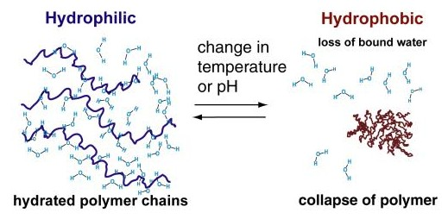
Goal: Match each polymer to the right crosslinking mechanism
#1
Poly(N-isopropylacrylamide),
or PNIPAAm (Travis)
#2
Pluronic® F-127, PEO-PPO-PEO (Ryan)
#3
Gelatin (Prof. Lewis)

Slide 4
Time’s Up: Share Your Conclusions

Slide 5
The Answers...
Gelatin Crosslinking Mechanism
Gelatin exhibits a gel-sol transition at ~37˚C. Gel formation occurs upon cooling due to assembly of triple helices by interchain hydrogen bonding
Pluronic F-127 assembles into micelles above ~5˚C, forming a gel. Below this temperature, the individual chains are soluble leading to liquid formation
When warmed above ~37˚C, PNIPAAm becomes less soluble in water. The polymer chains collapse due to hydrophobic interactions, resulting in a physically crosslinked polymer network.
Pluronic Crosslinking Mechanism
PNIPAAm Crosslinking Mechanism
10 w/v% gelatin, 30 w/v% Pluronic, and 20 w/v% pNIPAAM.
Notes:
PNIPAAm Mechanism Image Source: Pennadam et al. Journal of Nanobiotechnology, 2004. 2: 8.

