Slide 1
Questions: Sesame Street Study
A number of children were given a pre-treatment test on the letters of the alphabet.
A randomly selected group were encouraged to watch Sesame Street.
Regular watching was recorded (some non-compliance). Encouraged children might not watch regularly, and non-encouraged children might watch regularly.
The outcome (post-treatment test on letters) is recorded.

Slide 2
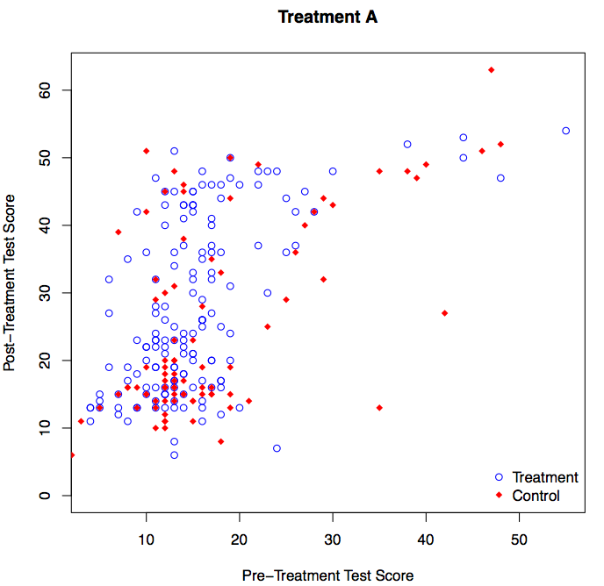
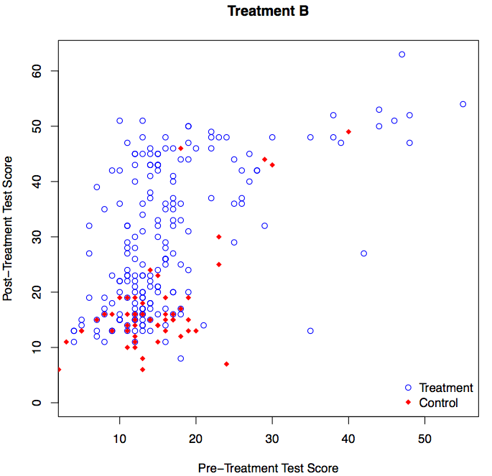
53772
53777
One of these plots (Treatment A or Treatment B) shows the encouragement treatment (randomized). The other plot shows the recorded regular watching treatment (not randomized). For which of these plots was the treatment randomized?
Treatment A 53772
Treatment B 53777
Don’t Know 53788
Text your answer to 37607 or go to http://poll4.com

