Slide 1
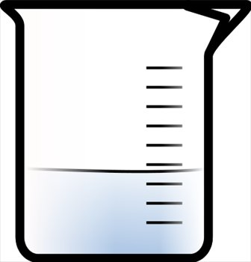
Print an equal number of the pH 5, pH 7 and pH 9 solution representations. Print an adequate number for each group to have a copy of only one beaker (either pH 5 or pH 7 or pH 9). Also give each group 6 small red/pink and 6 small blue sticky notes
pH 5
H⁺
H⁺
H⁺
H⁺
H⁺
H⁺
H⁺
H⁺
H⁺
H⁺
H⁺
H⁺
H⁺

Slide 2
pH 7
H⁺
H⁺
H⁺
H⁺
H⁺

Slide 3
pH 9
H⁺

