Slide 1
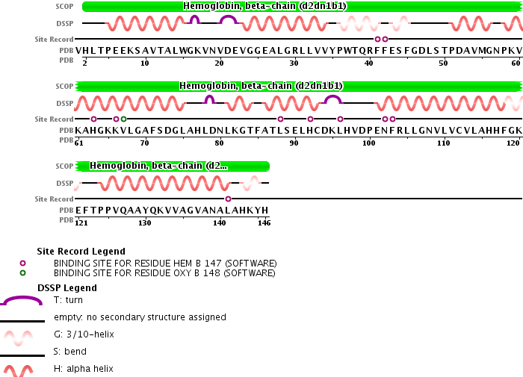
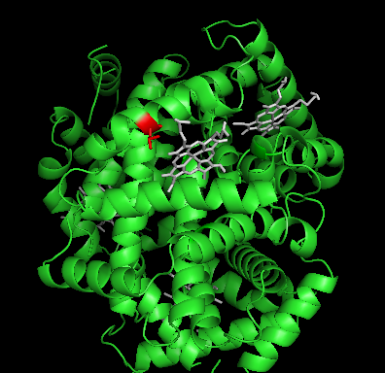
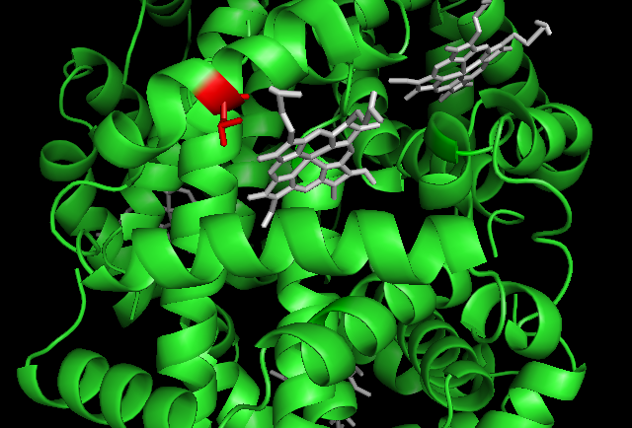
First Handout (group 1 – L88P):
Santa Ana Hb β L88P: beta chain amino acid 88 changed from leu to pro
Pro
Leu→ Pro
heme
Leu→ Pro

Slide 2
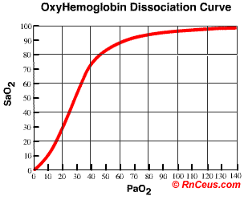
Discuss the Santa Ana variant hemoglobin with your group and generate a hypothesis about how the mutation L88P in the beta chain would affect the structure and function of this hemoglobin. Be able to justify your hypothesis.
Hypothesis:
On the graph below, draw a line to predict the oxygen dissociation curve for hemoglobin Santa Ana.

Slide 3
Second Handout (group 1-L88P):
Results for oxygen binding of Santa Ana hemoglobin:
Do these results support your hypothesis?
Why or why not?
If not, can you generate an alternative hypothesis to explain how this particular amino acid substitution affected protein structure?
Santa Ana
P50 = 22.5 mm Hg
Wild Type P50 = 27 mm Hg

Slide 4
Final Handout (Group 1-L88P):
Hemoglobin. 1985;9(2):157-69.
Oxygen binding and stability properties of Hb Santa Ana (beta 88 Leu----Pro).
Tanaka Y, Kelleher JF Jr, Schwartz E, Asakura T, Shelton J, Shelton JR, Schroeder WA.
Abstract
Hb Santa Ana (beta 88 Leu----Pro) was found at a level of 30% of total hemoglobin in red cells from a patient with congenital hemolytic anemia. Since no detailed functional studies of this hemoglobin have been done previously, we determined oxygen equilibrium curves of red cell suspensions, hemolysates, and isolated Hb Santa Ana. The P50 values obtained were 22.5 mm Hg (37 degrees C, pH 7.4) for red cell suspensions (normal mean = 27.0 mm Hg), 10.0 mm Hg (25 degrees C, pH 7.0) for hemolysate (normal = 13.5 mm Hg), and 1.3 mm Hg (25 degrees C, pH 7.0) for isolated Hb Santa Ana. Measurements of mechanical stability of Hb Santa Ana showed that the oxy-form of this hemoglobin was 10 times more unstable than that of Hb S and 100 times more unstable than that of Hb A. The deoxy-form of Hb Santa Ana was as unstable as its oxy-form, indicating that no stabilization (R----T conversion) takes place upon the deoxygenation of Hb Santa Ana.
PMID:3839771 [PubMed - indexed for MEDLINE]
Commentary on this type of hemoglobin mutation from “HEMOGLOBINOPATHIES ASSOCIATED WITH UNSTABLE HEMOGLOBIN” by ERNEST BEUTLER.
Copyright © 2001 McGraw-Hill
Ernest Beutler, Marshall A. Lichtman, Barry S. Coller, Thomas J. Kipps, and Uri Seligsohn
Williams Hematology
“If proline is introduced into an a helix beyond the third residue, distortion of the helix results in instability.” This instability results in a more open conformation of the hemoglobin, thus allowing easier access of oxygen to the heme group.

Slide 5
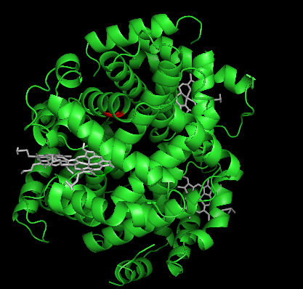
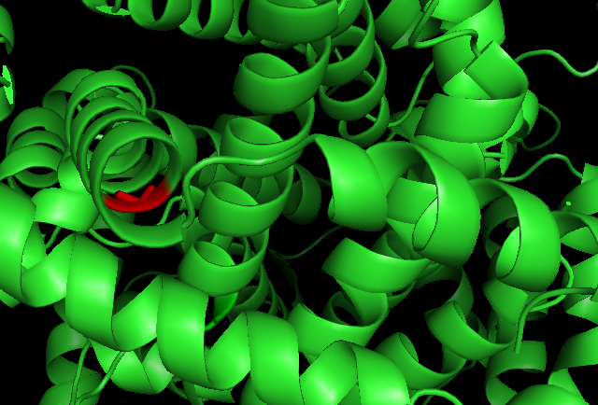
First Handout (group 2):
Savannah Hb β Gly24Val: beta chain amino acid 24 changed from gly to val
Val
Gly→ Val
Gly→ Val

Slide 6
Discuss the Savannah variant hemoglobin with your group and generate a hypothesis about how the mutation G24V in the beta chain would affect the structure and function of this hemoglobin. Be able to justify your hypothesis.
Hypothesis:
What type of experiments would you propose to test this hypothesis?

Slide 7
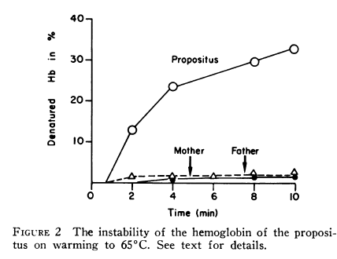
Second handout (group 2-Savannah G24V)
Case study for patient found to have Savannah G24V mutation in hemoglobin:
The patient (W. S. W.), born in 1958, was first seen by us at the age of 16 months because of severe unremitting hemolytic anemia. The physical findings at the age of 16 months showed pulse 120, respiration 20, and temperature 98.6°F. She was well developed and well nourished but quite pale.
Inclusions of precipitated hemoglobin (a.k.a. Heinz bodies) were observed in the red blood cells, which is evidence that the hemoglobin molecule itself is defective due to protein instability. Below is data collected to quantify the stability of the mutant hemoglobin from the patient (a.k.a. “propositus”). The heat stability of the hemoglobin in red cell hemolysates was tested by incubation of hemoglobin (final concentration 1.5 mg/ml) at 65°C in 0.2 M sodium phosphate buffer, pH 6.5. The percentage heat-precipitated hemoglobin was calculated from the amount originally present and that remaining in solution.
T. H. J.Huisman, A.K. Brown, G. D. Efremov, J.B. Wilson, C. A. Reynolds, R. Uy, L. L. Smith. Hemoglobin Savannah (B6(24) β-Glycine→Valine: an Unstable Variant Causing Anemia with Inclusion Bodies (1971) J Clinc Invest. 50: 650-659.

Slide 8
Do these results support your hypothesis?
Why or why not?
If not, can you generate an alternative hypothesis to explain how this particular amino acid substitution affected protein structure?

Slide 9
Final Handout (Group 2 – G24V)
Published in Volume 50, Issue 3 (March 1971)
J Clin Invest. 1971;50(3):650–659. doi:10.1172/JCI106535.
Copyright © 1971, The American Society for Clinical Investigation.
Hemoglobin Savannah (B6(24) β-glycine→valine): an unstable variant causing anemia with inclusion bodies
T. H. J. Huisman, Audrey K. Brown, G. D. Efremov, J. B. Wilson, Cecelia A. Reynolds, R. Uy* and Linda L. Smith
An abnormal hemoglobin, termed Hb Savannah, was found in red cell hemolysate of a young Caucasian girl with severe hemolytic anemia. The presence of this unstable variant became evident when inclusion bodies appeared rapidly upon exposure of red cells to redox dyes and a large percentage of hemoglobin in hemolysate precipitated on warming to 65°C. Treatment of the hemoglobin with p-hydroxymercuribenzoate (PMB) caused a rapid dissociation into monomers; starch-gel electrophoresis of PMB-treated hemoglobin showed the presence of abnormal β-chains. Data from structural studies of isolated β-chains indicated substitution of a valine residue for the normally occurring glycyl residue at position 24, which corresponds to helical residue B6. A similar substitution but with an arginine replacing the glycine residue has been observed in Hb Riverdale-Bronx. The glycine to valine substitution will change the relationship of the B and the E helices, which results in extensive conformational changes in the β-chain. This change presumably causes an increased dissociation of the hemoglobin molecule into dimers and probably monomers, and a decreased stability of the αβ-dimers. The hemoglobin abnormality may be the result of a fresh mutation because the abnormality is not present in the parents nor in any of the seven siblings.

Slide 10
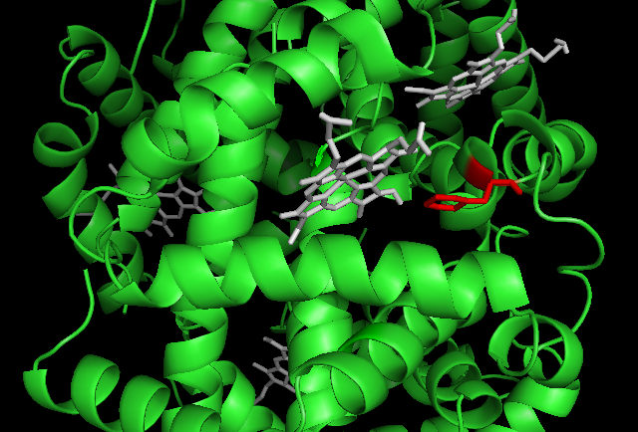
First Handout (Group 3 – F41S)
Denver Hb β Phe41Ser: beta chain amino acid 41 changed from phe to ser
Ser
Phe→ Ser

Slide 11
Discuss the Denver variant hemoglobin with your group and generate a hypothesis about how the mutation F41S in the beta chain would affect the structure and function of this hemoglobin. Be able to justify your hypothesis.
Hypothesis:
On the graph below, draw a line to predict the oxygen dissociation curve for hemoglobin Denver.

Slide 12
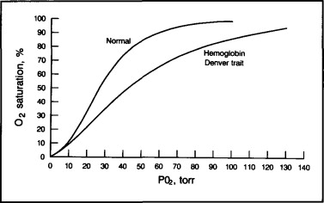
Second Handout (Group 3 – F41S)
Do these results support your hypothesis?
Why or why not?
If not, can you generate an alternative hypothesis to explain how this particular amino acid substitution affected protein structure?

Slide 13
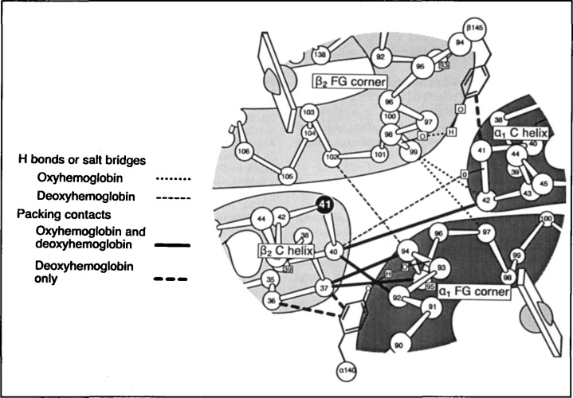
Final Handout (Group 3 – F41S)
Fig. Diagram of α₁β₂ contact or “hinge,” where rotational motion occurs as part of conformational changes associated with oxygenation and deoxygenation of hemoglobin. The β41 position (normally phenylalanine, but serine in hemoglobin Denver) is shown as a solid black circle, in its spatial relationship to the β₂ heme and to the intersubunit contacts around which the α₁FG and β₂C segments move with oxygenation and deoxygenation. Boldface solid lines = nonbonded “packing contacts,” which are the same in both the oxyhemoglobin and deoxyhemoglobin configurations. Boldface interrupted lines = “packing contacts” in the deoxyhemoglobin configuration only. Hydrogen bonds or salt bridges are shown as interrupted lines in the deoxyhemoglobin configuration and as dotted lines in the oxyhemoglobin configuration. Heme groups are depicted as spheres transected by rectangles. (Modified from Dickerson and Geis; copyright, Irving Geis.)
Figures from Stabler et al. (1994)
SALLY P. STABLER, RICHARD T. JONES, CHARLOTTE HEAD, DANIEL T.-B. SHIH, VIRGIL F. FAIRBANKS, Hemoglobin Denver [α2β241 (C7) Phe→Ser]: A Low-O2-Affinity Variant Associated With Chronic Cyanosis and Anemia, Mayo Clinic Proceedings, Volume 69, Issue 3, March 1994, Pages 237-243, ISSN 0025-6196, http://dx.doi.org/10.1016/S0025-6196(12)61062-3. (http://www.sciencedirect.com/science/article/pii/S0025619612610623)

