Slide 1
Follow agreed upon rules for discussions (p.7)
Unstructured | Structured
One person speaks at a time Invite others to speak Take turns Listen to peers | Teacher uses routine actions and identifies: Roles - each person is both the speaker and the listener Turns (who goes first) Time - each person speaks for same amount of time determined by the teacher Rules - to ensure access for all students (such as a rule of “Point and Repeat” - enabling students to point to another students who will repeat what they said. This is good for English learners to begin conversations.

Slide 2


Create Rules
“Add or Repeat”—students repeat a response spoken by another student or add a new idea.
“Point and Repeat”—students point to a student who has spoken before and that student
repeats what was said.
“Point, Repeat, Repeat.”
“Point, Repeat, Add or Repeat.”
“Support the Speaker”—if students were absent or are not finished and ready to share and it
is their turn to speak, support the speaker by passing a completed answer on a paper from
another group member to them to explain. In this way, each student has time to practice
talking about the problem or task. The student will return the completed work after their
turn to speak and can finish the task independently after the group discussion. This rule
enables all students to engage meaningfully in the group discussion.
Time-to-Talk—if someone in the group doesn’t understand the conversation then they can
signal a “time-out” sign and the group stops the routine for an open exchange to clarify
confusion. Then the group begins again when everyone is clear on what others are saying.

Slide 3
Structured
Equitable Discussion

Slide 4


Elbow Exchange
Roles
Speaker Listener
Equal time
for Speakers

Slide 5
Outcome/Product__________
MUST HAVE | AMAZING

Slide 6
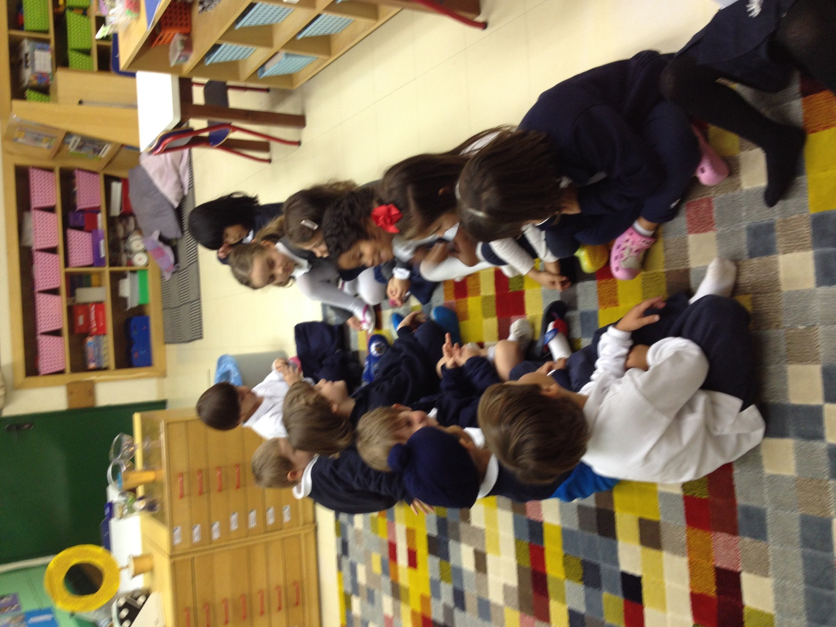
Elbow Partner Exchange
1
Left person
I think it’s a ______
Right person
What makes you think that?
Left person
I think it’s a _________ because
______ have ….
Right person
“Oh, you think it’s a ________ because _________ have…”
2
3
4

Slide 7
















General Classroom Seating
A B
A B
A B
A B
1
2
3
4
5
6

Slide 8
ELBOW EXCHANGE - Identify A & B Rows
A B
A B
A B
A B
1
2
3
4
5
6
Notes:
A ROWS = Purple background - B ROWS = Red background

Slide 9
ELBOW EXCHANGE - A Row Speaks First
A B
A B
A B
A B
1
2
3
4
5
6
Notes:
A ROWS = Purple background - B ROWS = Red background

Slide 10
ELBOW EXCHANGE - B Row Speaks Second
A B
A B
A B
A B
1
2
3
4
5
6
Notes:
A ROWS = Purple background - B ROWS = Red background

Slide 11
ELBOW EXCHANGE - B Row Speaks Second
1
2
3
4
5
6
Notes:
A ROWS = Purple background - B ROWS = Red background

Slide 12
Return to Individual Task
A B
A B
A B
A B
1
2
3
4
5
6

Slide 13
Unstructured
Free Discussion

Slide 14
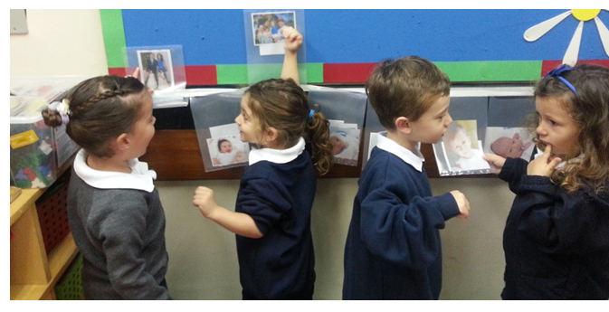
2 x 2 x 2
2 People
2 Minutes
2 __________

Slide 15
Goal = 1 question – 1 Reporter
MUST HAVE | AMAZING
Reporter represents the group Short a few words Poses a question that you’d like answered | Memorable (gesture, expression, word choice) You look for information to use to answer your question throughout our time together

Slide 16


TASK
TASK
Record Responses from Each Group
TASK
TASK

Slide 17
General Classroom Seating
A1 B1
A2 B2
A3 B3 4
A4 B4
1
2
3
4
5
6

Slide 18
Quad Stations - Odd Rows = Stand & Turn
A B
A B
A B
A B
1
2
3
4
5
6
Notes:
ODD ROWS - 1,3,5, = Blue background - Even ROWS = Green background

Slide 19
QUADS
A B
A B
A B
A B
1
2
3
4
5
6

Slide 20
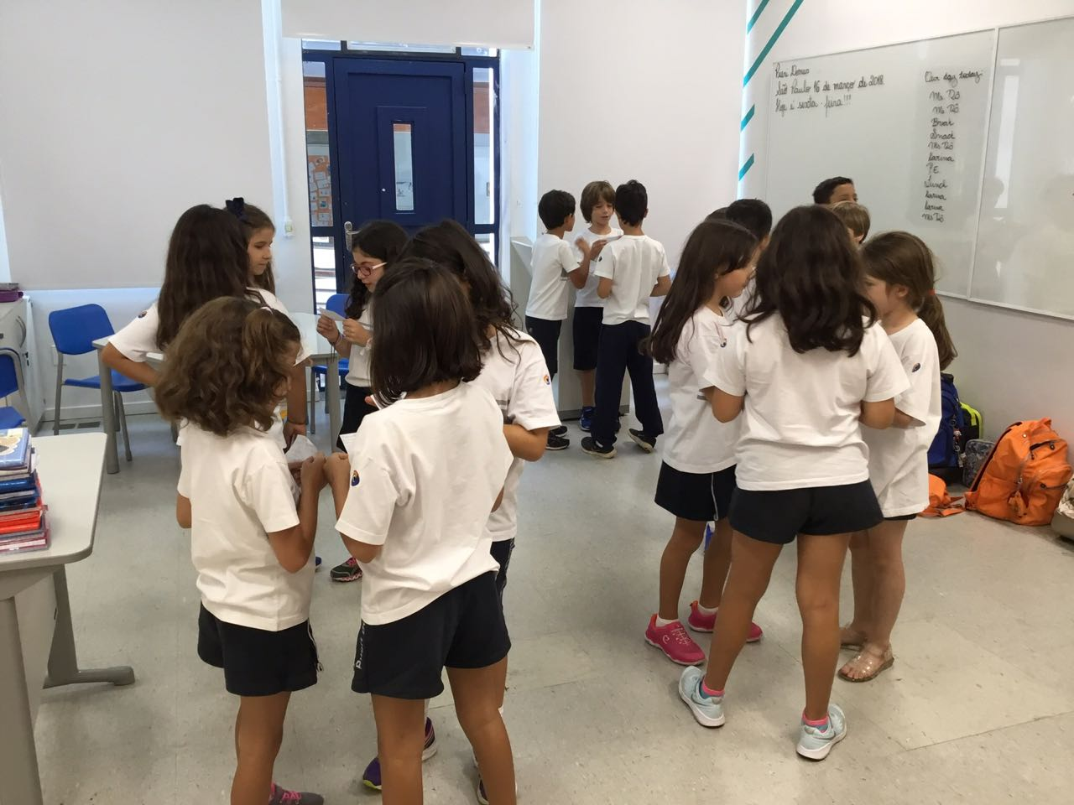
1
Gather 4 People
TASK
TASK
TASK
2
TASK
TASK
TASK
TASK
TASK
TASK
TASK
TASK
TASK
TASK
TASK
3
TASK
TASK
1 Question
?
Notes:
Research Quads

Slide 21
TASK
TASK
TASK
TASK

Slide 22
TASK
TASK
TASK
TASK
TASK
TASK
TASK
TASK
TASK
TASK
TASK
TASK
TASK
TASK
TASK
TASK

Slide 23
TASK
TASK
Record Responses from Each Group
TASK
TASK

Slide 24
TASK

Slide 25




S
STRUCTURES
Explicit Instruction
Individual Learning Routine
Free Discussion
Group Learning Routine
Notes:
I kept the seating plans to 48 students. 64 was massive and hard to see. I think participants can extrapolate out from this number… hopefully.

Slide 26

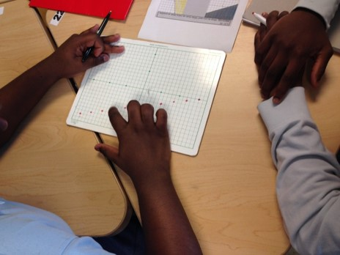
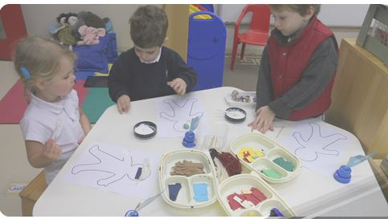
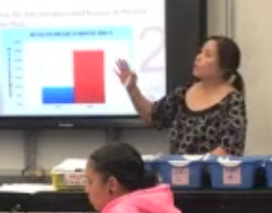
Structures for Tasks
Individual
Structured Group Learning Routines
Free Discussion
Explicit Instruction

Slide 27

STRUCTURES FOR CLASSROOM ROUTINES
Increased Teacher Thinking Time
High
Group Learning
STUDENT AUTONOMY
Individual Learning
Low
Explicit Instruction
Free Discussion
Low
High
STUDENT ENGAGEMENT
Notes:
Alternative tasks structures
Behavioral engagement -
Cognitive and affective may or may not follow this trajectory

