Slide 1
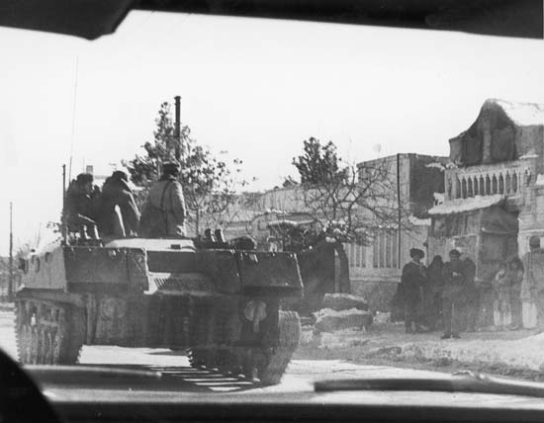
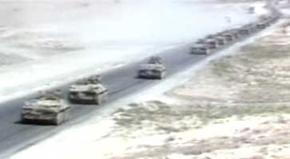
CIA APPRAISAL
CIA estimates size of Soviet invasion force to be 30,000, but unclear as to forces in reserve in AFG
CIA IS NOT CERTAIN that USSR goal is oil fields
WE DISSENT from DoD view that oil seizure is imminent
CIA theorizes believe it possible this action was the result of a power struggle in Moscow, but that Gvosdev is very much in charge
CIA AGREES that without Western reaction, Soviets might proceed
Smuggled photos from Iran border, received 1130 GMT 24 APR

Slide 2
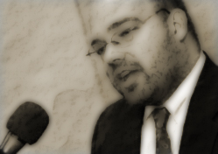
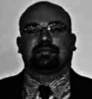
Who is Nikolai Gvosdev?
Born 1935, city of Tula
Father: Kyrill, killed WWII
Mother: unknown
Wife: Known to be married, has never been seen in public, one son
“General” in Soviet Army, but no service other than mandatory time
Highly motivated in Communist organizations since youth
Higher Party schools; believed to have law degree after completing basic engineering course
Highly intelligent; considered ruthless inside Party circles
Leningrad State University, c. 1967
At a Leningrad Party Committee, meeting c. 1979, supporting the invasion of Afghanistan (from Pravda; could be stock or retouched)

Slide 3
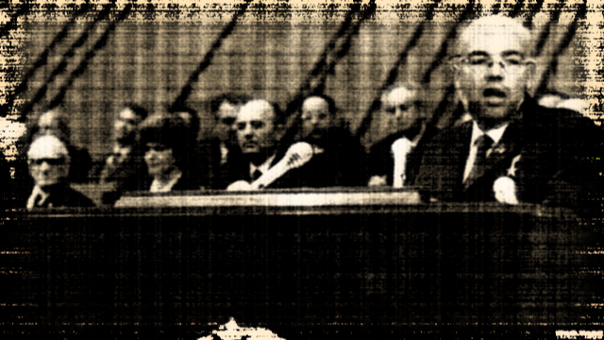
Gvosdev file:
Gvosdev is a protégé of Andropov and highly feared
Was Andropov’s choice before death, but mostly to forestall “liberals” like Gorbachev and others
Known to have close KGB connections
Background is in Leningrad defense industry
Well-regarded by Army but disliked by some of the foreign policy establishment
Supported invasion of Aghanistan
Dedicated opponent of better relations with USA
Opposed détente of 1970s but supported Andropov line until Reagan election
Deeply angry over “Evil Empire” speech and known to have personal animus to late President Reagan
Secretive and dour even by Soviet standards; has no known vices
CIA emphasizes: Gvosdev has repeatedly has refused opportunities for foreign travel; his image of the West is mostly through Soviet filter
Only known photo of Gvosdev addressing Soviet Central Committee, 1983, from a screen grab on Soviet television; his rival Gorbachev is third from left

Slide 4
CIA ESTIMATE
GVOSDEV:
IRAN INVASION:
CIA ANALYSIS
  Nikolai Gvosdev is the worst possible opponent the United States has faced since Stalin
  He is intractable, clever, and feared within Moscow
  His hostility to the West is clear, but he is also a pragmatist who has worked carefully to build up Soviet military strength
CIA VIEW IS:
  Gvosdev ordered the invasion
  His Politburo is not entirely “his” yet; some of the other holdovers, however, are too young to oppose him
  He has clashed with the Minister of Foreign Affairs, but that may not mean much right now
  He will not back down unless faced with no other options

Slide 5
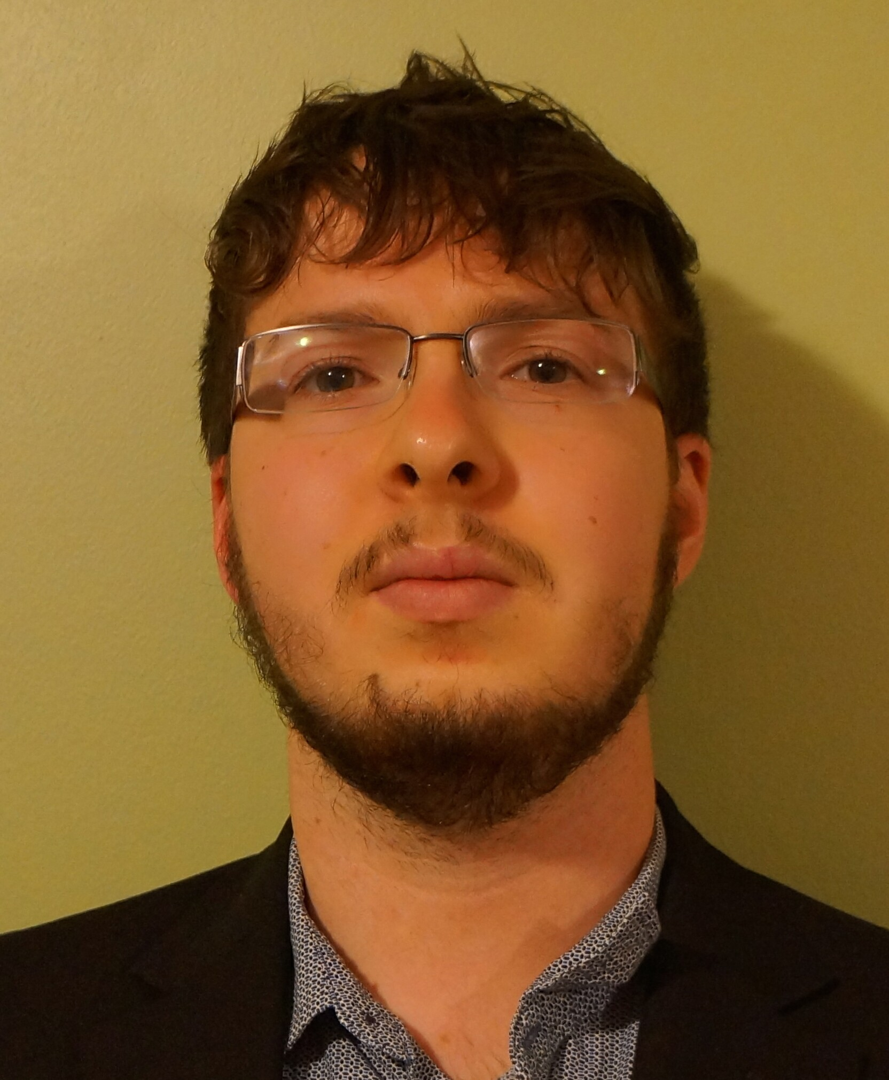

OTHER SOVIET OFFICIALS
KGB CHAIRMAN HARMATZ
MINISTER OF DEFENSE YOUNG
HARMATZ is youngest KGB chair ever, handpicked by GVOSDEV. We must assume he is the most dangerous man in the room when it comes to advocating action, but he is also ambitious, so this high-risk move may not have had his full concurrence.
CIA DOES NOT EXPRESS UNANIMOUS VIEW ON HARMATZ
OTHERS CAVEAT THAT HE COULD BE MORE CAUTIOUS THAN ASSESSED
CIA estimates that YOUNG, an industrialist who achieved marshal’s rank as a loyalist under Andropov, will seek to prove his toughness in front of GVOSDEV

Slide 6
POLITBURO APPRAISAL
GVOSDEV is firmly in control
CIA believes, however, that there is dissent within POLITBURO on the invasion
CIA believes that GVOSDEV will NOT back down to public pressure
  CAVEAT: Some Soviet Branch analysts believe this is a test and not meant to do anything but establish Soviet right to interfere
  CAVEAT: Defense Intelligence Agency dissents from CIA minority view and believes this is all-out war
CIA believes unanimously, however, that this is meant to test new POTUS with Reagan death
CIA also advises that they will view female POTUS differently from predecessors and POTUS must be made aware of this

